Slide 1
Instructions for speakers
Remove this instructional page before presenting
REMOVING PAGES
This presentation template is created to be used by all sectors; some pages might not be applicable for your audience, and those pages may be removed
You may remove pages that are marked “optional” in the speaker notes section
All other pages that are not marked “optional” are all required pages and cannot be removed
UPDATING PAGE CONTENT
There are customizable sections in some of the slides indicated by carets, such as <Presenter name>
Be sure to go through and customize those sections as needed
Content that is not in carets may not be altered
ADDING PAGES
You may not add slides to this presentation without getting proper Compliance approval
If you are presenting additional information, you may show any other Compliance-approved materials but do not add them within the PowerPoint
Notes:
Review these instructions and remove this slide before presenting.

Slide 2

Personal Finance 101
Creating healthy habits that can boost your financial wellness
Notes:
Welcome! Today we’ll be talking about creating habits that can make you feel confident about your personal finances and boost your financial wellness. We’ll have some time at the end of our session today for Q&A, but feel free to ask questions as we go along as well. I’m excited to share this information with you today, as well as many tools and resources that are available to help. Let’s get started.

Slide 3
Important information
• Not a deposit • Not FDIC or NCUSIF insured • Not guaranteed by the institution
• Not insured by any federal government agency • May lose value
This material is not a recommendation to buy or sell a financial product or to adopt an investment strategy. Investors should discuss their specific situation with their financial professional.
Investing involves market risk, including possible loss of principal, and there is no guarantee that investment objectives will be achieved.
Nationwide and its representatives do not give legal or tax advice. An attorney or tax advisor should be consulted for answers to specific questions.
Nationwide Investment Services Corporation, member FINRA, Columbus, Ohio.
Nationwide, the Nationwide N and Eagle, Nationwide is on your side and REALtirement are service marks of Nationwide Mutual Insurance Company. My Interactive Retirement Planner is a service mark of Nationwide Life Insurance Company. Third-party marks that appear in this message are the property of their respective owners. © 2023 Nationwide
PNM-19805AO (08/23)
Notes:
[Please read this important information.]

Slide 4
Nice to meet you
<Presenter name>
<Presenter job title>
<Presenter email address>
<Presenter phone number>
Presenter photo
Notes:
<OPTIONAL PAGE – May be removed if not needed>
I’m <NAME> and I’m a <TITLE> at Nationwide. Nationwide is the recordkeeper for your company’s employer-sponsored retirement plan.
We’ve grown from a small mutual auto insurance company to one of the largest insurance and financial services companies in the United States. Our mission has never been clearer: to protect people, businesses and futures with extraordinary care. And that’s why we’re here today.

Slide 5
Your financial professional
<FP firm>
<FP email address>
<FP phone number>
FP photo
Notes:
<OPTIONAL PAGE – May be removed if not needed>
I’m <NAME> and I’m a <TITLE> at <FIRM>.
<Introduce yourself>

Slide 6
What financial wellness is and how to assess it
The basics of budgeting
Steps to saving
The basics of debt
and how to manage it
How credit works and ways to raise your credit score
Today
we’ll learn:
Notes:
Today, we’re going to talk about healthy financial habits you can create to help boost your financial wellness. We’ll learn about....[read bullets on screen]
We’ll have time for Q&A at the end. I’m excited to talk to you about ways to increase your financial well-being and help you face the future with confidence, so let’s get started.

Slide 7
How financially well are you?
What is financial wellness?
A state of financial well-being
that allows you to: ¹
Meet financial obligations
Feel secure in your financial future
Make choices that help you enjoy life
Ask yourself: ¹
How much control do I have over my finances?
How well can I absorb a financial shock?
Am I on track to meet my financial goals?
Do I have enough financial freedom to make choices that allow me to enjoy life?
^{1 “}Financial well-being resources,“ Consumer Financial Protection Bureau,
consumerfinance.gov/consumer-tools/educator-tools/financial-well-being-resources/
Notes:
So what exactly is financial wellness?
According to the U.S. Consumer Financial Protection Bureau, it’s a state of financial well-being that allows you to:
Meet your current and ongoing financial obligations
Feel secure in your financial future
Make choices that allow you to enjoy your life
That sounds good, right? Most people want those things. But how do you know what your own level of financial wellness is? Asking yourself these questions can help you consider your answer:
How much control do I have over my daily and monthly finances?
How well can I handle a financial surprise such as an unexpected expense?
Am I on track to meet my financial goals?
Do I have the financial freedom I need to make choices that let me enjoy my life?
The more positive your answers, the more financially healthy you're likely to be.
¹ Financial well-being resources," consumerfinance.gov/consumer-tools/educator-tools/financial-well-being-resources/ (accessed July 27, 2023).

Slide 8
One Way to Measure
Financial Health
Assets - Liabilities = Net Worth
Assets include:
Liabilities include:
Checking and savings accounts
Retirement savings
Real estate
Vehicles
Consumer debt
Loans (student, auto)
Mortgages
Other debt
Notes:
Another way to assess your financial health is by calculating something called your net worth. It looks at what you own vs. what you owe, and it can actually paint a more accurate picture of how well you’re doing financially than your income. That’s because people with high incomes can have a low net worth if they aren’t disciplined with their money. People with lower salaries can have a high net worth if they have good financial habits.
To calculate your net worth:
Make a list of your assets. Assets include cash, such as money in checking, savings, retirement accounts, IRAs and other investment accounts. It also includes items like cars, property and investments you could sell for cash. If you own a home, you can count that, too, if you’d be willing to tap into the equity or sell if it needed.
Next, list your liabilities, which is any money you owe to a lender, whether it’s a person, a bank or another institution. It includes debt like credit card balances and the balances on loans like personal, auto, payday and title loans. If you’re including your home as an asset, include the mortgage as a liability, too.
Subtract the total liabilities from the total assets.
The number you get can be positive, negative or zero. If it’s positive, it means you own more than you owe. That’s great! To improve your financial wellness, you can focus on growing that number. If it’s negative, that means you owe more than you own. To improve your financial wellness, you can focus on reaching a positive number and then growing it. If it’s zero, what you own and what you owe are equal to each other. You’re not in debt but you don’t have more than what you owe to others. Again, to improve your financial wellness, you can focus on creating a positive number.
Keep in mind that knowing your net worth is not about comparing yourself to anyone else. It’s about taking a look at where you are today and taking steps to grow your own financial wellness. The good news is that no matter where you are today, you can take steps to get there. Those steps begin with creating key financial habits.

Slide 9





What are your financial goals?
Short-term
Mid-term
Long-term
Build an emergency fund
Pay off
debt
(credit cards)
Buy a home
or car
Pay off
debt
(student loans)
Save for retirement
Save for
college
Notes:
To create that positive number and keep it growing, you need healthy financial habits. Just like exercising and eating nutritious foods, it takes time and effort to create them. So it can help to think about why you want to take control of your money. What are the goals you’re trying to achieve?
In the next year or two, will you:
Build an emergency fund to help cover unexpected expenses?
Pay off debt, such as credit card debt?
In the next 3 to 5 years, do you plan to:
Buy a home or car?
Pay off a larger debt, like student loans?
In the long term, are you:
Saving for retirement?
Saving for college, whether for yourself or a child?
Knowing your goals can motivate you to set aside time and money to achieve them. Consider writing them down and putting them somewhere you can see them. That way, they'll regularly remind you why these habits are worth keeping.

Slide 10


Budgeting
A budget is a spending plan for your money that can help you reach financial goals.
It allows you to:
See where your money goes each month
Find ways to make room for saving and paying off debt
Create categories to set money aside for major goals and purchases
Notes:
Let’s talk about the first habit: setting up a budget, which is one of the most important things you can do for your financial health. Think of it as a spending plan that gives you control of your money and sets you up for success. It helps you track income and expenses, decide where your money goes and save it or spend it on what matters most.
Your spending plan will allow you to:
See where your money goes each month so you can prioritize how to spend and save for your financial goals
Find expenses you can reduce to make more room for savings
Create categories to set money aside for major goals and purchases, like retirement, a child's college fund or vacations

Slide 11
Track your expenses
Day | Expense | Amount | Need (N), Want (W), or Obligation (O)
Sunday |  | $
 |  | $
Monday |  | $
 |  | $
Tuesday |  | $
 |  | $
Wednesday |  | $
 |  | $
Thursday |  | $
 |  | $
Friday |  | $
 |  | $
Saturday |  | $
 |  | $
Total |  | $
Notes:
First, you need to track your expenses to figure out where your money is going. Documenting your spending and saving for a few weeks will create awareness of how you’re currently using your income. For instance, you may be surprised by how much you’re spending on small habits, such as buying coffee every day or eating out for lunch.
You can create a simple chart on a spreadsheet or on paper like the one shown here. There are also apps that can make this process easier. We aren’t able to recommend specific apps but there are free ones to choose from. You can look for them by searching with the phrase “track spending” online or in your phone’s app store.
Once you have a sense of where your money is going, look for patterns. For example:
How much of your money is going toward needs such as housing or food?
How much are you spending on extras, such as streaming services or vacations?
How much of your money is currently going toward saving?
Lastly, do you notice any habits that could keep you from reaching financial goals; for example, making impulsive purchases?

Slide 12
The 50/30/20 Rule
Divide your budget to allow for needs, wants and savings.
20%
Savings
examples:
Emergency fund
Retirement
50%
Needs
examples:
Housing
Food
30%
Wants
examples:
Entertainment
Vacation
Notes:
Next, you can begin prioritizing how you want to spend your money. While there are different ways to divide up your budget, one of the most common is called the 50/30/20 rule. To use it, aim to spend 50% of your income on needs like housing and food, 30% on wants like entertainment and 20% on savings like an emergency fund, college fund or retirement account.

Slide 13
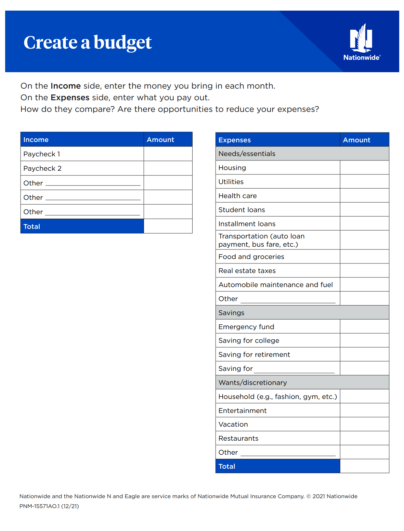
To create a budget using the 50/30/20 rule:
List your monthly income and expenses.
Put each dollar of income into
a category.
Compare the breakdown to the target amounts for needs, wants and savings.
Review your budget monthly and update as needed.
Notes:
To create your budget using the 50/30/20 rule:
Make a list of your monthly income and expenses. You can use our budget worksheet, shown here. We’ll tell you at the end of the webinar where to access the worksheet. You can also use a spreadsheet or a budgeting app – whatever works best for you.
Put each dollar of your income into a category, such as utilities, emergency fund and restaurants. By assigning each dollar to a category, you become the “boss” of your money. At first, you may need to ballpark the amount for each category. You can fine-tune the numbers later.
<<As you do this, think about ways to curb unhelpful money habits. For example, if you noticed when you tracked your spending that you often make impulse purchases, you could create a category for this type of spending. Then, you could set a monthly limit for it that will still allow you to meet your financial goals. Or, if you realized you tend to have late fees, you could eliminate those fees – and put that money into other parts of your budget – by setting up automatic payments.>>
3. When you're done, look at how your spending compares to the goal: 50% for needs, 30% for wants and 20% for savings. Make adjustments to align your spending as closely as possible with these goals.
4. Once you’ve created your budget, review it every month and update it as needed. It’s a living document you can change over time. For instance, you can adjust the amounts for each category as you get a better sense of how much each one requires. And when your income, expenses and priorities change, you can adapt your budget to match.

Slide 14

Savings
Money you keep or invest for short- and long-term financial goals
Notes:
Saving, or setting money aside in your budget for short- and long-term goals, is another healthy financial habit. Putting money toward your goals can increase your financial wellness. It can also make you feel more in control and reduce stress.

Slide 15





Keys to saving:
    Pay yourself first
Make saving
automatic
Avoid misusing savings
    Use financial and budgeting tools
    Remember:
    Aim to put 20% of your budget toward savings
    Look for expenses to reduce or eliminate
Notes:
If you use the 50/30/20 rule, saving 20% of your income may seem like a lot. These keys to saving can help:
Assign money in your budget to the savings category before assigning money to wants. Then, use what’s left over for extras.
Set up automatic contributions or deposits to make saving easier and help you stay on track. You’re less likely to miss money you don’t see in your checking account first. For instance, you could have a portion of your take-home pay deposited into a savings account, if your employer offers that as an option. Also, you can set up regular contributions to your retirement account, so you’ll be putting money into your retirement account each payday.
Think ahead about how to prevent misusing your savings. If you find yourself dipping into savings when you don’t need to, try using cash instead of a credit card to avoid overspending. Or consider making it harder to quickly transfer money from your savings by having your checking and savings accounts at separate institutions.
Budgeting can be a trial-and-error process. Using financial and budgeting tools can help. Our website offers several, and we'll talk about those later. Your bank or financial institution may also have free tools you can use.
Don’t forget that to make more room for savings in general, you can look for expenses to reduce or eliminate. That way, you can put more money in the savings category. And remember that you can use your savings toward more than one goal. For example, you might use part of your savings to build an emergency fund – which experts say should contain enough to cover expenses for several months – and you could contribute part of it toward retirement.

Slide 16



Debt
Good debt
Bad debt
Student loans
Car loans
Mortgages
Credit card
debt
Cash or paycheck advance loans
Notes:
As with budgeting and saving, managing your debt is another healthy habit that can put you on the path toward financial wellness. Debt is money you borrow and need to repay. It's not always possible to have enough cash on hand to cover a large expense like a house, a car or college, so many people have debt.
Not all debt is the same. Good debt is money you borrow at a low interest rate that helps you achieve your goals and improve your financial outlook. For example, student loans can help you get a college education, a car loan can provide transportation to get to work and a mortgage allows you to own a home and build equity.
Bad debt, on the other hand, is money you borrow that doesn’t help improve your financial future and that has higher interest rates. Examples include high-interest credit cards and cash advance or paycheck advance loans.

Slide 17

Consider future debt
Is it good or bad debt?
How much of my income
will debt payments take up?
What are the terms?
Notes:
To manage debt, think about whether money you may borrow would create good debt or bad. Also, try to stay within recommended guidelines. For example, some experts say a mortgage payment shouldn’t take up more than 28% of your income. For student loans, many say not to borrow more for college overall than you’ll likely earn your first year on the job. Another rule of thumb is that student loan payments shouldn’t take up more than 10% of your post-graduation income.
Be sure to read the fine print on any debt you’re considering taking on. What is the interest rate and how long do you have to pay it back? Is there a penalty for making additional payments or paying it off early?

Slide 18

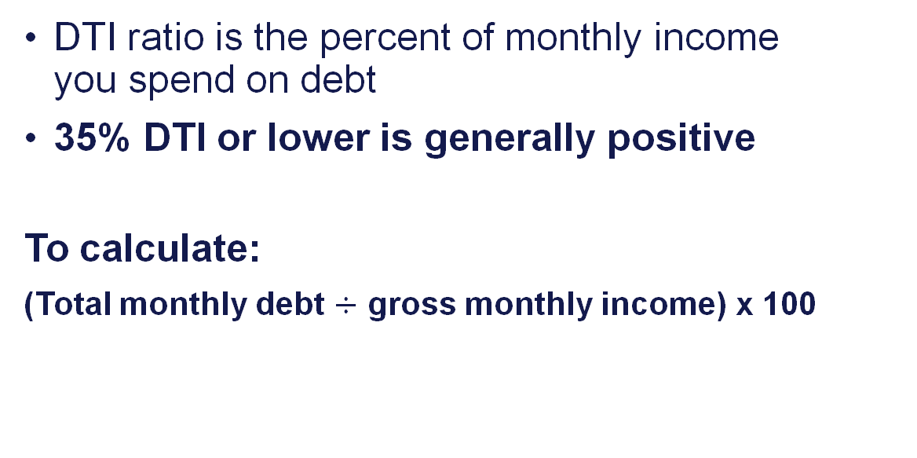
Calculate your debt-to-income (DTI) ratio
DTI ratio is the percent of monthly income
you spend on debt
35% DTI or lower is generally positive
To calculate:
(Total monthly debt $÷$ gross monthly income) x 100
Notes:
One thing that can help guide your decision to take on debt is your debt-to-income (or DTI) ratio. It’s the amount of your monthly income that goes toward debt, which gives a snapshot of your financial health. Generally, having total debt that equals 35% or less of your annual income is considered positive. Lenders prefer to give loans to borrowers with less than a 36% DTI. An even lower DTI ratio is better.
To calculate your DTI ratio:
Add up your total monthly debt payments
Divide it by your gross monthly income, or your income before taxes and deductions are taken out
Multiply by 100
Here’s an example. Let’s say your debt payments equal $1,500 and your gross monthly income is $5,000. Divide $1,500 by $5,000, which is .3 Multiply .3 by 100 to get 30%, your DTI.
A low DTI ratio shows you have a good balance between your debt and income. If your ratio is 20%, for example, that means that 20% of your gross monthly income goes toward debt payments each month. On the other hand, a high DTI ratio may mean you have too much debt for your monthly income.
SOURCES:
"Mortgages key terms: Debt ratio," Consumer Financial Protection Bureau, consumerfinance.gov/consumer-tools/mortgages/answers/key-terms/#:~:text=Your%20debt-to-income%20ratio,money%20you%20plan%20to%20borrow. (accessed July 27, 2023).
"What Constitutes a Good Debt-to-Income (DTI) Ratio?" investopedia.com/ask/answers/081214/whats-considered-be-good-debttoincome-dti-ratio.asp (May 7, 2023).
"Debt-to-Income (DTI) Ratio: What's Good and How To Calculate It," investopedia.com/terms/d/dti.asp#:~:text=to%2DIncome%20Ratio%3F,As%20a%20general%20guideline%2C%2043%25%20is%20the%20highest%20DTI%20ratio,varies%20from%20lender%20to%20lender. (May 30, 2022).

Slide 19






Assess your debt
Debt type | Monthly payment amount | Monthly due date | Interest rate (%) | Amount outstanding | Payoff date or goal | Notes (including any fees)
Child support | $ |  | % | $
Car loan | $ |  | % | $
Student loan | $ |  | % | $
Credit card debt | $ |  | % | $
Medical debt | $ |  | % | $
Mortgage | $ |  | % | $
Other | $ |  | % | $
Other | $ |  | % | $
Other | $ |  | % | $
Total monthly payment amount | $
Notes:
It’s a good idea to assess the debt you have so you can see the total you owe and how much you’re paying for it.
List the types of debt you have, the monthly payments for each one and when those payments are due. Include the interest rate and the outstanding amount you owe. If you know the payoff date or have a goal for when to pay it off, write that down, too. You can also include notes, like fees you’ll be charged if you don’t make a payment on time.

Slide 20

Make a plan to pay off debt
Include debt payments in your budget
Make more than the minimum payments
As you pay off each debt, apply that payment toward another debt
Consider balance transfers carefully
Use a method that works for you:
  Debt Avalanche
  Debt Snowball
Notes:
Once you’ve assessed your debt, you can make plan to pay it off. These tips can help you get started:
First, remember to include debt payments in your budget. Look for expenses you can reduce so you can pay more toward debt. If you feel stuck or need help coming up with a plan, consider working with a financial professional.
Aim to pay more than the minimum payments each month to pay your debt down faster and save money on interest. It can take years to wipe out debt by paying only what you need to and it costs a lot more in the long-run. Your credit card statements should show how much you can save with bigger payments.
Focus on paying off one debt at a time; as each debt is paid off, use the money you’d been paying for it toward another debt
Consider balance transfers carefully before using them to move debt. While it may be tempting to transfer balances to a credit card with a low-interest-rate offer, it may only work in your favor if you pay the balance off before the rate expires. If you do apply for a balance transfer, make sure you understand the terms and conditions, including fees, and have a plan to pay the debt in full by the deadline. Also, it’s better not to do a balance transfer if you think you might run up the balance and add to your debt.
Lastly, you can use a method called the debt avalanche or the debt snowball to pay off debt faster.

Slide 21
The debt avalanche method
Step 1: List your debts from highest to lowest interest rate.
Step 2: Pay extra on the debt with the highest interest rate but the minimum on everything else.
Step 3: When that debt is paid off, apply that payment to debt with the next-highest interest rate.
Step 4: Repeat until all debt
is paid.
Credit Card Debt Interest rate: 18.9% | Medical Bill Interest rate: 8.7% | Car Loan Interest rate: 6.4% | Student loan Interest rate: 4.99%
Pay off $223 | Make the minimum payment $58 | Make the minimum payment $449 | Make the minimum payment $286
 | Pay off $281 | Make the minimum payment $449 | Make the minimum payment $286
 |  | Pay off $730 | Make the minimum payment $286
 |  |  | Pay off $1,016
Notes:
With the debt avalanche method, the idea is to pay off debts with the highest interest rates first. This will help you save the most money in the long run.
To start, pay as much as you can toward the bill with the highest rate while making minimum payments on the rest. The idea is to spend less in other parts of your budget so you can put more money toward that debt. In this example, if you were the borrower, you’d pay $223 a month toward the credit card, which has the highest interest rate of 18.9%.
Next, when you pay that debt off, you take the money you’d been putting toward the highest-interest debt and apply it to the debt with the next-highest rate – in this case, the medical bill with an interest rate of 8.7%. You’d add $223 from the credit card payment to the $58 minimum payment for the medical bill, so you can now pay $281 a month toward that bill. In the meantime, you’d continue making minimum payments on the other bills. Then, repeat the process until all the debt is paid off.

Slide 22
The debt snowball method
Step 1: List your debts from the lowest balance to the highest.
Step 2: Pay extra toward your smallest debt but the minimum on everything else.
Step 3: Once that debt is paid off, apply that payment to the next-smallest debt.
Step 4: Repeat until all debt
is paid.
Credit Card Debt Total balance: $1,380 | Medical Bill Total balance: $3,210 | Car Loan Total balance: $22,845 | Student loan Total balance: $27,000
Pay off $223 | Make the minimum payment $58 | Make the minimum payment $449 | Make the minimum payment $286
 | Pay off $281 | Make the minimum payment $449 | Make the minimum payment $286
 |  | Pay off $730 | Make the minimum payment $286
 |  |  | Pay off $1,016
Notes:
Another method for paying off debt is the “debt snowball” method. If you’re motivated by fast results, this approach may work better for you because you’ll see progress more quickly.
As you can see, the idea is to pay off debts with the smallest balances first while making minimum payments on the rest. To start, you pay as much as you can toward the debt you owe the least on while making minimum payments on the others. In this example, if you were the borrower, you’d pay $223 a month toward the credit card, which has the lowest balance at $778. You’d be able to pay that off in less than 3 months.
When you pay that debt off, you then take the money you’d been putting toward it and apply it to the debt with the next smallest balance. Here, you’d add the $223 from the credit card to the $58 minimum payment for the medical bill. With this new payment of $281, you’d pay off the medical bill in under 5 months, making minimum payments on the other bills in the meantime. Continue paying off each bill and applying that money to the next one until all the debt is paid off.

Slide 23

Can you pay off debt while saving for the future?
One method:
Use money you save in other categories toward debt and savings
Build an emergency fund first
Start saving for retirement at the same time, even if you start small
Focus on paying off debt
When you’re out of debt, decide what
to do with the “extra” money!
Notes:
If you have debt like credit cards or student loans, you may wonder if you should pay it off first or save for retirement. While everyone’s financial situation is different, many experts recommend doing both at the same time. Here’s one approach.
Find money in your budget.
As we talked about before, finding expenses you can reduce or eliminate can make room for saving and paying off debt. If you shave $200 from your monthly expenses, that’s $200 you can apply toward savings and debt.
Take one step at a time.
Consider building an emergency fund before paying extra money toward debt. That way, you won’t go further into debt if unexpected expenses come up. At first, you might put the majority of your savings into an emergency fund. Keep going until you have enough to cover 3-6 months of expenses
Contribute to your employer-sponsored retirement plan while building your emergency fund, even if you start small. The sooner you begin, the more you can benefit from compounding — your earnings creating more earnings of their own — which boosts your savings with less money out-of-pocket. Plus, you can increase your contributions anytime. <<Also, if your employer will match your contributions, contribute enough to take advantage of it. It’s free money>>
Once you’ve established your emergency fund and started your retirement contributions, focus on paying off debts.
Once you’re out of debt, you can decide what to do with the extra cash — and face the future with more confidence in your finances.

Slide 24

Credit
Credit
700
Credit score
Your ability to obtain goods or services before paying for them.
The three-digit number (usually between 300 and 850) that helps represent your “creditworthiness,” or how likely you are to pay.
Notes:
Lastly, let’s talk about managing your credit, another healthy habit. Credit is your ability to obtain goods or services before you pay for them. The more confidence a lender has that you’ll make the payments for what you owe, the more credit you have.
The amount of trust a lender puts in your ability to pay is based on by your credit score. A credit score is a three-digit number that represents your “creditworthiness,” or how likely you are to pay your bills on time. The most widely used credit scores, called FICO scores, range from 300 to 850, with higher being better.
Your credit score is important because it influences whether or not you are approved for loans. It may also play a part in being approved for things like renting an apartment or getting a job. And your score can influence the interest rate you receive for financing you apply for, like a car loan. The higher your score, the better your credit — and the lower your interest rates will generally be. It also can influence whether you can access services such as utilities and cell phone plans, as those providers pull credit reports.

Slide 25
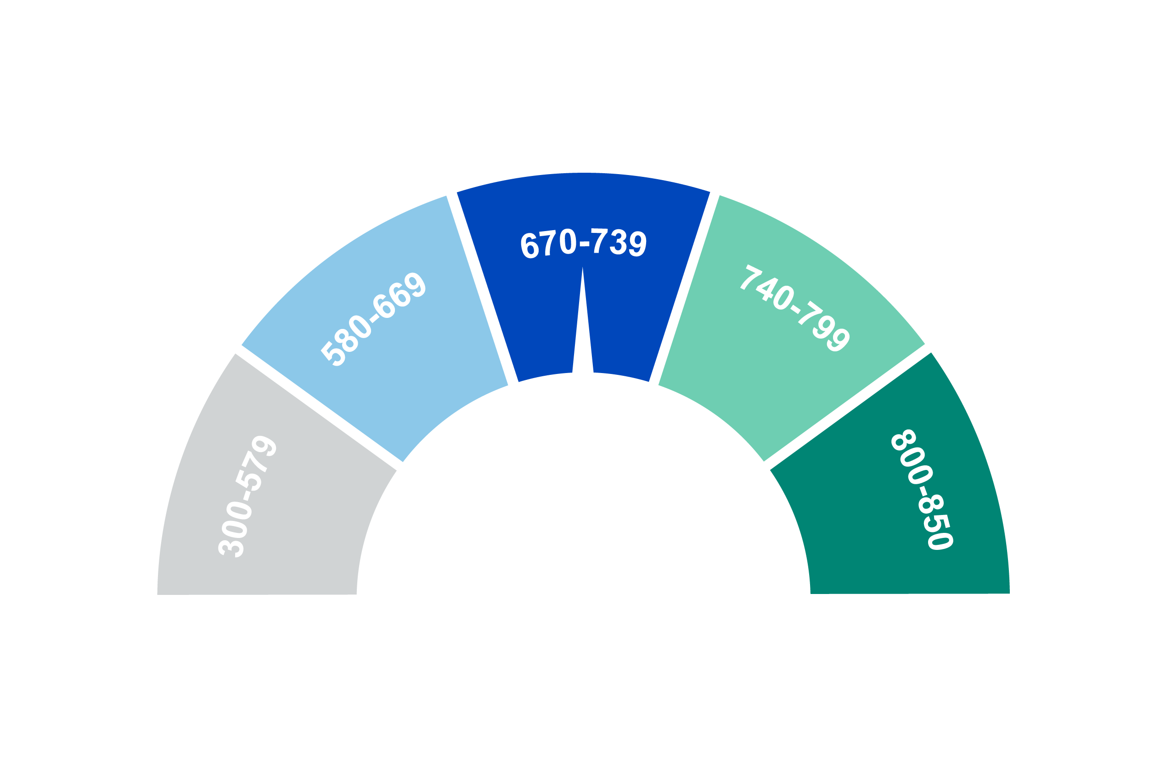
What is a good credit score?
700+ is generally considered good
Notes:
For FICO, scores of 700 or above are considered good. Most people have scores between 600 and 750.
Scores can fall into one of 5 categories:
800 – 850: Excellent. Consumers in this range are low-risk borrowers who may be able to secure credit more easily and get better interest rates than those in lower ranges.
740 – 799: Very good. Borrowers in this category have a positive credit history and may be able to secure credit more easily and get better interest rates.
670 – 739: Good. Lenders consider those in this range to be acceptable or lower risk borrowers.
580 – 669: Fair. Sometimes referred to as “subprime,” people in this category are considered higher risk and may find it harder to get credit. They may be offered higher interest rates when they do.
300 – 579: Poor. Those with the lowest credit scores may not be approved for credit and may receive it at higher interest rates. To increase their chances of getting credit, they need to improve their scores.
We’ll talk about how to check and improve your credit score shortly.

Slide 26
What’s in a credit score?
Top 5 factors
10%
30%
New
Credit
Amounts Owed
15%
FICO®SCORE
Length of Credit History
35%
10%
Payment History
Credit
Mix
Notes:
Credit scores are based on several factors:
Your payment history is the biggest one, accounting for 35% of your score
The amount you owe is the next-highest factor, which looks at how much debt you have compared to your available credit
The third factor is the length of your credit history
Next is how many times you apply for credit. A lender may request to view your credit reports when you apply for credit, which is considered a “hard inquiry,” Hard inquiries are reflected on your credit report whether you receive the credit or not.
Lastly, the types of credit you have, which looks at whether you have a mix of credit like mortgages, installment loans (such as an auto loan) and credit cards
There are 3 main credit bureaus that provide credit scores: Equifax, Experian, and TransUnion. They collect consumers’ information and analyze it to determine your score based on their own criteria. They each assign you their own credit score, which is why your credit scores may vary.

Slide 27


How to check your credit score
Credit card companies
Banks
Lenders
Notes:
One thing that may surprise you is that credit reports don’t actually contain your credit score. While you can’t see your credit score in a credit report, you can check your score other ways.
Many credit card companies, banks and other lenders offer customers their credit score. Look for yours on your monthly statements for credit cards, bank accounts or loans. You can also log into your accounts on lender websites or apps to see if you can view your score online. Don’t forget you can always call to ask if they make your score available.
There are also free credit score services that make credit scores available. But avoid websites or services that claim to provide a free credit score, then ask you to sign up for a free trial or enter credit card information. You don’t need to pay for them!
Creditors don’t have to report to all 3 credit reporting agencies, they can report to 1, 2 or all 3. So it’s important to check all 3 credit reports, because they can be different.

Slide 28

7 ways to raise your credit score
Check your credit reports and dispute errors.
Catch up on past-due payments.
Keep credit card balances low.
Pay bills on time.
  Set up automatic bill payments
  Set payment reminders
Don’t apply for credit you don’t need.
Don’t open multiple accounts at once.
Use a variety of credit.
Notes:
You can’t raise your credit score by 100 points overnight but you can work to build it up over time. Having a strategy and sticking with it can help you get there.
The most important thing is to manage your credit responsibly over time. In addition:
Check your credit reports and look for errors. You can dispute them, which can help raise your credit score. We’ll talk about how to do that in a minute.
Catch up on any overdue payments you have.
In general, keep your credit card balances low compared to the amount of available credit you have. Aim to use only 30% of your available credit.
Pay your bills on time. Setting up automatic bill payments or setting payment reminders can help. Once a payment goes 30 days past due, that’s when it can be reported on your credit report. Something can stay on your report for up to 7 years from the date of your first missed payment. Don’t apply for new credit you don’t need. Opening too many credit accounts at once can also hurt your score.
Try to have a variety of credit, such as a mortgage, installment loans (for example, an auto loan) and credit cards
There can be lag time between when you take these actions and your credit score starts to raise, especially because it takes time for the lenders to report your actions to the credit bureaus. Keep going and you will eventually see results!

Slide 29
Build credit with limited history
Become an authorized user
Report rent and utility payments
to credit bureaus
Get a credit-builder loan
Open a secured credit card
Notes:
If you’re just starting out and don’t have credit yet, or you want to re-establish credit, there are ways you can build it.
One is to become an authorized user on someone else’s credit card who has good credit, like a spouse or relative. You don’t have to use the card in order for their positive payment history to help create positive credit for you. Just keep in mind that it’s important to either not use the card or to pay for any purchases you make, so it doesn’t negatively impact their credit score.
You can also report your rent and utility payments to the credit bureaus or have a rent-reporting service do it for you. This can show a reliable history of on-time payments. Some rent-reporting services are free and others cost money, so check details. Some landlords may also provide this service as a courtesy.
A third option is to take out a credit-builder loan – a small loan you take out to show you can reliably repay it. These are good for people with no or low credit and are typically offered by smaller lenders like credit unions or online lenders. The amounts are usually between $300 and $1,000. Missing payments can actually damage your credit rather than help it, so be certain you can repay a loan before taking one.
Lastly, you could open a secured credit card. You deposit money with a lender to cover purchases you make with the card. There may be small fees for using a secured card, but the purpose is to create a positive credit history that can boost your score. It’s very important that you have enough money deposited to cover any purchases you make. If the lender has to cover purchases there isn’t enough money for, it can damage your credit.

Slide 30
How to dispute errors:
How to request your credit reports:
Online by visiting
annualcreditreport.com
By calling
1-877-322-8228
By filling out the Annual Credit Request form available on the
website and mailing it to:
Annual Credit Report Request Service
P.O. Box 105281
Atlanta, GA
30348-5281
Online or by phone
experian.com (888) 397-3742
transunion.com (800) 916-8800
equifax.com (866) 349-5191
In writing
Experian
P.O. Box 4500
Allen, TX
75013
TransUnion LLC Consumer Dispute Center
P.O. Box 2000
Chester, PA 19016
Equifax Information Services LLC
P.O. Box 740256
Atlanta, GA 30374
Notes:
It’s a good idea to review your credit reports annually. Because each of the three agencies has its own information, you should review all 3. You can get a free report from them every year by visiting annualcreditreport.com, calling the 800 number you see here or sending a written request to these addresses.
You can dispute an error with the bureau that has the error in its report. They are required to correct incorrect or incomplete information in your report for free.
Each of the credit bureaus has its own dispute process. To get started, visit their websites, call or send a request in writing. Use their forms and process to let them know what you believe the mistake is. Include copies of any documents that support your claim, and keep records of the dates you provide information and what you provide.
You can dispute an error with the bureau that has an error on your report. They are required to respond within 30 to 45 business days.

Slide 31



Take action
Enroll
Create a budget at nrsforu.com/
budgeting
    Use My Interactive Retirement PlannerSM
    Set up
    or increase contributions
Notes:
<OPTIONAL – Applicable for Public & Institutional sector participants only>
Now that you know more about creating healthy financial habits, including saving for goals like retirement, you can start improving your financial wellness. Here are some steps you can take right away:
First, be sure you’re enrolled in your retirement plan. You don't want to miss out on this important benefit, which can enhance your financial well-being now and down the road.
Create a budget. That’s the foundation for everything we talked about. You can find budgeting resources, including a worksheet, on our website at <<nrsforu.com/budgeting>>
To determine how much to save for retirement, use My Interactive Retirement Planner in your account. It can help you set goals, check your progress and make changes to stay on track.
Paying yourself first will help you stick with saving, like we talked about. Log in to set up or increase your contributions to help you stay on track. If you’re curious how increasing your contributions could affect your take-home pay, use the Paycheck Impact Calculator on your plan’s website under Tools & Calculators. If your contributions are made pre-tax, the impact may be less than you think!
If your plan offers a feature called auto-increase, you can choose to have your contributions automatically go up by a set amount each year. If it’s available, your plan may enroll you by default or allow you to select it as an option. If not, you can also choose a date on your calendar to increase them each year.

Slide 32
Take action
Enroll
Create a budget at nationwide.
com/
mybudget
    Use My Interactive Retirement PlannerSM
    Set up
    or increase contributions
Notes:
<OPTIONAL – Applicable for Emerging Markets sector KEYNOTE participants only>
Now that you know more creating healthy financial habits, including saving for goals like retirement, you can start improving your financial wellness. Here are some steps you can take right away:
First, be sure you’re enrolled in your retirement plan. You don't want to miss out on this important benefit, which can enhance your financial well-being now and down the road.
Create a budget. That’s the foundation for everything else we talked about. You can find budgeting resources on our website at <<nationwide.com/mybudget>>>
To determine how much to save for retirement, use My Interactive Retirement Planner in your account. It can help you set goals, check your progress and make changes to stay on track.
Paying yourself first will help you stick with saving, like we talked about. Set up or increase your contributions to your retirement plan to help you stay on track. If you’re curious how increasing your contributions could affect your take-home pay, use the Paycheck Impact Calculator on your plan’s website under Tools & Calculators. If your contributions are made pre-tax, the impact may be less than you think!
If your plan offers a feature called auto-increase, you can choose to have your contributions automatically go up by a set amount each year. If it’s available, your plan may enroll you by default or allow you to select it as an option. If not, you can also choose a date on your calendar to increase them each year.

Slide 33
Take action
Enroll
Create a budget at nationwide.
com/
budgeting
    Use My Retirement Goals
    Set up
    or increase contributions
Notes:
<OPTIONAL – Applicable for Emerging Markets sector SS&C participants only>
Now that you know more creating healthy financial habits, including saving for goals like retirement, you can start improving your financial wellness. Here are some steps you can take right away:
First, be sure you’re enrolled in your retirement plan. You don't want to miss out on this important benefit, which can enhance your financial well-being now and down the road.
Create a budget. That’s the foundation for everything else we talked about. You can find budgeting resources on our website at <<nationwide.com/budgeting>>>
To determine how much to save for retirement, use My Retirement Goals in your account. It can help you set goals, check your progress and make changes to stay on track.
Paying yourself first will help you stick with saving, like we talked about. Set up or increase your contributions to your retirement plan to help you stay on track. If you’re curious how increasing your contributions could affect your take-home pay, use the Paycheck Impact Calculator on your plan’s website under Tools & Calculators. If your contributions are made pre-tax, the impact may be less than you think!
If your plan offers a feature called auto-increase, you can choose to have your contributions automatically go up by a set amount each year. If it’s available, your plan may enroll you by default or allow you to select it as an option. If not, you can also choose a date on your calendar to increase them each year.

Slide 34
Q&A
Notes:
Questions?

Slide 35


We’re here to help
<Presenter name>
<Presenter job title>
<Presenter email address>
<Presenter phone number>
Access your retirement account at NRSforU.com
1-888-401-5272

Slide 36
We’re here to help
Access your retirement account at
nationwide.com/myretirement
1-800-772-2182

Slide 37
We’re here to help
Access your retirement account at
nationwide.com/REALtirement
1-800-772-2182

