Slide 1

The Nationwide Retirement Institute®
2021 Social Security Survey
June 2021
Access more Social Security insights at
Nationwide.com/SocialSecurity
This material should be regarded as general information on Social Security and is not intended to provide specific advice. If you have questions regarding your particular situation, you should contact the Social Security Administration and/or your legal or tax advisors.
NFM-23017AO (06/23)

Slide 2




Research Method
INTRODUCTION
Audience:
1,931 U.S. adults age 25+
Survey Timing:
April 19 – May 7, 2021
Mode:
20-minute online survey
Weighting:
Data are weighted to ensure results are projectable to the U.S. population of adults 25+
Method Statement (to be included in all press materials):
This survey was conducted online within the U.S. by The Harris Poll on behalf of Nationwide between April 19 and May 7, 2021 among 1,931 U.S. adults age 25+ (national sample) including 627 Millennials (age 25-40), 634 Gen Xers (age 41-56), and 670 Boomers+ (age 57+) and an oversample of 513 Black adults for a total of 604 Black adults. Data were statistically weighted as needed to bring them in line with the population of U.S. residents age 25+ from the 2020 Current Population Survey for age by gender, education, race/ethnicity, region, household income, marital status, and household size. To ensure the national sample was representative, the data were initially weighted by generation (Millennials 25-40, Gen Xers 41-56, and Boomers+ 57+) and then combined into a total 25+ group. Data for Black adults were weighted as needed for age by gender, education, region, household income, marital status, and household size. Our weighting algorithm also included a propensity score which allows us to adjust for attitudinal and behavioral differences between those who are online versus those who are not, those who join online panels versus those who do not, and those who responded to this survey versus those who did not.

Slide 3


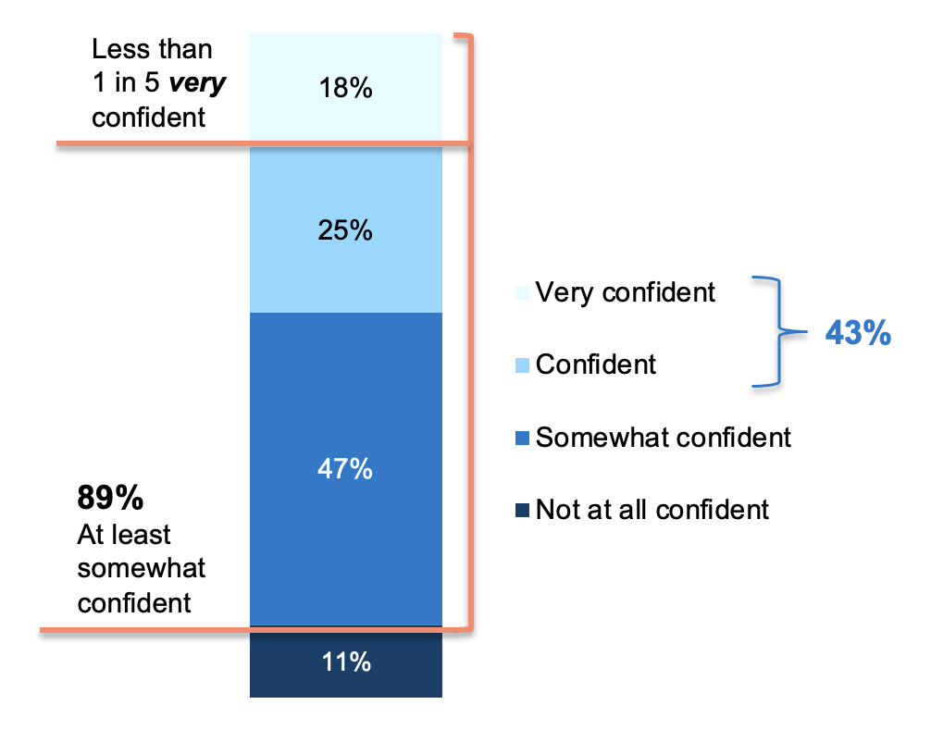



Generally, Adults Are At Least Somewhat Confident in Their Knowledge of SS
KNOWLEDGE OF SOCIAL SECURITY
However, only about 2 in 5 express strong confidence and less than 1 in 5 are very confident; Millennials and men are more likely to express confidence in their knowledge of Social Security
Confidence in Social Security Knowledge
% confident/very confident
Millennials are more likely than Gen Xers and Boomers+ to express confidence
(52% vs. 39%, 42%)
Men are more likely to be confident in their knowledge of SS
(51% vs. 35%)
While those who currently receive SS are more likely than those who don’t to be confident in their knowledge, still only half say they are confident/very confident
(52% vs. 34%)
Notes:
BASE: ALL QUALIFIED RESPONDENTS (n=1,931; Millennials (n=627), Gen Xers (n=634), Boomers+ (n=670); Men (n=937), Women (n=983); Currently receives SS (n=900), Not currently receiving SS (n=1,031))
Q701. How confident are you in your knowledge about Social Security?

Slide 4
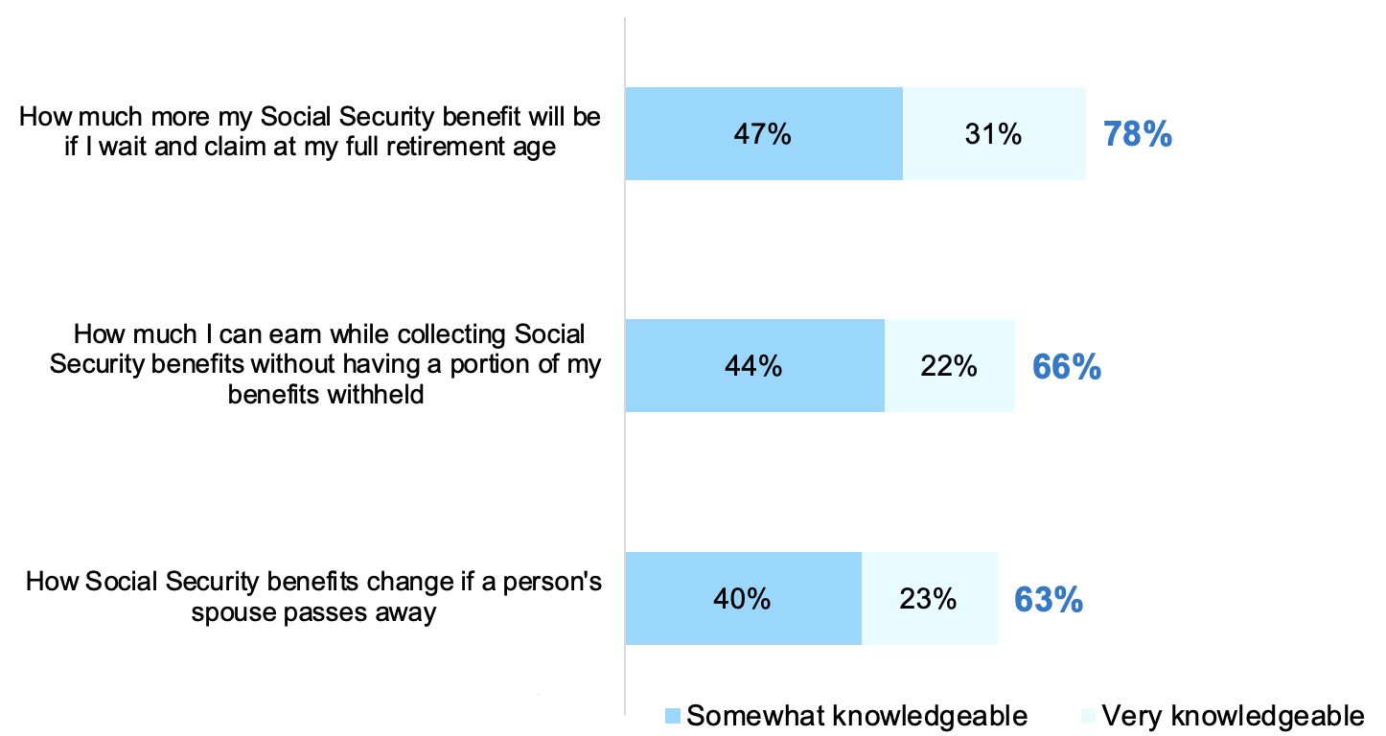
Majorities Feel Knowledgeable About Certain Aspects of Social Security
KNOWLEDGE OF SOCIAL SECURITY
But again, more are “somewhat” knowledgeable than are “very” knowledgeable
Knowledge of Aspects of Social Security
Boomers+ are more likely than Millennials and Gen Xers to be knowledgeable about this
(85% vs. 70%, 73%)
Men are more likely than women to be knowledgeable about this
(84% vs. 74%)
Men are more likely than women to be knowledgeable about this
(72% vs. 61%)
Notes:
BASE: ALL QUALIFIED RESPONDENTS (n=1,931; Millennials (n=627), Gen Xers (n=634), Boomers+ (n=670); Men (n=937), Women (n=983))
Q4NEW2021. How knowledgeable are you about the following aspects of Social Security?

Slide 5
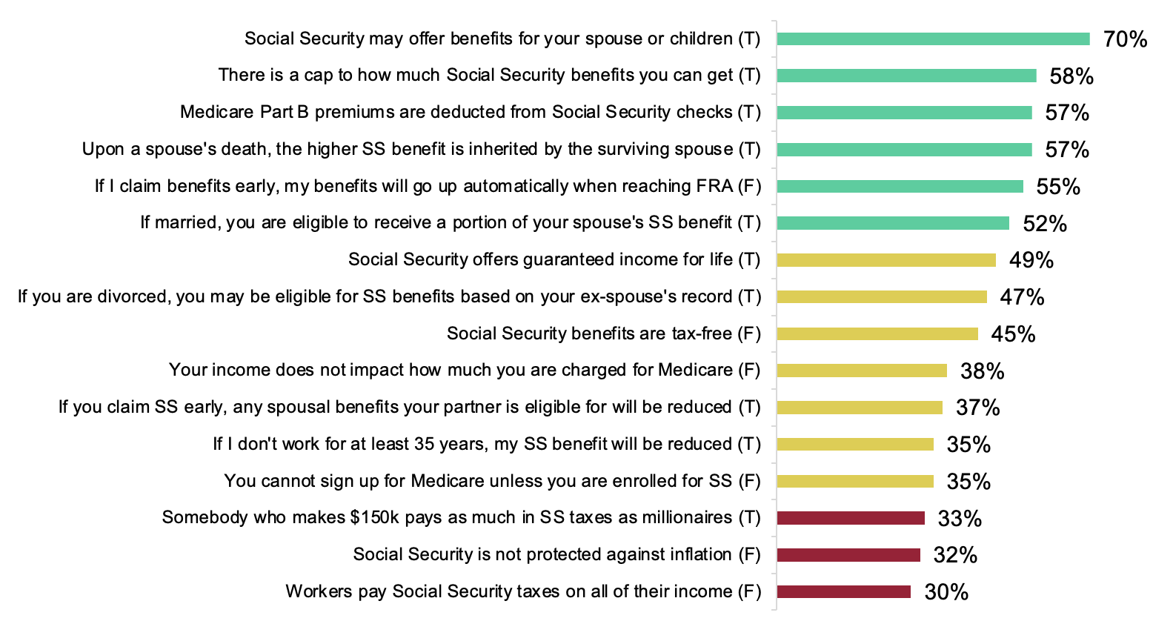
But When Tested About Specifics, Clear Gaps in Knowledge Exist
KNOWLEDGE OF SOCIAL SECURITY
For all but one statement, less than two-thirds provided the correct response
Knowledge Testing Specific Statements About Social Security
% correct
Higher knowledge topics
Moderate knowledge topics
Lowest knowledge topics
In most cases, Boomers+ are more likely than Millennials and Gen Xers and Men are more likely than Women to provide the correct answer
Those who currently receive SS are more likely than those who don’t to correctly answer some, but not all, of these statements – especially some of those in the moderate and lowest knowledge topic tiers
Notes:
BASE: ALL QUALIFIED RESPONDENTS (n=1,931; Millennials (n=627), Gen Xers (n=634), Boomers+ (n=670); Men (n=937), Women (n=983); Currently receives SS (n=900), Not currently receiving SS (n=1,031))
Q735. Do you believe the following statements to be true or false?
Please see data tables for supporting data for subgroup call-outs

Slide 6
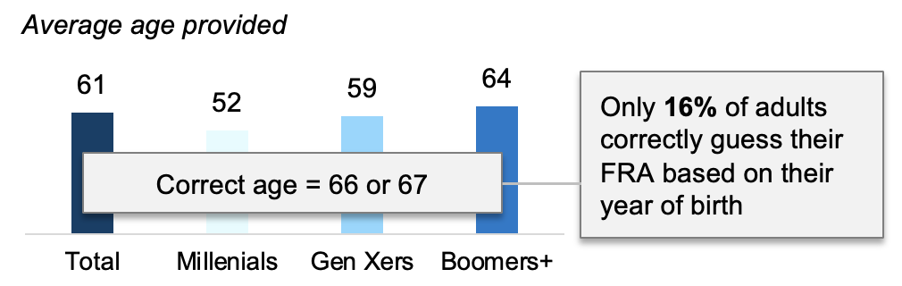
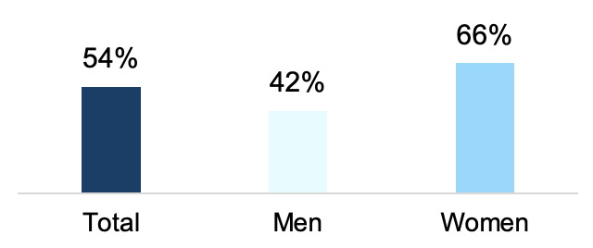
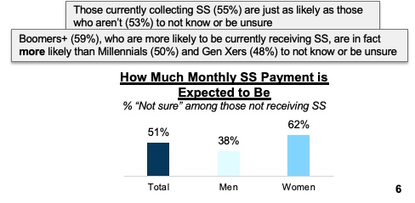
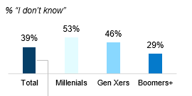
Many Express Uncertainty About Several Basic Social Security Details
KNOWLEDGE OF SOCIAL SECURITY
Women are especially likely to be uncertain about many aspects of Social Security; younger generations unsure of FRA
Age Believe You Are Eligible for Full Retirement Benefits
Percent of Income Is or Will be Replaced in Retirement by SS
% “Don’t know / Not sure”
Women (46%) are more likely than men (31%) to say they don’t know
Notes:
BASE: ALL QUALIFIED RESPONDENTS (n=1,931; Millennials (n=627), Gen Xers (n=634), Boomers+ (n=670); Men (n=937), Women (n=983))
Q7130. At what age are/were you eligible for full retirement benefits?
BASE: NOT CURRENTLY RECEIVING SOCIAL SECURITY (n=1,031; Men (n=422), Women (n=601))
Q720. What monthly payment are you expecting to receive from Social Security?
BASE: ALL QUALIFIED RESPONDENTS (n=1,931; Millennials (n=627), Gen Xers (n=634), Boomers+ (n=670); Men (n=937), Women (n=983); Currently receives SS (n=900), Not currently receiving SS (n=1,031))
Q5NEW2020. What percentage of your income [is / will be] replaced in retirement by Social Security?

Slide 7
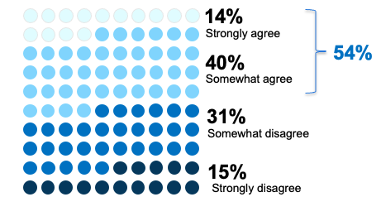
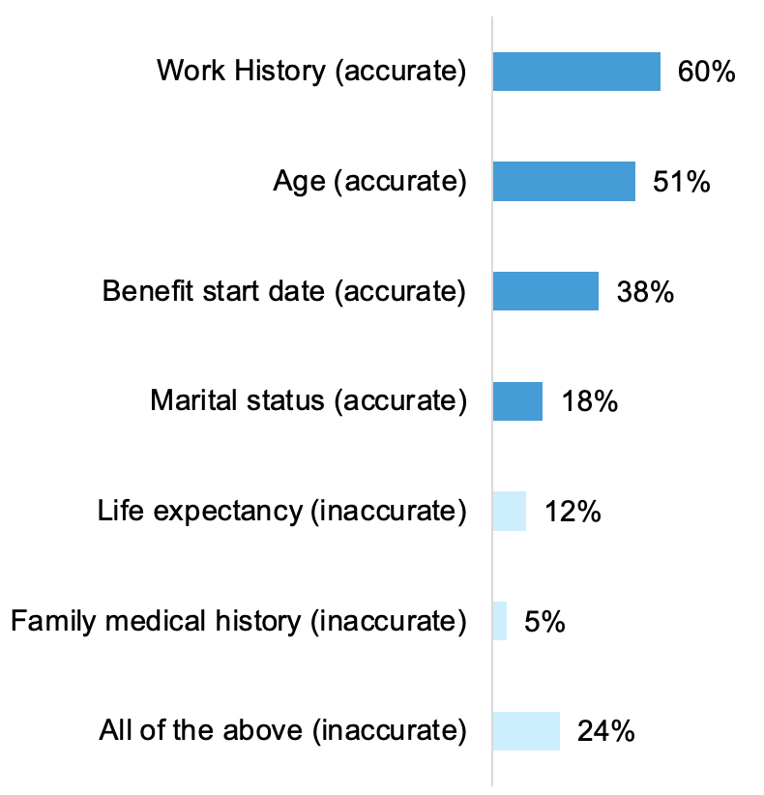
Only About Half Know Exactly How To Maximize Their Benefits
KNOWLEDGE OF SOCIAL SECURITY
Less than 1 in 10 know all of the factors that determine the maximum Social Security benefit someone can receive
Agreement with Statement
Factors that Determine Maximum SS Benefit Someone Can Receive
I know exactly how to maximize my Social Security benefits
Only 6% selected all 4 accurate answers only
Men are more likely than women to agree
(61% vs. 47%)
Notes:
BASE: ALL QUALIFIED RESPONDENTS (n=1,931; Men (n=937), Women (n=983))
Q740. How much do you agree or disagree with the following statements?
Q742. What factors determine the maximum Social Security benefit an individual can receive?

Slide 8
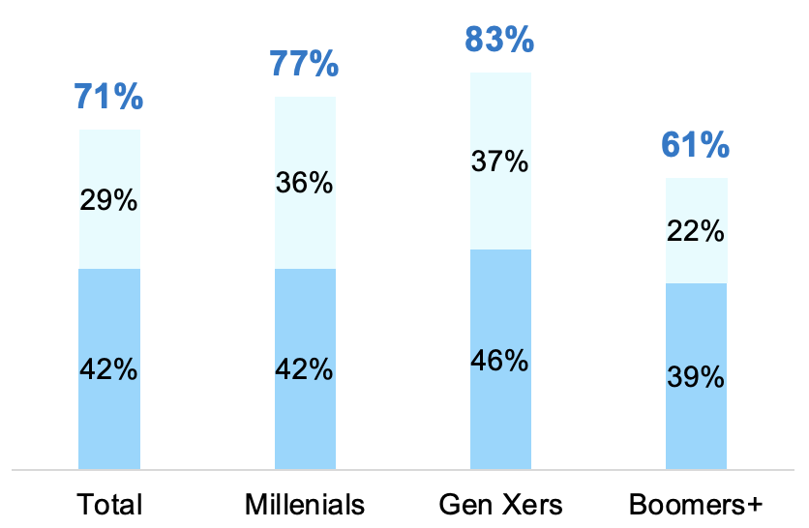
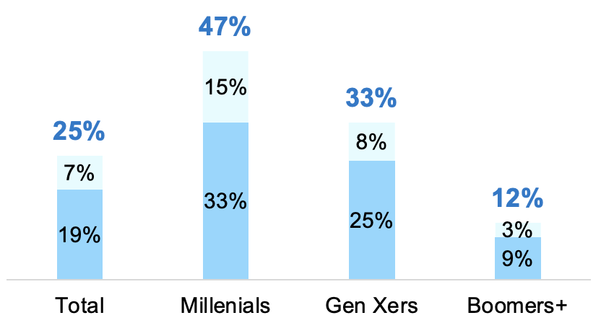
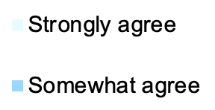
Confidence in Future of SS is Low, Especially for Younger Adults
FUTURE OF SS AND RETIREMENT
Majorities worry about the program running out of funding, even among Boomers+, and nearly half of Millennials think they won’t get a dime of the benefits they’ve earned
Agreement with Statements
I worry about the Social Security program running out of funding in my lifetime
I will not get a dime of the Social Security benefits I have earned
Women are more likely than men to agree
(77% vs. 64%)
Even a majority of those who currently receive SS (62%) agree with this statement, though they are less likely than those who don’t receive it (79%)
Notes:
BASE: ALL QUALIFIED RESPONDENTS (n=1,931; Millennials (n=627), Gen Xers (n=634), Boomers+ (n=670); Men (n=937), Women (n=983))
Q740. How much do you agree or disagree with the following statements?

Slide 9
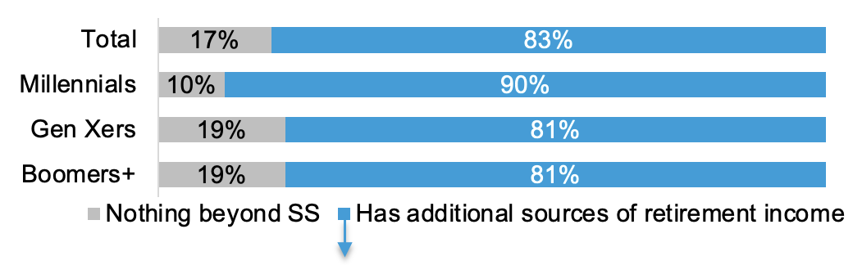
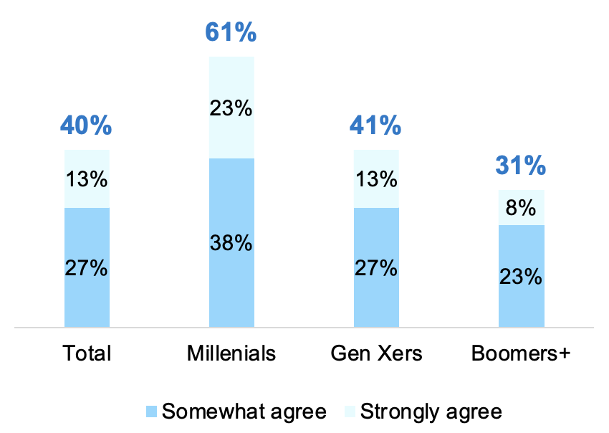
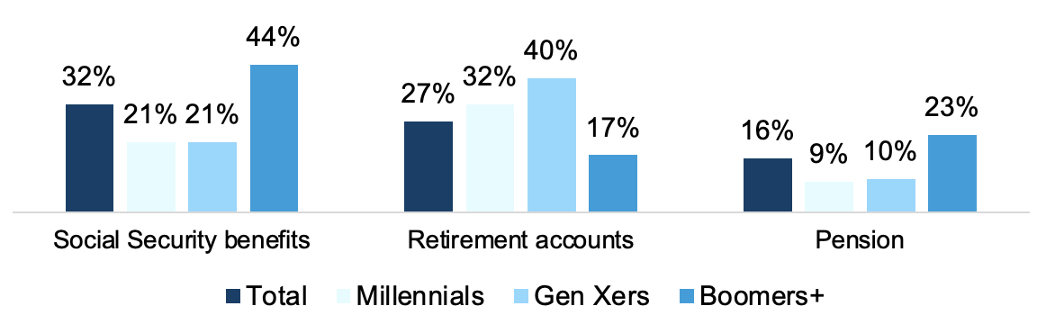
SS Not Expected To Be Primary Income Source in Retirement For Younger Adults
FUTURE OF SS AND RETIREMENT
However, many younger adults feel that it should be enough on its own, indicating a disconnect between the ideal of the program and the reality for them
Sources of Retirement Income
Agreement with Statement
Social Security on its own should be enough to help me live comfortably in retirement
Primary Source of Retirement Income^
Among those who have additional sources of retirement income beyond SS
^Only the top 3 are shown
Notes:
BASE: ALL QUALIFIED RESPONDENTS (n=1,931; Millennials (n=627), Gen Xers (n=634), Boomers+ (n=670))
Q740. How much do you agree or disagree with the following statements?
Q716. In addition to Social Security, [do you have / will you have] any of the following sources of retirement income? Please select all that apply.
Base: HAS SOURCES OF RETIREMENT INCOME IN ADDITION TO SOCIAL SECURITY (n=1,640; Millennials (n=572), Gen Xers (n=513), Boomers+ (n=555))
Q901. Which of the following [is / will be] your primary source of retirement income?

Slide 10
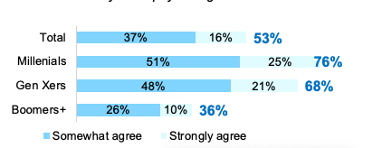
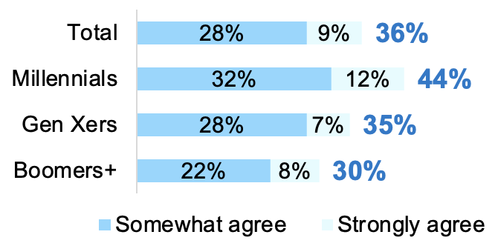
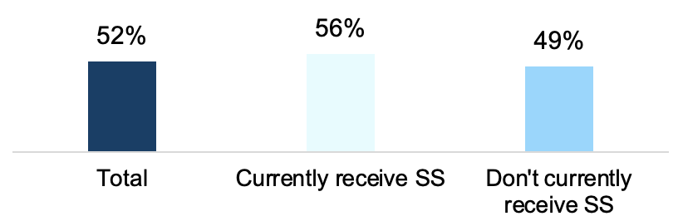
Younger Adults Expect to Need to Continue to Work Due to SS Limitations
FUTURE OF SS AND RETIREMENT
Perhaps because Social Security benefits cover/are expected to cover only about half of living expenses
Agreement with Statements
I need to continue working because Social Security won't pay enough
I plan on filing for Social Security benefits early, but continuing to work
Among those who don’t currently collect SS
Percent of Expenses [Expect] SS Benefits to Cover
Average
Notes:
BASE: ALL QUALIFIED RESPONDENTS (n=1,931; Millennials (n=627), Gen Xers (n=634), Boomers+ (n=670))
Q740. How much do you agree or disagree with the following statements?
BASE: NOT CURRENTLY RECEIVING SS (n=1,031; Millennials (n=412), Gen Xers (n=499), Boomers+ (n=120))
Q740. How much do you agree or disagree with the following statements?
BASE: ALL QUALIFIED RESPONDENTS (n=1,931; Currently receiving SS (n=900), Not currently receiving SS (n=1,031))
Q813. What percent of your expenses [do / do you expect] your Social Security benefits [to] cover?

Slide 11
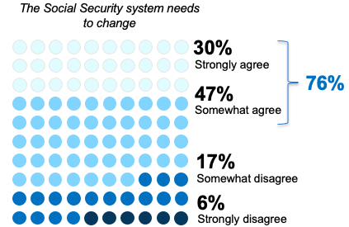
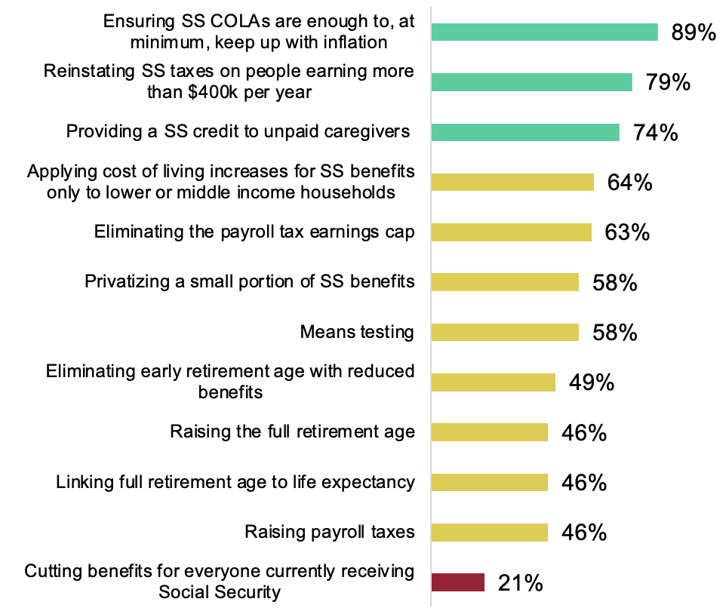
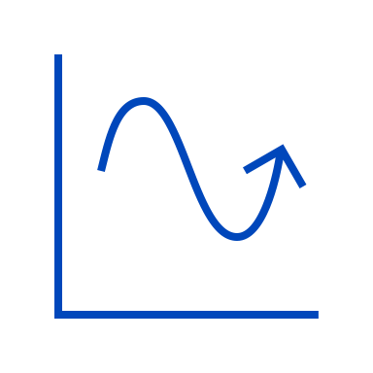
Most Agree the System Needs to Change and Support Certain Measures To Do So
FUTURE OF SS AND RETIREMENT
Millennials are especially likely to support these measures
Agreement with Statement
Support for SS measures
% Strongly/somewhat support
Higher support
Moderate support
Lower support
With the exception of eliminating the payroll tax earnings cap and raising payroll taxes, Millennials are more likely than Boomers+ (and often Gen Xers as well) to support all of the “moderate” and “lower” support measures. And, Millennials this year are more likely than Millennials last year to support cutting benefits for those currently receiving SS (46% vs. 29% in 2020).
Notes:
BASE: ALL QUALIFIED RESPONDENTS (n=1,931; Millennials (n=627), Gen Xers (n=634), Boomers+ (n=670))
Q740. How much do you agree or disagree with the following statements?
Q7NEW2020. To what extent do you support or oppose each of the following potential ways to keep Social Security financially viable Table 104
in the future?
Q6NEW2021. Please indicate the extent to which you support or oppose each of the following.
Please see data tables for supporting data for subgroup call-outs

Slide 12
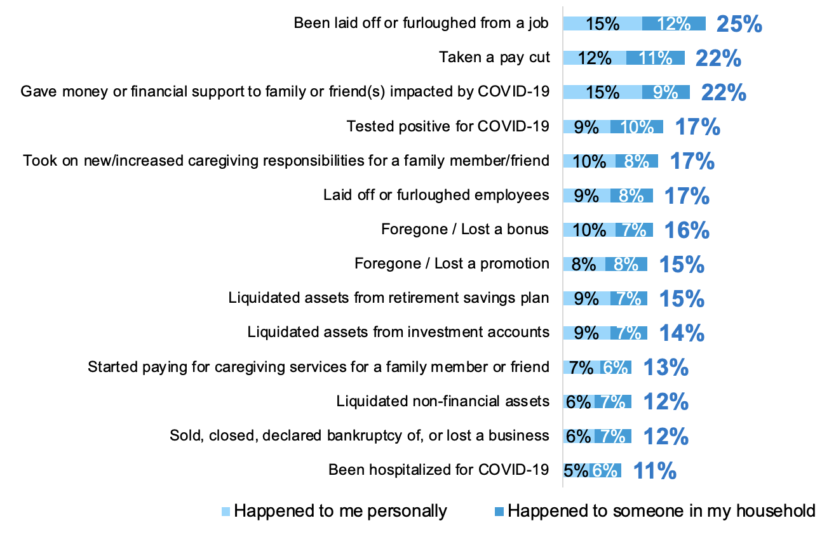
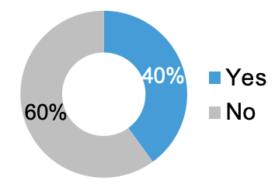
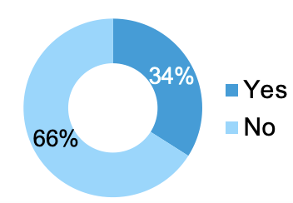
COVID Impacts Multiple Aspects of Life, From Job Loss to Caregiving Duties
COVID IMPACTS
One-quarter of adults ages 25+ say they and/or someone in their household was laid off or furloughed. In fact, among those who were ever out of the workforce for an extended period of time, one-third say they were during the pandemic, especially Millennials and Gen Xers
Impacts from COVID-19
Ever Out of Workforce for
Extended Period of Time
Out of Workforce for Extended Period
During COVID-19 Pandemic
Among those who have ever been out of the
workforce for an extended period of time
Millennials are more likely than Gen Xers and both are more likely than Boomers+ to have been out of the workforce for an extended time period during the pandemic
(68% vs. 48% vs. 12%)
Notes:
BASE: ALL QUALIFIED RESPONDENTS (n=1,931)
Q7NEW2021. Have you personally, or has someone in your household, experienced any of the following due to the COVID-19 pandemic?
Q1001. Were you ever out of the workforce for an extended period of time?
BASE: OUT OF THE WORKFORCE FOR AN EXTENDED PERIOD OF TIME (n=771; Millennials (n=293), Gen Xers (n=247), Boomers+ (n=231))
Q8NEW2021. You mentioned that you took time out of the workforce for an extended period of time. Did you take time out of the workforce for an extended period of time during the COVID-19 pandemic?

Slide 13
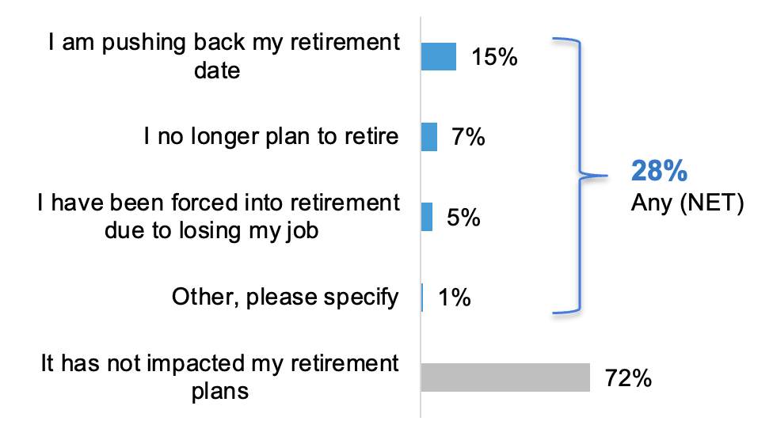
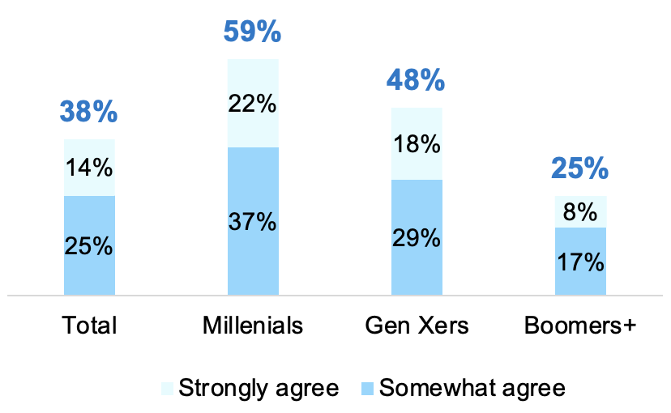
More Than 1 in 4 Say COVID Has Impacted Retirement Plans
COVID IMPACTS
And, nearly 2 in 5 are reevaluating their retirement plans to assess the financial impacts of COVID, especially younger generations – suggesting that for these groups in particular, long-term financial impacts may linger from this time period
COVID-19 Impact on Retirement
Among those who are not retired
Agreement with Statement
I am reevaluating my retirement (plans) to assess the financial impact of COVID-19
Compared to the 2020 Nationwide Harris Poll COVID Flash poll^ the proportion who say COVID has impacted retirement plans has decreased (28% vs. 38% in 2020), and the proportion who say they are reevaluating their retirement plans has also decreased
(38% vs. 42% in 2020)
^Nationwide Harris Poll COVID Flash Poll conducted online among 1,798
U.S. adults 24+ including 1,332 who are not retired, May 15-19, 2020.
Notes:
BASE: NOT RETIRED (n=1,389)
Q1NEW2021. How, if at all, has the COVID-19 pandemic impacted your retirement plans?
BASE: ALL QUALIFIED RESPONDENTS (n=1,931; Millennials (n=627), Gen Xers (n=634), Boomers+ (n=670))
Q3NEW2021. To what extent do you agree or disagree with each of the following statements about how the COVID-19 pandemic has impacted your (plan for) retirement or could impact retirement for others?
COVID FLASH POLL:
BASE: NOT RETIRED 24+ (n=1,332)
Q2 How, if at all, has the COVID-19 pandemic impacted your retirement plans? Please select all that apply.
BASE: ALL QUALIFIED RESPONDENTS 24+(n=1,798)
Q7. To what extent do you agree or disagree with the following statements about how the COVID-19 pandemic has impacted your [plan for] retirement?

Slide 14
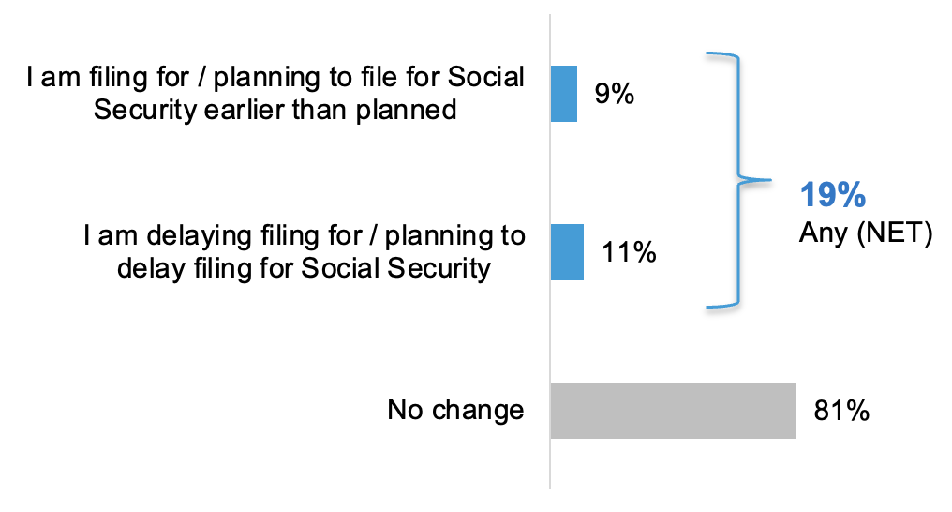
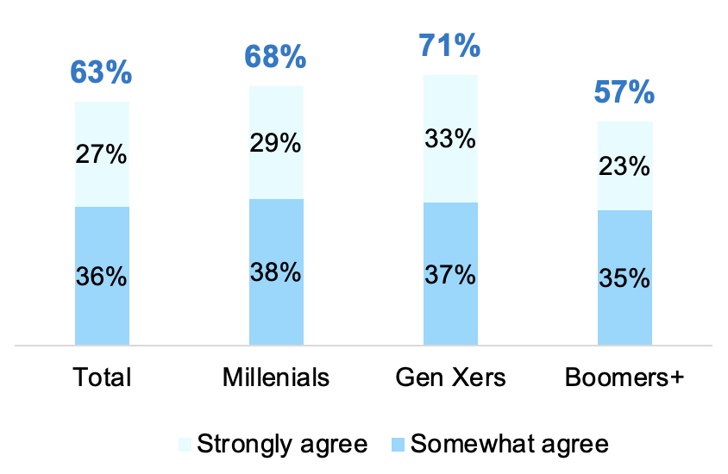
Nearly 1 in 5 Say COVID Has Impacted Social Security Filing Plans
COVID IMPACTS
Majorities across generations agree that the government shouldn’t penalize people who claim early by reducing Social Security benefits because COVID has forced so many people into retirement, especially younger generations
COVID-19 Impact on Social Security Filing
Agreement with Statement
Because COVID-19 has forced many people into retirement, the government shouldn't penalize people by reducing Social Security benefits for those who claim early
Compared to the 2020 Nationwide Harris Poll COVID Flash poll^ the proportion who say COVID has impacted Social Security filing plans has remained flat
(19% vs. 18% in 2020)
^Nationwide Harris Poll COVID Flash Poll conducted online among 1,798 U.S. adults 24+, May 15-19, 2020.
Notes:
BASE: ALL QUALIFIED RESPONDENTS (n=1,931)
Q2NEW2021. How, if at all, has the COVID-19 pandemic impacted your plans around filing for Social Security?
BASE: ALL QUALIFIED RESPONDENTS (n=1,931; Millennials (n=627), Gen Xers (n=634), Boomers+ (n=670))
Q3NEW2021. To what extent do you agree or disagree with each of the following statements about how the COVID-19 pandemic has impacted your (plan for) retirement or could impact retirement for others?
COVID FLASH POLL:
BASE: ALL QUALIFIED RESPONDENTS 24+(n=1,798)
Q3. How, if at all, has the COVID-19 pandemic impacted your plans around filing for Social Security?

Slide 15
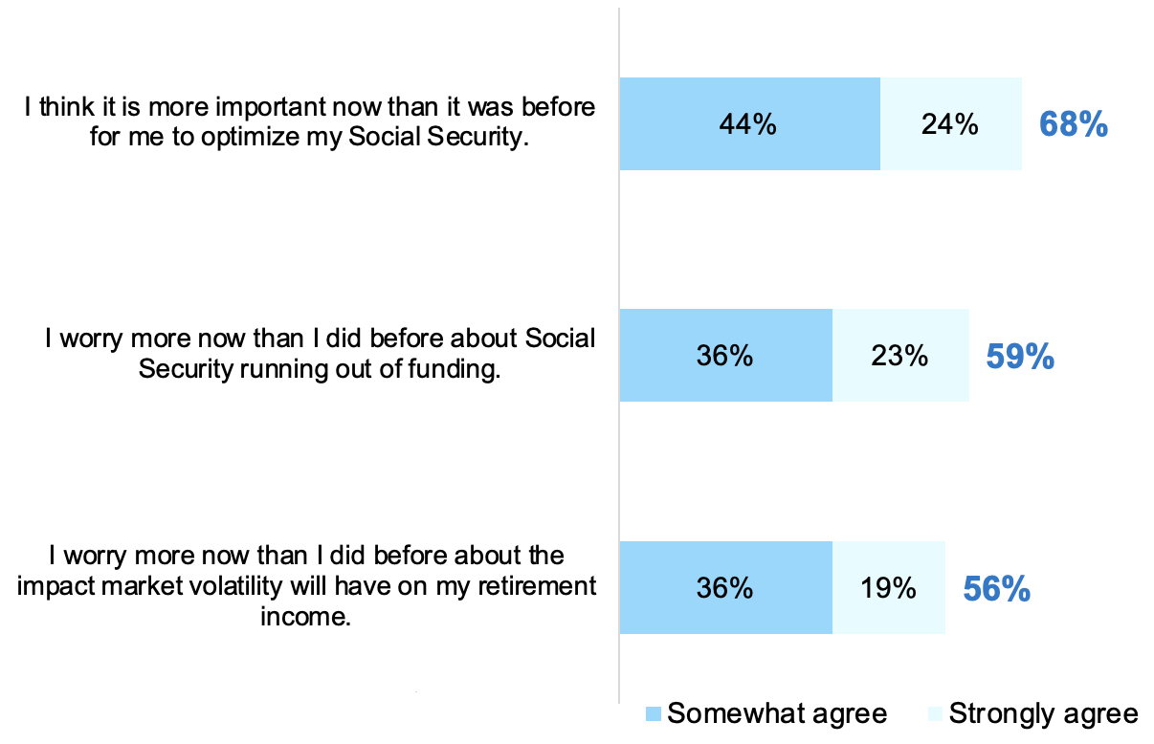
COVID Heightens Worries About SS Funding, Market Volatility Impact
COVID IMPACTS
Younger generations and women are especially likely to hold these views
Agreement with Statements about COVID Impacts on Social Security and Retirement
Millennials and Gen Xers are more likely than Boomers+ to agree with all of these statements
Women are more likely than men to agree with all of these statements
Compared to the 2020 Nationwide Harris Poll COVID Flash poll^ the proportion who agree that it is more important to optimize SS has increased (68% vs. 63% in 2020), while the proportion who worry more about SS running out of funding and worry more about the impact of market volatility on retirement income have remained steady
(59% vs. 62% in 2020 and
56% vs. 57% in 2020, respectively)
^Nationwide Harris Poll COVID Flash Poll conducted online among 1,798 U.S. adults 24+, May 15-19, 2020.
Notes:
BASE: ALL QUALIFIED RESPONDENTS (n=1,931; Millennials (n=627), Gen Xers (n=634), Boomers+ (n=670); Men (n=937), Women (n=983))
Q3NEW2021. To what extent do you agree or disagree with each of the following statements about how the COVID-19 pandemic has impacted your (plan for) retirement or could impact retirement for others?
Please see data tables for supporting data for subgroup call-outs
COVID FLASH POLL:
BASE: ALL QUALIFIED RESPONDENTS 24+ (n=1,798)
Q7. To what extent do you agree or disagree with the following statements about how the COVID-19 pandemic has impacted your [plan for] retirement?

Slide 16
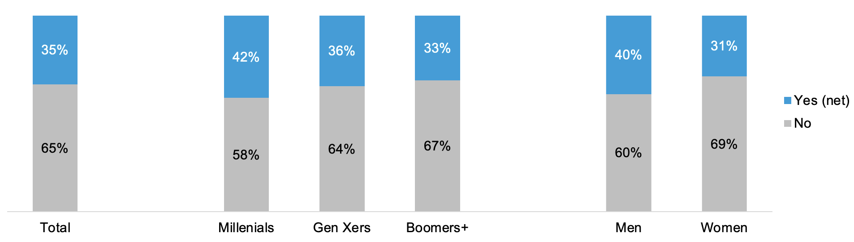
More Than One-Third of Adults Work with a Financial Professional
WORKING WITH A FINANCIAL PROFESSIONAL
Younger adults and men are more likely to work with one
Currently Working with a Financial Professional**
Gen Xers are more likely this year to say they work with a financial professional** (36% vs. 27% in 2020)
**Note that we changed from “financial advisor” to “financial professional (e.g., (e.g., Certified Financial Planner (CFP), broker, financial advisor working at an insurance agency, etc.)” this year which could impact trending of this and other responses where this new term is used
Notes:
BASE: ALL QUALIFIED RESPONDENTS (n=1,931; Millennials (n=627), Gen Xers (n=634), Boomers+ (n=670); Men (n=937), Women (n=983))
Q800. Do you currently work with a financial professional (e.g., Certified Financial Planner (CFP), broker, financial advisor working at an insurance agency, etc.)?

Slide 17
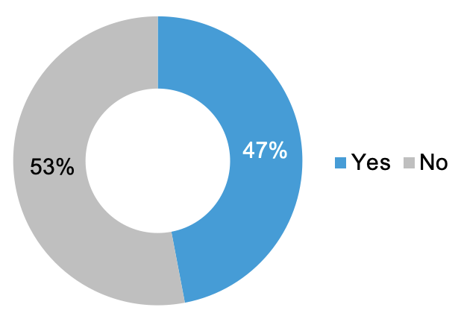
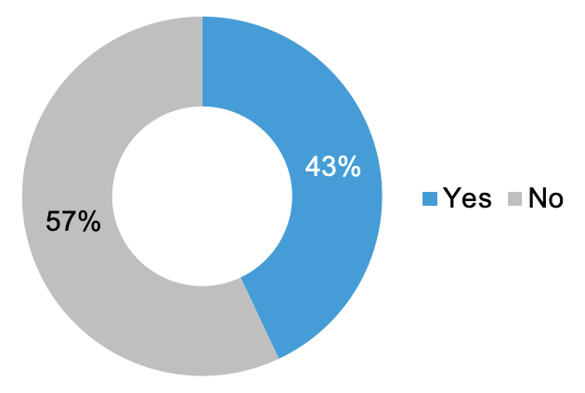
About Half Who Work with an FP Say They Provide Social Security Advice
WORKING WITH A FINANCIAL PROFESSIONAL
However, a majority who haven’t been advised on Social Security say it isn’t something they expect
Financial Professional Provided Advice on How/When to File for SS Benefits
Among those who work with a financial professional
SS Advice Something Expected
from Financial Professional
Among those who work with a financial professional
but haven’t been advised on SS
Millennials who work with an FP are more likely than Gen Xers and both are more likely than Boomers+ to say their FP provides advice about how/when to file for Social Security
(68% vs. 52% vs. 32%)
Notes:
BASE: WORK WITH A FINANCIAL PROFESSIONAL (n=742; Millennials (n=293), Gen Xers (n=222), Boomers+ (n=227))
Q802. Has your financial professional provided advice on how and when to file for Social Security benefits?
BASE: WORK WITH A FINANCIAL PROFESSIONAL AND HAVE NOT BEEN ADVISED ON SOCIAL SECURITY (n=316)
Q804. Is Social Security advice something you expect from your financial professional?

Slide 18
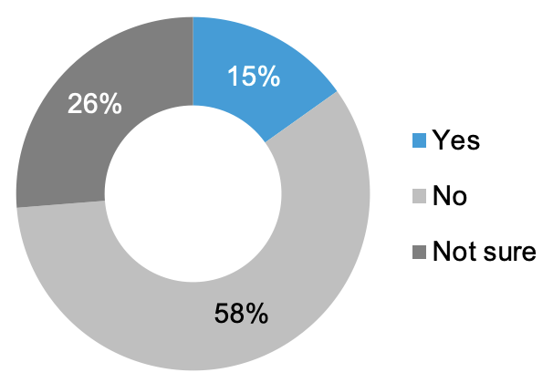
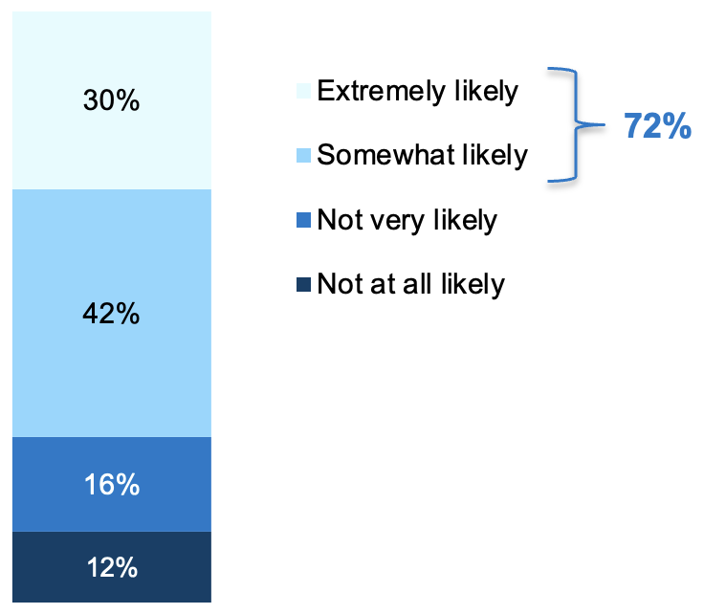
Less Than 1 in 5 Without an FP Plan To Ask One About SS, With 1 in 4 Unsure
WORKING WITH A FINANCIAL PROFESSIONAL
Most with a financial professional or who plan to ask one about Social Security would switch financial professionals if theirs couldn’t show them how to maximize their Social Security benefit
Plan on Asking FP About SS Benefits
Among those who do not work with a financial professional
Likelihood to Switch FPs if Theirs Couldn’t Show How to Maximize SS Benefits
Among those who work with a financial professional or plan to ask one about SS
Millennials and Gen Xers who work with an FP or plan to ask one about SS are more likely than Boomers+ to be somewhat or extremely likely to switch
(85%, 87% vs. 52%)
Millennials and Gen Xers who don’t work with an FP are more likely than Boomers+ to say they plan to ask a financial professional about Social Security benefits or to be unsure
(27%, 24% vs. 6%; and 40%, 35% vs. 17%, respectively)
Notes:
BASE: DON’T WORK WITH A FINANCIAL PROFESSIONAL (n=1,189; Millennials (n=334), Gen Xers (n=412), Boomers+ (n=443))
Q810. Do you plan on asking a financial professional specifically about Social Security benefits?
BASE: WORK WITH A FINANCIAL PROFESSIONAL OR PLAN TO ASK ONE ABOUT SOCIAL SECURITY (n=948; Millennials (n=395), Gen Xers (n=307), Boomers+ (n=246))
Q812. If a financial professional could not show you how to maximize your Social Security benefits, how likely would you be to switch to one who could?

Slide 19
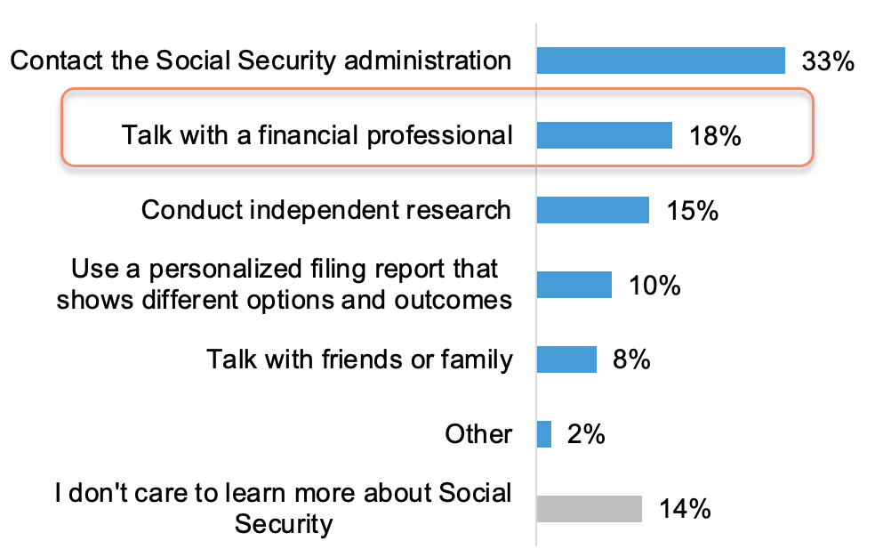
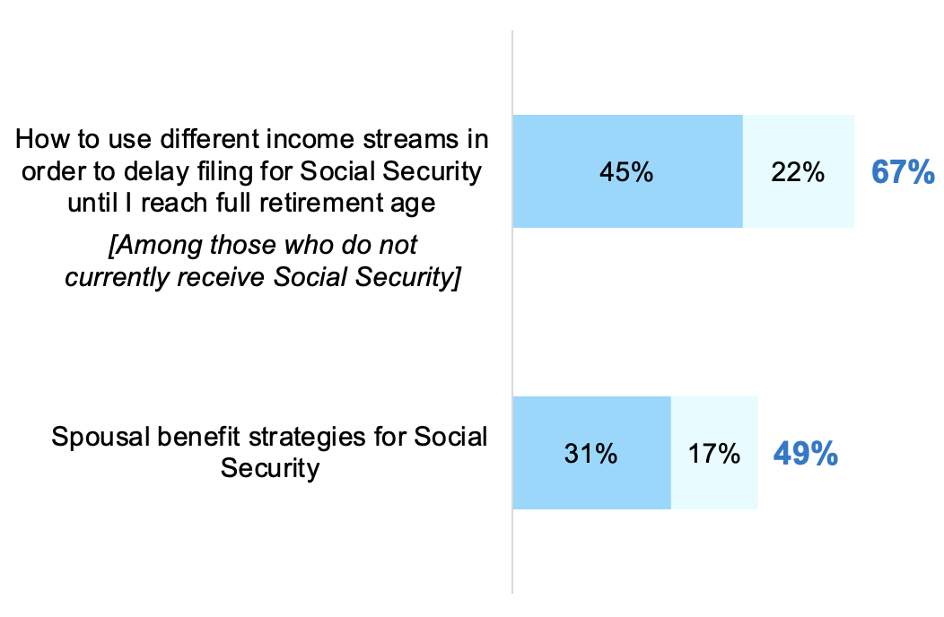
Contacting SS Admin Preferred Over FP for Learning About SS
WORKING WITH A FINANCIAL PROFESSIONAL
Two-thirds who aren’t yet collecting SS are interested in discussing with an FP how to use different income streams to delay filing until they reach full retirement plan, and around half are interested in discussing spousal benefits
Interest in Talking to a
Financial Professional About…
How Prefer to Learn More About SS
Millennials and Gen Xers are more likely than Boomers+ to say they prefer to learn more about Social Security from a financial professional
(27%, 23% vs. 11%)
Millennials and Gen Xers are more likely than Boomers+ to be interested in both of these discussions
(71%, 70% vs. 57%; and 70% vs. 61% vs. 32%, respectively)
Notes:
BASE: ALL QUALIFIED RESPONDENTS (n=1,931; Millennials (n=627), Gen Xers (n=634), Boomers+ (n=670))
NEWQ1025A. How would you prefer to learn more about Social Security? Please select only one response.
Q5NEW2021. How interested are you in the following?
BASE: NOT CURRENTLY RECEIVING SS (n=1,031; Millennials (n=412), Gen Xers (n=499), Boomers+ (n=120))
Q5NEW2021. How interested are you in the following?

Slide 20
Disclaimers
This material is not a recommendation to buy, sell, hold or rollover any asset, adopt an investment strategy, retain a specific investment manager or use a particular account type. It does not take into account the specific investment objectives, tax and financial condition or particular needs of any specific person. Investors should work with their financial professional to discuss their specific situation.
This information is general in nature and is not intended to be tax, legal, accounting or other professional advice. The information provided is based on current laws, which are subject to change at any time and has not been endorsed by any government agency.
Nationwide and Harris Poll are separate and non-affiliated companies.
Nationwide Investment Services Corporation, member FINRA, Columbus, OH. Nationwide Retirement Institute is a division of NISC.
Nationwide, the Nationwide N and Eagle, Nationwide is on your side and Nationwide Retirement Institute are service marks of Nationwide Mutual Insurance Company. © 2023 Nationwide

Slide 21
Access more Social Security insights at http://nationwide.com/SocialSecurity
NFM-23017AO (06/23)

