Slide 1

The Nationwide Retirement Institute®
2022 Social Security Survey
July 2022
Access more Social Security insights at
Nationwide.com/SocialSecurity
This material should be regarded as general information on Social Security and is not intended to provide specific advice. If you have questions regarding your particular situation, you should contact the Social Security Administration and/or your legal or tax advisors.
NFM-20936AO.3 (06/23)

Slide 2
Background and Objectives
INTRODUCTION
The Corporate Communications Team aims to create positive consumer and financial media coverage that demonstrates Nationwide understands consumers’ financial challenges and helps professionals have meaningful discussions with their clients—specifically, to help maximize clients’ Social Security (SS) benefits.
To this end, since 2014 Nationwide has annually tracked whether sentiment towards or usage and knowledge of Social Security benefits have changed.
Objectives:
To understand attitudes and knowledge about Social Security
To measure whether adults are using a financial professional, particularly for Social Security advice and planning
To determine if these sentiments and behaviors have changed over time
  Specifically, in 2022 continue exploring the impacts of the COVID-19 pandemic as well as impacts of inflation especially as they relate to Social Security and retirement planning
To compare sentiments, behaviors, and knowledge among key generational groups:
    Millennials (26-41 years old)
    Gen X (42-57 years old)
    Boomers+ (58+ years old)

Slide 3




Research Method
INTRODUCTION
Audience:
1,853 U.S. adults age 26+
Survey Timing:
April 25 – May 23, 2022
Mode:
20-minute online survey
Weighting:
Data are weighted to ensure results are projectable to the U.S. population of adults 26+
Method Statement (to be included in all press materials):
This survey was conducted online within the U.S. by The Harris Poll on behalf of Nationwide between April 19 and May 7, 2021 among 1,853 U.S. adults age 26+ (national sample) including 674 Millennials (age 26-41), 576 Gen Xers (age 42-57), and 603 Boomers+ (age 58+) and an oversample for a total of 502 Hispanic adults, a total of 591 Asian adults, a total of 593 Rural adults. Data were statistically weighted as needed to bring them in line with the population of U.S. residents age 26+ from the 2022 Current Population Survey for age by gender, education, race/ethnicity, region, household income, marital status, and household size. To ensure the national sample was representative, the data were initially weighted by generation (Millennials 26-41, Gen Xers 42-57, and Boomers+ 58+) and then combined into a total 26+ group. Data for Hispanic, Asian, and Rural adults were weighted as needed for age by gender, education, region, household income, marital status, and household size. Our weighting algorithm also included a propensity score which allows us to adjust for attitudinal and behavioral differences between those who are online versus those who are not, those who join online panels versus those who do not, and those who responded to this survey versus those who did not.

Slide 4



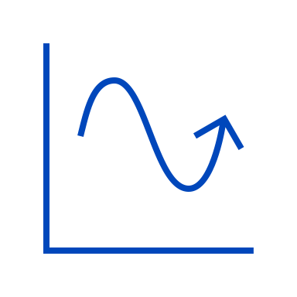
Report Notes
INTRODUCTION
In tables and charts:
Percentages may not add up to 100% due to weighting, computer rounding, and/or the acceptance of multiple responses.
An asterisk (*) in a data chart indicates a percentage greater than zero but less than 1%; a “ – ” indicates a value of zero.
Unless otherwise noted, results for the Total (adults 26+) are displayed.
Results based on small samples (n<100) are too small to report quantitatively for PR and should be interpreted as directional only. These are noted with “*Caution, small base <100, results are directional in nature” and stat testing is not shown.
Throughout this report:
Where appropriate, key highlights or statistically significant differences at the 95% confidence level between subgroups of interest are noted throughout the detailed findings slides. Look for the icons below to denote these call outs. In some instances, subgroup data may be charted for ease of visual comparison.
Key generational subgroup finding
Key gender subgroup finding
Key SS status subgroup finding
Key trend finding
Note that due to space limitations, not all significant differences among subgroups of interest are displayed. Full survey results for all subgroups are available in the data tables.
  In some instances, there may be too many data points to reference within a slide to support key highlights or subgroup findings. In these cases, we have included a note within the notes section to see data tables for supporting data.
Base labels, sizes, and question text are included within the notes section of each page for reference.

Slide 5
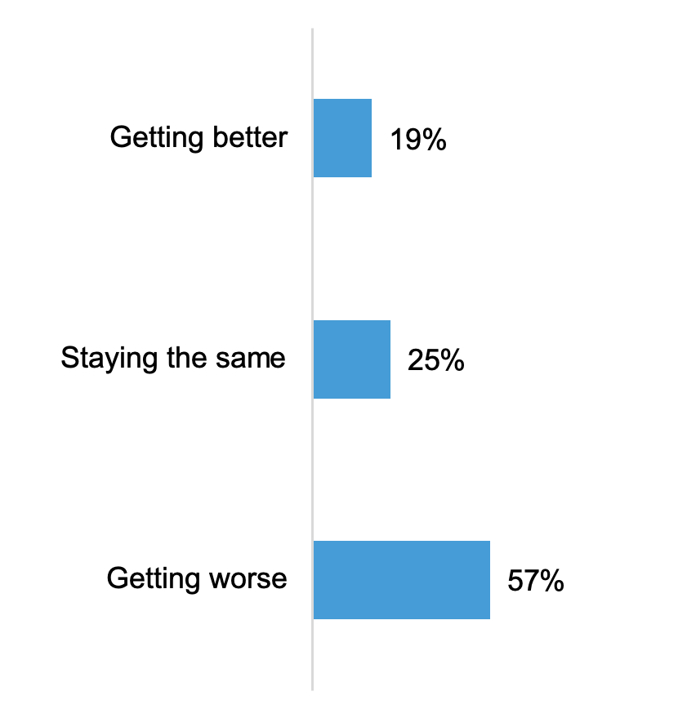
Majorities Believe The US Economy Is Getting Worse
Inflation Perception and Impacts
Only one quarter believe it is staying the same and about a fifth believe it’s getting better
Perception of U.S. Economy
Gen Xers and Boomers+ are more likely than Millennials to believe the U.S. economy is getting worse
(57%, 67% vs. 36%)
Women are more likely than men to believe the U.S. economy is getting worse
(63% vs. 50%)
Notes:
BASE: ALL QUALIFIED RESPONDENTS (n=1,853; Millennials (n=674), Gen Xers (n=576), Boomers+ (n=603); Men (n=926), Women (n=912))
Q3NEW2022. Right now, would you say the economy in the United States is...?

Slide 6
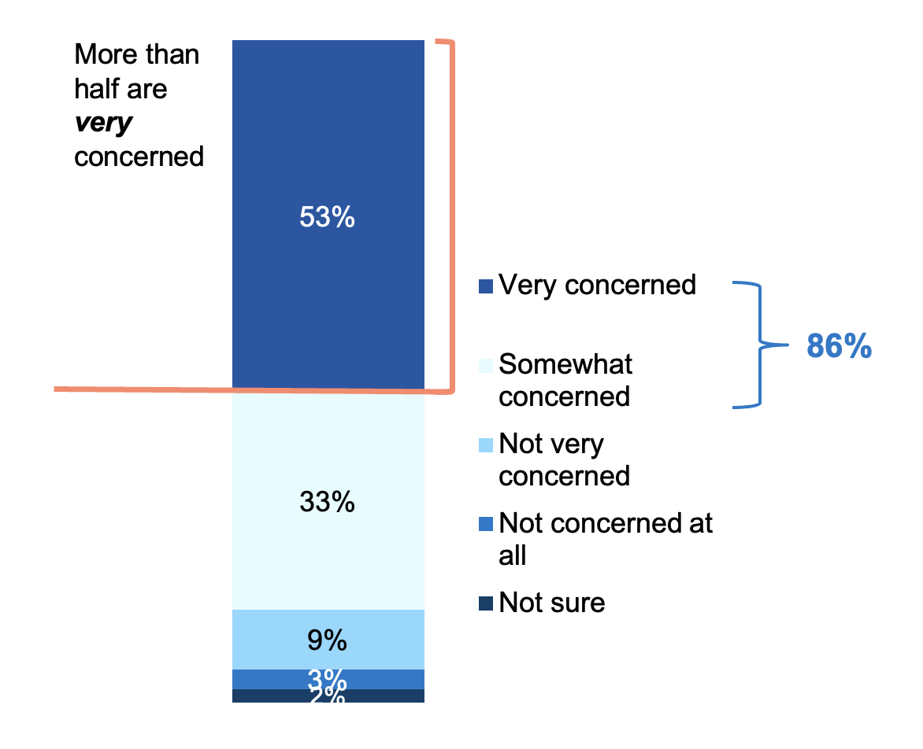

Nearly 9 In 10 Are Very/Somewhat Concerned About Inflation In The US
Inflation Perception and Impacts
More than half are very concerned about the level of inflation in the US economy today
Concern About Inflation in U.S. Economy
Women and men are about as likely to be very concerned and similar at other levels of concern
(54% vs. 52%)
Gen Xers are more likely than Millennials to be very concerned
(56% vs. 49%)
Boomers+ are directionally higher than Millennials when it comes to being very concerned
(54% vs 49%)
Those who are not currently working with a FP are more likely than those who are working with a FP to be very concerned
(55% vs 49%)
Notes:
BASE: ALL QUALIFIED RESPONDENTS (n=1,853; Millennials (n=674), Gen Xers (n=576), Boomers+ (n=603); Men (n=926), Women (n=912))
Q4NEW2022. Thinking about your own personal finances, how concerned are you about the level of inflation in the US economy today?

Slide 7
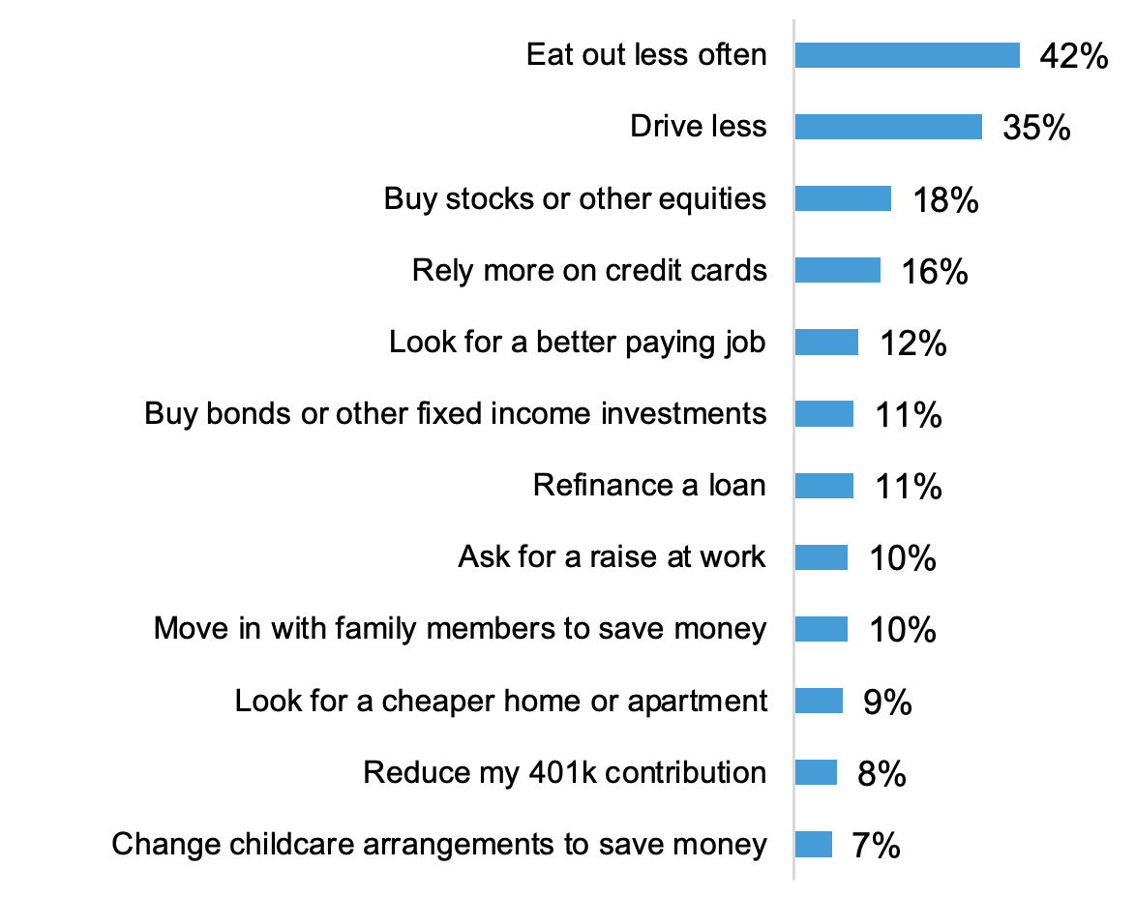
Many Ate Out Less Often Or Drove Less In The Past 12 Months Due to Inflation
Inflation Perception and Impacts
Almost one fifth bought stocks or other equities or relied more on credit cards in the past 12 months because of rising inflation
Done in the Past 12 Months Because of Rising Inflation
Millennials are more likely than Gen Xers and Boomers+ to have taken these actions except for eating out less often or driving less
Specifically, Millennials and Gen Xers are more likely than Boomers+ to have reduced their 401(k) contributions
(17%, 7% vs 1%)
Women are more likely than men to have eaten out less (49% vs. 34%) or driven less
(41% vs. 30%)
Those not currently receiving SS are more likely than currently receiving SS to have eaten out less, bought stocks or other equities, looked for a better paying job or asked for a raise at work
Those who are not retired are more likely than those who are not retired are more likely to have taken these actions except for eating out less often or driving less
Notes:
BASE: ALL QUALIFIED RESPONDENTS (n=1,853; Millennials (n=674), Gen Xers (n=576), Boomers+ (n=603); Men (n=926), Women (n=912), Currently Receiving SS (n=827), Not Receiving SS But Expect to Receive in the Future (n=1,026))
Q5NEW2022. Which of the following actions have you taken over the past 12 months or are you currently considering because of rising inflation?
Please see data tables for supporting data for generation or SS status subgroup call-outs

Slide 8
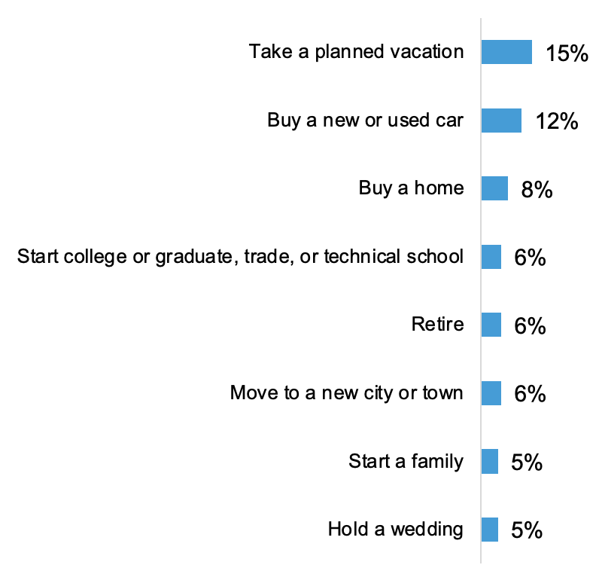
Rising Inflation Impacted Some Important Life Events Or Long-term Plans
Inflation Perception and Impacts
Almost one in ten cancelled or postponed plans to buy a home because of rising inflation
Cancelled or Postponed Plans in Past 12 Months Because of Rising Inflation
Millennials are more likely than Gen Xers and Boomers+ to have cancelled or postponed these actions in the past 12 months except for retiring or starting a family
Notes:
BASE: ALL QUALIFIED RESPONDENTS (n=1,853; Millennials (n=674), Gen Xers (n=576), Boomers+ (n=603); Men (n=926), Women (n=912), Currently Receiving SS (n=827), Not Receiving SS But Expect to Receive in the Future (n=1,026))
Q6NEW2022. Are you considering canceling or postponing plans to do any of the following because of rising inflation?
Please see data tables for supporting data for subgroup call-outs

Slide 9
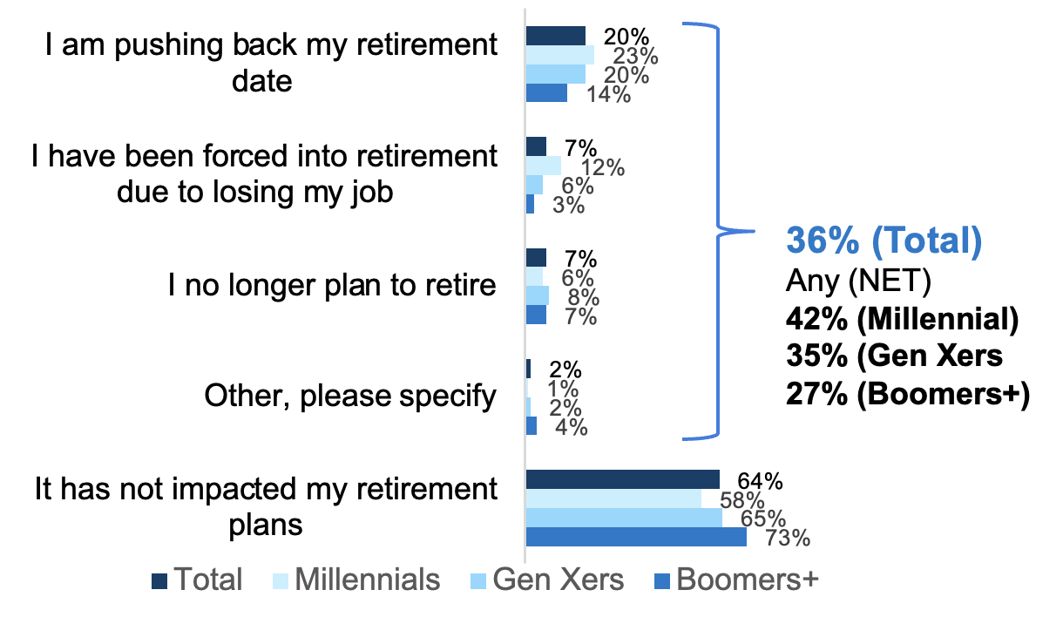
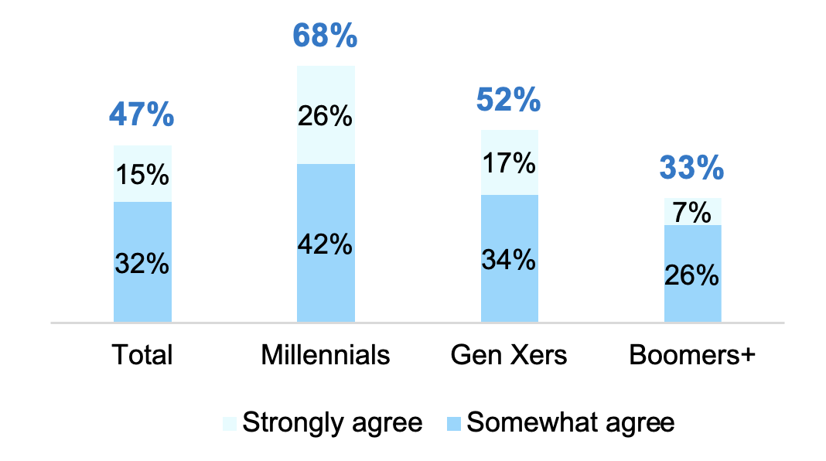
More Report COVID Has Impacted Their Retirement Plans Compared to 2021
Social Security and Retirement Planning Changes Due to COVID
Almost half are reevaluating their retirement plans to assess the financial impacts of COVID, significantly higher than in 2021 and significantly higher among Millennials and Gen Xers
COVID-19 Impact on Retirement
Among those who are not retired
Agreement with Statement
I am reevaluating my retirement (plans) to assess the financial impact of COVID-19
Significantly more are pushing back their retirement date due to COVID-19 compared to 2021 (20% vs. 15% in 2021)
Significantly more are reevaluating their retirement (plans) to assess the financial impact of COVID-19 compared to 2021 (47% vs. 38% in 2021)
Notes:
BASE: NOT RETIRED (Total 2022 (n=1,372), Total 2021 (n=1,389); Millennials (n=667), Gen Xers (n=525), Boomers+ (n=180))
Q1NEW2021. How, if at all, has the COVID-19 pandemic impacted your retirement plans?
BASE: ALL QUALIFIED RESPONDENTS (Total 2022 (n=1,853), Total 2021 (n=1,931); Millennials (n=674), Gen Xers (n=576), Boomers+ (n=603))
Q3NEW2021_4. To what extent do you agree or disagree with each of the following statements about how the COVID-19 pandemic has impacted your (plan for) retirement or could impact retirement for others?

Slide 10
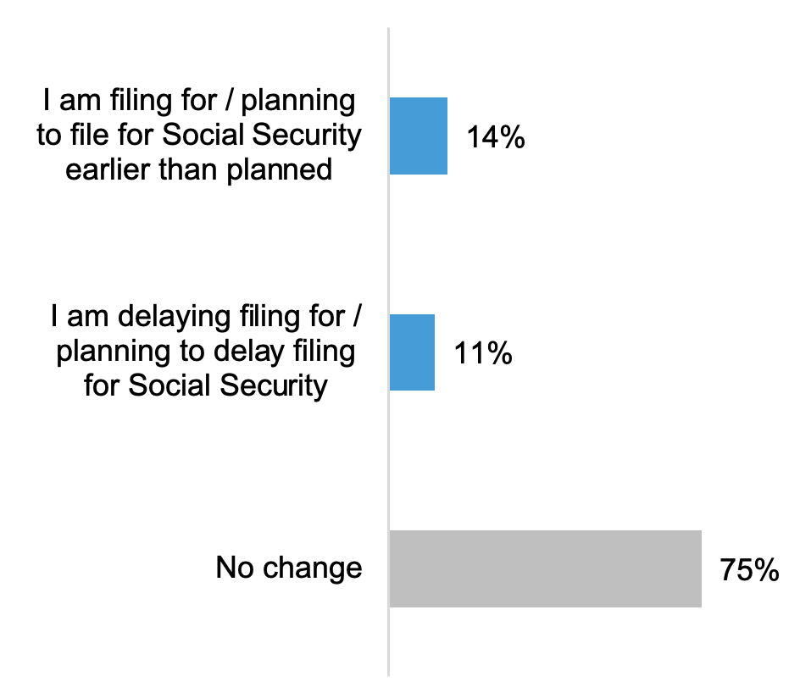
About One Fifth Report COVID Has Impacted Their SS Filing Plans
Social Security and Retirement Planning Changes Due to COVID
Majorities across generations agree that the government shouldn’t penalize people who claim early by reducing SS benefits because COVID has forced so many people into retirement, especially younger generations
COVID-19 Impact on Social Security Filing
Compared to the 2021, significantly more report that plan to file/filed earlier than planned for Social Security
(14% vs. 9% in 2021)
Millennials and Gen Xers are more likely than Boomers+ to be filing/planning to file for Social Security earlier than expected (25% and 15% vs. 7%)
Notes:
BASE: ALL QUALIFIED RESPONDENTS (Total 2022 (n=1,853), Total 2021 (n=1,931); Millennials (n=674), Gen Xers (n=576), Boomers+ (n=603))
Q2NEW2021. How, if at all, has the COVID-19 pandemic impacted your plans around filing for Social Security?

Slide 11
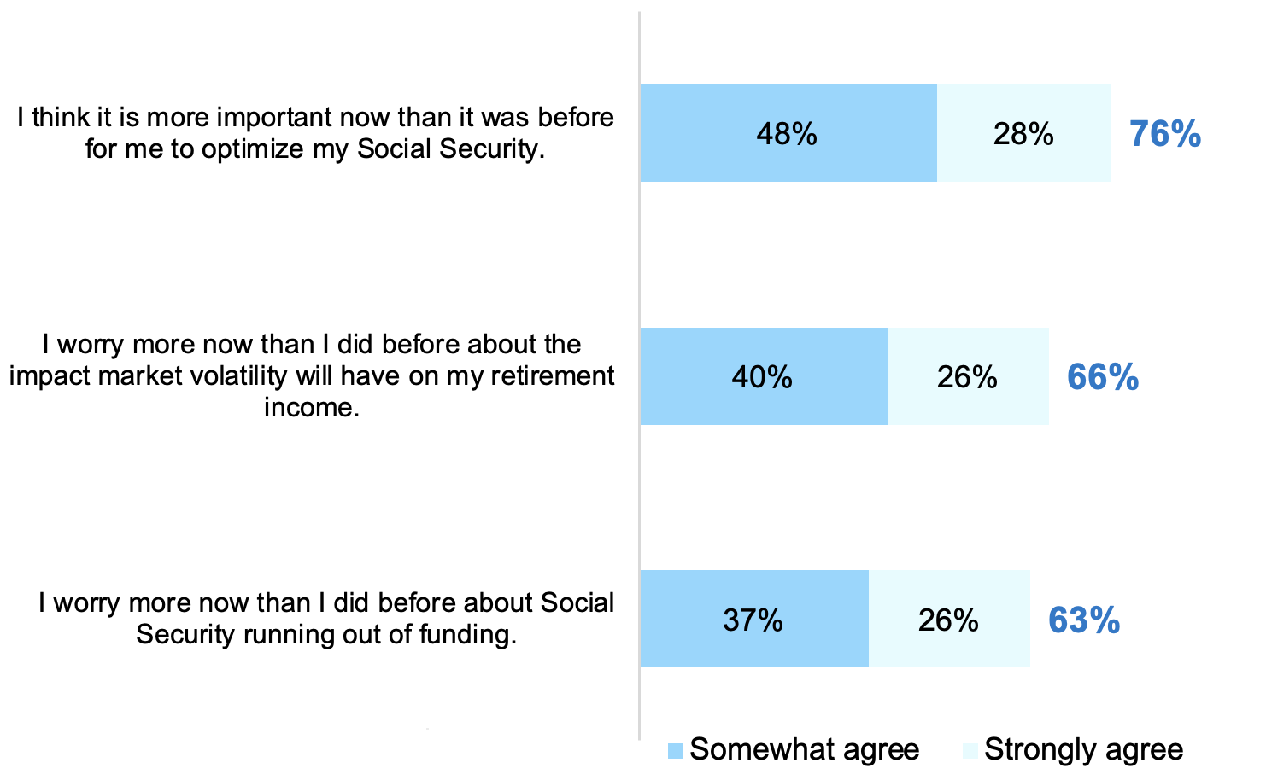
COVID Heightens Worries About SS Funding, Market Volatility Impact
Social Security and Retirement Planning Changes Due to COVID
Younger generations and women are more likely to agree with these statements about the impact of COVID-19
Agreement with Statements about COVID Impacts on Social Security and Retirement
Millennials and Gen Xers are more likely than Boomers+ to agree they worry more now than they did before about Social Security running out of funding or agree that they worry more now than they did before about the impact of market volatility will have on their retirement income
Women are more likely than men to agree with the statements
Compared to 2021, significantly more think it is more important now than it was before for them to optimize their Social Security (76% vs. 68% in 2021), worry more now than they did before about Social Security running out of funding (63% vs. 59% in 2021), or worry more now than they did before about the impact of market volatility will have on their retirement income (66% vs. 56% in 2021)
Notes:
BASE: ALL QUALIFIED RESPONDENTS (Total 2022 (n=1,853), Total 2021 (n=1,931); Millennials (n=674), Gen Xers (n=576), Boomers+ (n=603); Men (n=926), Women (n=912))
Q3NEW2021. To what extent do you agree or disagree with each of the following statements about how the COVID-19 pandemic has impacted your (plan for) retirement or could impact retirement for others?
Please see data tables for supporting data for subgroup call-outs

Slide 12
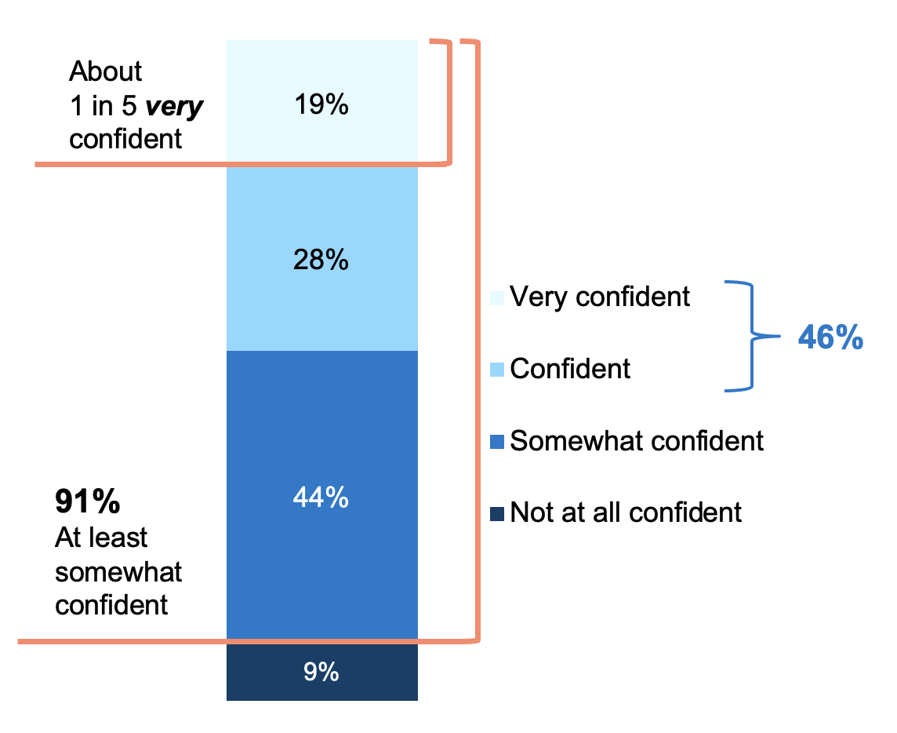
Strong Majority Are At Least Somewhat Confident in Their SS Knowledge
Social Security Knowledge and Misconceptions
Almost half are confident/very confident and only about 1 in 5 are very confident; Millennials and Gen Xers more likely to be very confident and Women are less likely to be very confident
Confidence in SS Knowledge
Millennials and Gen Xers are more likely than Boomers+ to be very confident
(28% and 20% vs. 13%)
Women are less likely than men to be very confident in their knowledge about SS
(13% vs. 24%)
Those who currently receive SS are more likely than those who don’t to be confident/very confident in their knowledge, but just a little more than half who currently receive SS are confident/very confident
(54% vs. 38%)
Notes:
BASE: ALL QUALIFIED RESPONDENTS (n=1,853; Millennials (n=674), Gen Xers (n=576), Boomers+ (n=603); Men (n=926), Women (n=912); Currently receives SS (n=827), Not currently receiving SS (n=1,026))
Q701. How confident are you in your knowledge about Social Security?

Slide 13
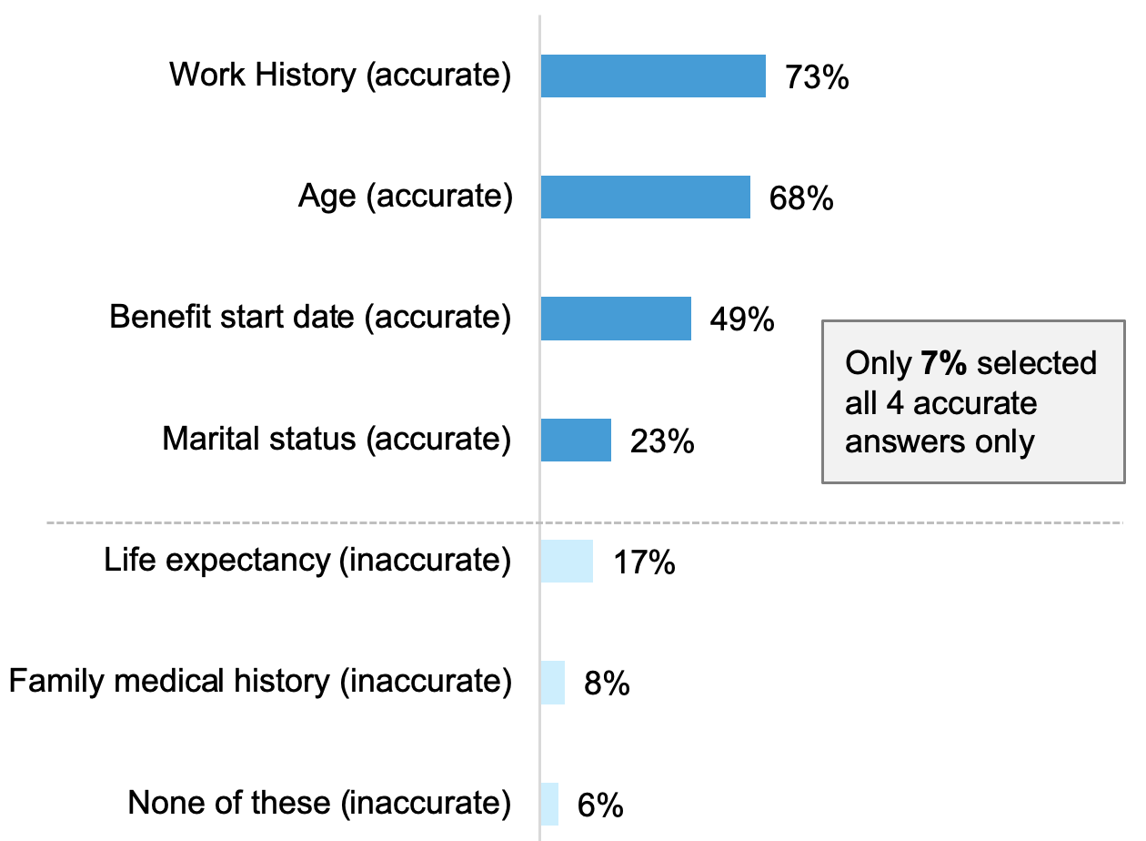
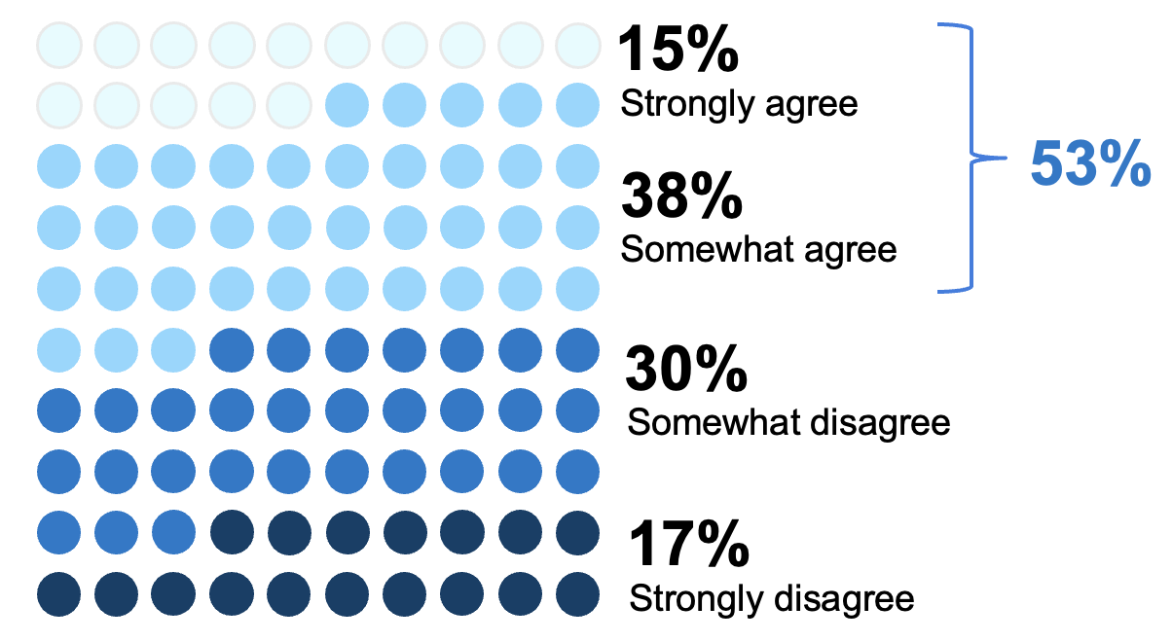
Factors that Determine Maximum SS Benefit Someone Can Receive
Social Security Knowledge and Misconceptions
A Little Over Half Agree They Know Exactly How To Maximize SS Benefits
Only 7% correctly identified all of the listed factors that determine the maximum SS benefit someone can receive; almost a fifth thought life expectancy is a factor
Agreement with Statement
I know exactly how to maximize my Social Security benefits
Women are less likely than men to agree
(47% vs. 59%)
Millennials are more likely than Gen Xers or Boomers+ to agree
(60% vs. 48% and 52%)
Notes:
BASE: ALL QUALIFIED RESPONDENTS (n=1,853; Millennials (n=674), Gen Xers (n=576), Boomers+ (n=603); Men (n=926), Women (n=912))
Q740_3. How much do you agree or disagree with the following statements?
Q742. What factors determine the maximum Social Security benefit an individual can receive?

Slide 14
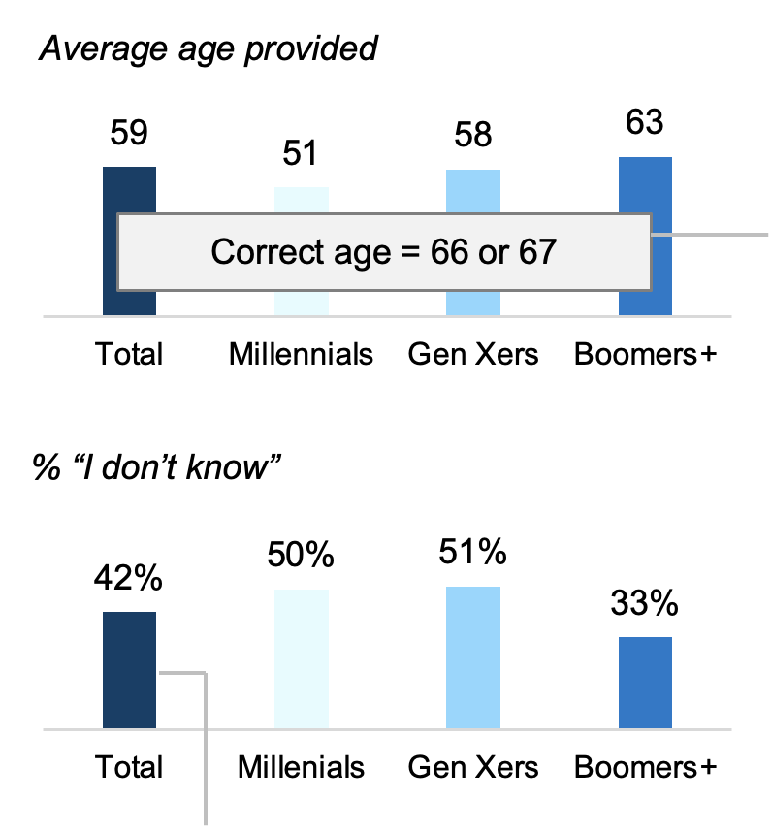
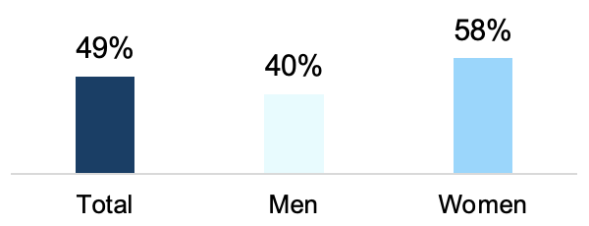
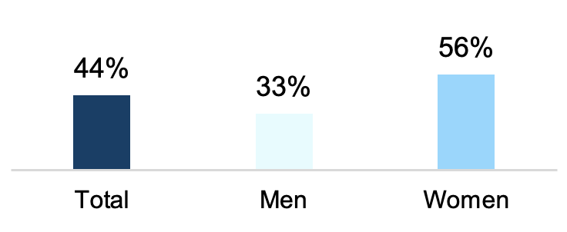
Many Are Not Sure About Basic SS FRA Or Payment Details
Social Security Knowledge and Misconceptions
Women are more likely to be unsure about FRA or payment details and Millennials and Gen Xers unsure of FRA for themselves
Age Believe You Are Eligible for Full Retirement Benefits
Percent of Income Is or Will be Replaced in Retirement by SS
% “Don’t know / Not sure”
Compared to 2021, fewer are not sure, but still almost half are not sure (49% vs. 54% in 2021)
Only 13% of adults correctly guess their FRA based on their year of birth
54% correctly answered that some of their benefits may be withheld if they’re still working before their full retirement age (FRA), between ages 66 and 67 depending on their year of birth
How Much Monthly SS Payment is Expected to Be
% “Not sure” among those not receiving SS
Women are more likely than men to not be sure
Compared to 2021, fewer are not sure, but still more than 2 in 5 (44% vs. 51% in 2021)
Women are more likely than men to say they don’t know (50% vs. 34%)
Notes:
BASE: ALL QUALIFIED RESPONDENTS (2022 (n=1,853), 2021 (n=1,931); Millennials (n=674), Gen Xers (n=576), Boomers+ (n=603); Men (n=926), Women (n=912))
Q7130. At what age are/were you eligible for full retirement benefits?
Age of Full Retirement (table 21)
Q735. Do you believe the following statements to be true or false?
BASE: ALL QUALIFIED RESPONDENTS (2022 (n=1,853), 2021 (n=1,931); Millennials (n=674), Gen Xers (n=576), Boomers+ (n=603); Men (n=926), Women (n=912))
Q5NEW2020. What percentage of your income [is / will be] replaced in retirement by Social Security?
BASE: NOT CURRENTLY RECEIVING SOCIAL SECURITY (2022 (n=1,026), 2021 (n=1,031); Men (n=471), Women (n=544))
Q720. What monthly payment are you expecting to receive from Social Security?

Slide 15
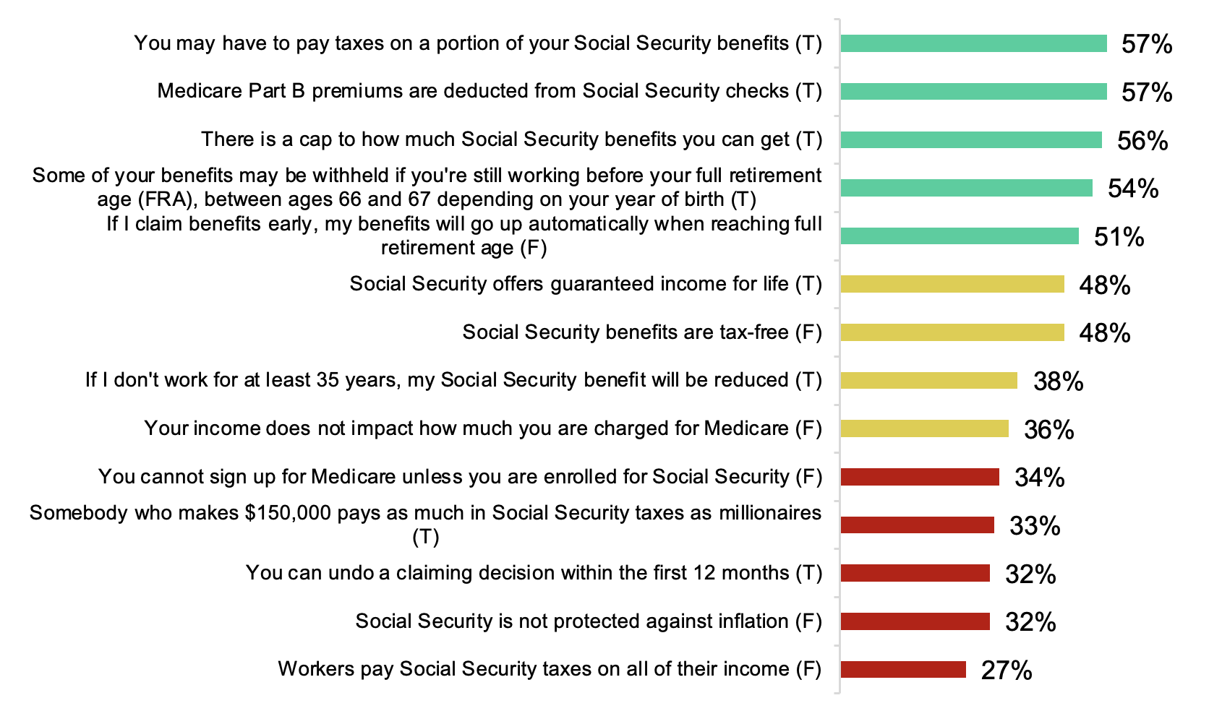
Large Knowledge Gaps Exist On General SS Topics
Social Security Knowledge and Misconceptions
Taxes, protection against inflation, and enrollment details have the lowest knowledge levels among the general SS topics tested
Knowledge Testing Specific Statements About General SS Topics
% correct
Higher knowledge topics (50%+)
Moderate knowledge topics (35%-49%)
Lowest knowledge topics (<35%)
In many cases, Boomers+ are more likely than Millennials and Gen Xers to provide the correct answer in the higher knowledge topics
Overall, those currently receiving SS are more likely than those who don’t to correctly answer the statements for the higher knowledge topics
Notes:
BASE: ALL QUALIFIED RESPONDENTS (n=1,853; Millennials (n=674), Gen Xers (n=576), Boomers+ (n=603); Men (n=926), Women (n=912); Currently receives SS (n=827), Not currently receiving SS (n=1,026))
Q735. Do you believe the following statements to be true or false?
Please see data tables for supporting data for subgroup call-outs

Slide 16
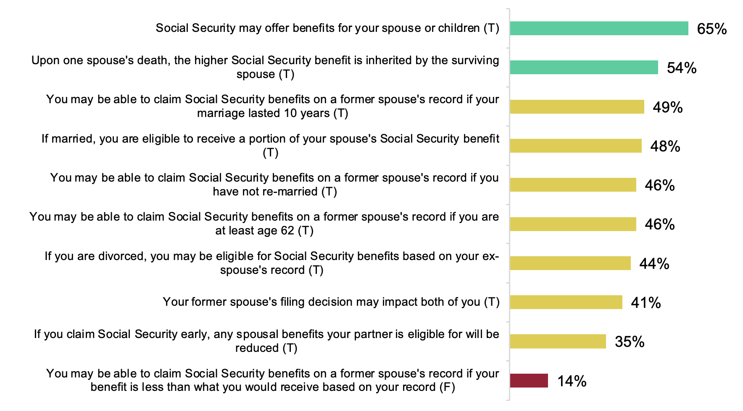
Spouse-related SS Topics Mostly Fall In The Moderate Knowledge Level
Social Security Knowledge and Misconceptions
More education is needed about the ability to claim SS benefits on a former spouse’s record if their benefit is less than what they would receive based on their own record
Knowledge Testing Specific Statements About Spouse-related SS Topics
% correct
Higher knowledge topics (50%+)
Moderate knowledge topics (35%-49%)
Lowest knowledge topics (<35%)
Boomers+ are more likely than Millennials and Gen Xers to provide the correct answer to these spouse-related statements
Those who currently receive SS are more likely than those who don’t to correctly answer the higher and moderate knowledge level spouse-related statement
Notes:
BASE: ALL QUALIFIED RESPONDENTS (n=1,853; Millennials (n=674), Gen Xers (n=576), Boomers+ (n=603); Men (n=926), Women (n=912); Currently receives SS (n=827), Not currently receiving SS (n=1,026))
Q735. Do you believe the following statements to be true or false?
Please see data tables for supporting data for subgroup call-outs

Slide 17
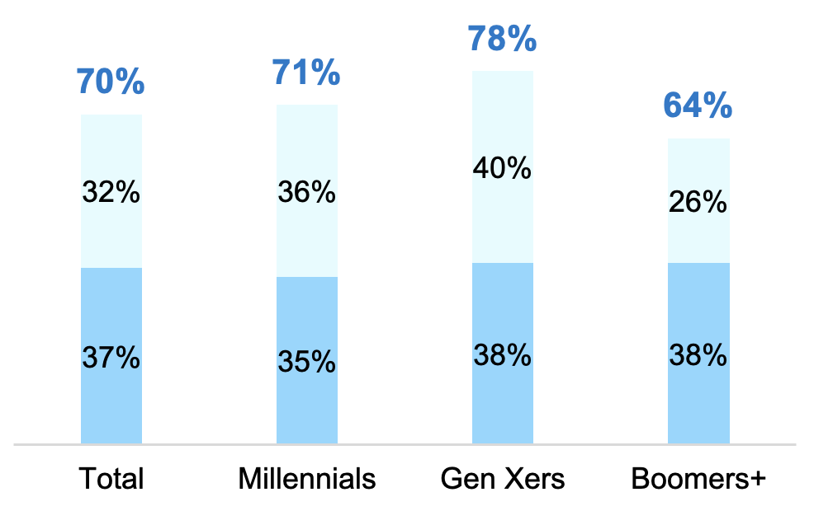
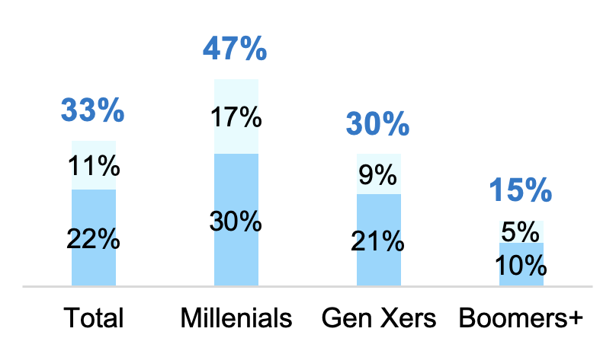
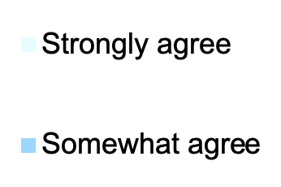
Majority Across Gens Worry SS Will Run Out Of Funding In Their Lifetime
Planning That Social Security Won’t Be There For Them
One in three adults age 26+ not currently receiving SS believe they won’t get a dime of SS benefits they’ve earned
Agreement with Statements
I worry about the Social Security program running out of funding in my lifetime
I will not get a dime of the Social Security benefits I have earned
(among those who aren’t getting SS but expect to in the future)
Women are more likely than men to agree
(74% vs. 65%)
While a majority of those who currently receive SS (64%) agree, they are less likely to agree than those who don’t currently receive SS (76%)
Notes:
BASE: ALL QUALIFIED RESPONDENTS (n=1,853; Millennials (n=674), Gen Xers (n=576), Boomers+ (n=603); Men (n=926), Women (n=912); Currently Receiving SS (n=827), Not Currently Receiving SS But Expect To In The Future (n=1,026))
Q740. How much do you agree or disagree with the following statements?
BASE: Aren’t getting SS but expect to in the future (n=1,026; Millennials (n=456), Gen Xers (n=447), Boomers+ (n=123))
Q740_8. How much do you agree or disagree with the following statements?

Slide 18
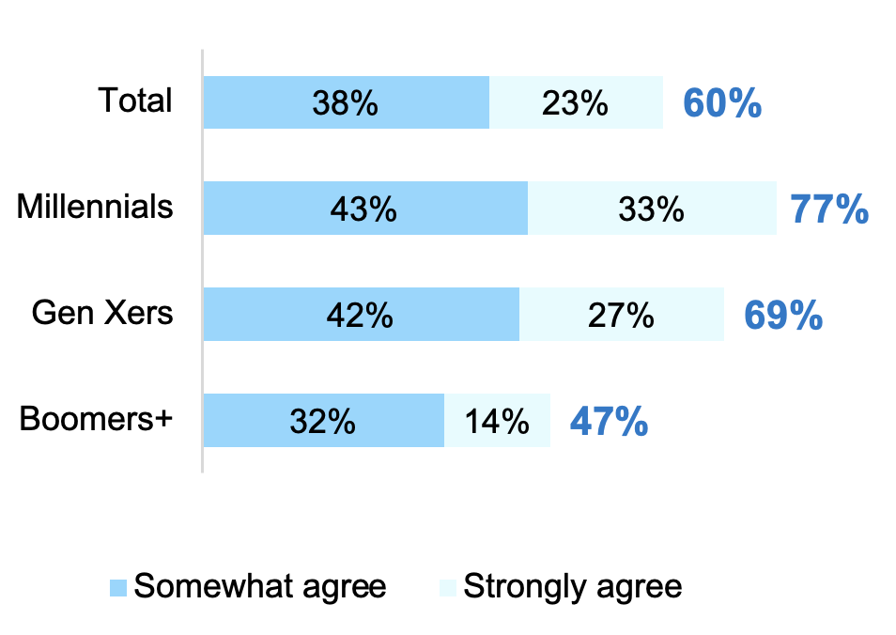
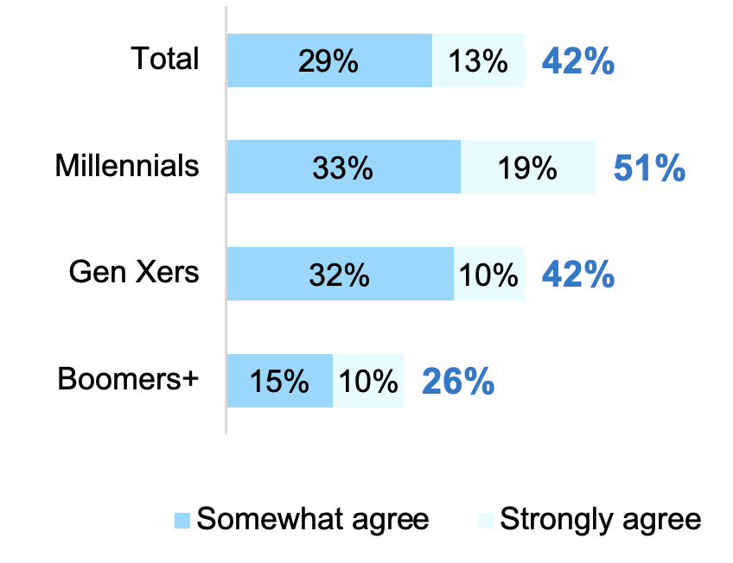
Many Plan To Work To Supplement SS, Especially Among Younger Gens
Planning That Social Security Won’t Be There For Them
Most believe they will need to continue working because Social Security won’t pay enough and even 2 in 5 of those not currently collecting SS plan to file for SS early, while continuing to work
Agreement with Statements
I need to continue working because Social Security won't pay enough
I plan on filing for Social Security benefits early, but continuing to work
(Among those who don’t currently collect SS)
Compared to 2021, significantly more agree
(60% vs. 53% in 2021)
Compared to the 2021, significantly more agree
(42% vs. 36% in 2021)
Women are more likely than men to agree
(64% vs. 57%)
Notes:
BASE: ALL QUALIFIED RESPONDENTS (Total 2022 (n=1,853), Total 2021 (n=1,931); Millennials (n=674), Gen Xers (n=576), Boomers+ (n=603); Men (n=926), Women (n=912))
Q740_13. How much do you agree or disagree with the following statements?
BASE: NOT CURRENTLY RECEIVING SS (Total 2022 (n=1,026), Total 2021 (n=1,031); Millennials (n=456), Gen Xers (n=447), Boomers+ (n=123))
Q740_12. How much do you agree or disagree with the following statements?

Slide 19
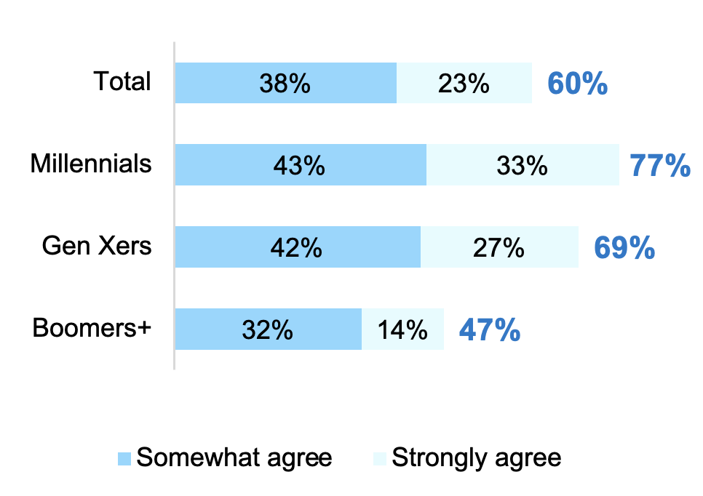
Many Plan To Work To Supplement SS, Especially Among Younger Gens
Planning That Social Security Won’t Be There For Them
Most believe they will need to continue working because SS won’t pay enough with significantly more who plan on this compared to 2021
Agreement with Statements
Compared to 2021, significantly more agree
(60% vs. 53% in 2021)
Women are more likely than men to agree
(64% vs. 57%)
I need to continue working because Social Security won't pay enough
Significantly more Boomers+ agree in 2022 compared to 2021
(47% vs. 36% in 2021)
Significantly more men agree in 2022 compared to 2021
(57% vs. 48% in 2021)
Significantly more of those who are working with a FP agree in 2022 compared to 2021
(59% vs. 50% in 2021)
Significantly more of those who are not working with an FP agree in 2022 compared to 2021
(61% vs. 55% in 2021)
Significantly more Millennials strongly agree in 2022 compared to 2021
(47% vs. 36% in 2021)
Significantly more Gen Xers strongly agree in 2022 compared to 2021
(27% vs. 21% in 2021)
Significantly more women strongly agree in 2022 compared to 2021
(24% vs. 17% in 2021)
Notes:
BASE: ALL QUALIFIED RESPONDENTS (Total 2022 (n=1,853), Total 2021 (n=1,931); Millennials (n=674), Gen Xers (n=576), Boomers+ (n=603); Men (n=926), Women (n=912))
Q740_13. How much do you agree or disagree with the following statements?

Slide 20
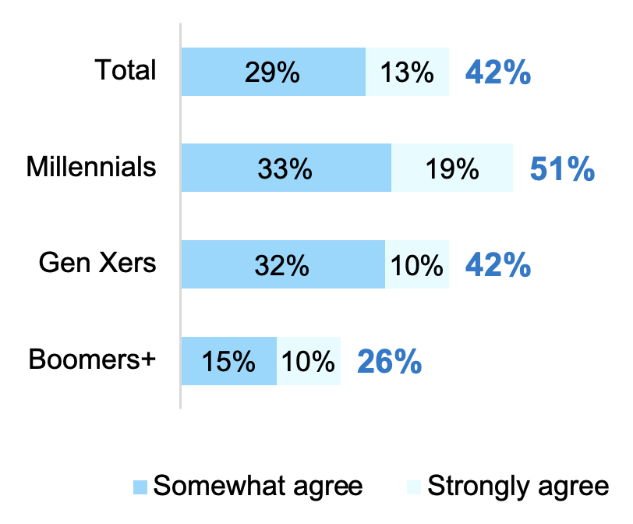
Some Plan To File For SS Benefits Early But Will Continue To Work
Planning That Social Security Won’t Be There For Them
Most believe they will need to continue working because SS won’t pay enough and even 2 in 5 of those not currently collecting SS plan to file for SS early but continue to work
Agreement with Statements
I plan on filing for Social Security benefits early, but continuing to work
(Among those who don’t currently collect SS)
Compared to the 2021, significantly more agree
(42% vs. 36% in 2021)
Significantly more women agree in 2022 compared to 2021
(42% vs. 34% in 2021)
Significantly more of those working with a FP agree in 2022 compared to 2021
(54% vs. 40% in 2021)
Notes:
BASE: NOT CURRENTLY RECEIVING SS (Total 2022 (n=1,026), Total 2021 (n=1,031); Millennials (n=456), Gen Xers (n=447), Boomers+ (n=123))
Q740_12. How much do you agree or disagree with the following statements?

Slide 21
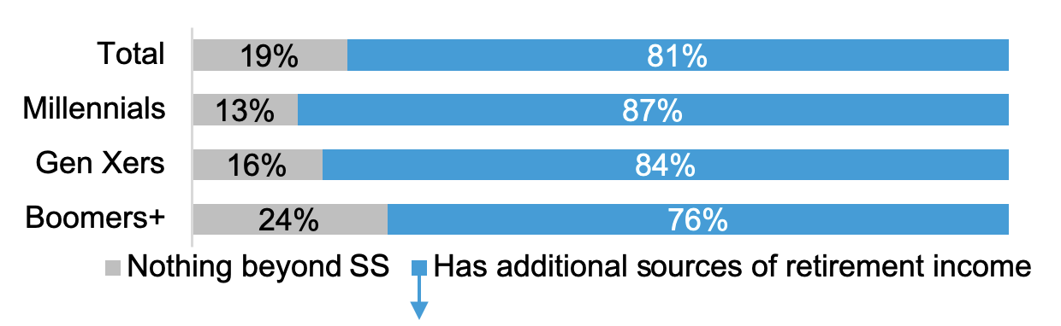
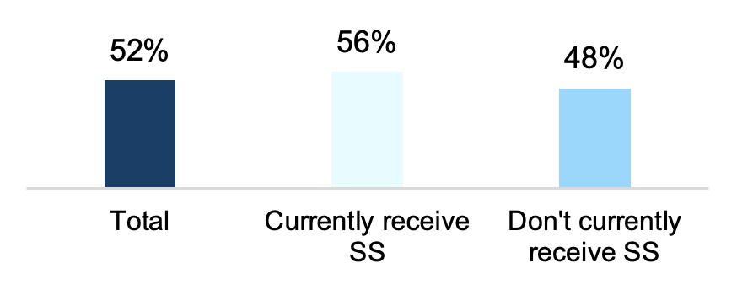
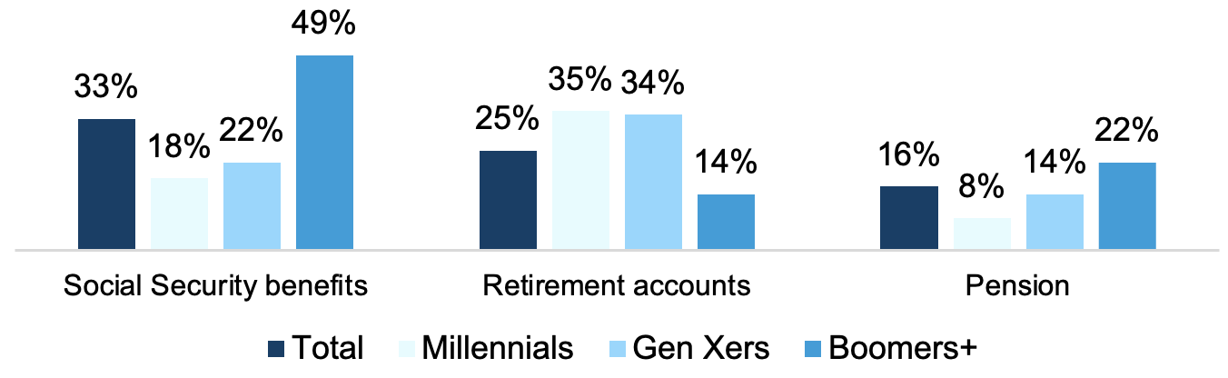
Younger Gens Plan On Other Income Sources To Supplement SS
Planning That Social Security Won’t Be There For Them
Adults age 26+ expect SS benefits cover/are to cover about half of living expenses although almost a fifth do not have a source of retirement income beyond SS
Sources of Retirement Income
Percent of Expenses [Expect] SS Benefits to Cover
Average
Primary Source of Retirement Income (TOP 3)
Among those who have additional sources of retirement income beyond SS
Notes:
BASE: ALL QUALIFIED RESPONDENTS (n=1,853; Currently receiving SS (n=827), Not currently receiving SS (n=1,026))
Q813. What percent of your expenses [do / do you expect] your Social Security benefits [to] cover?
BASE: ALL QUALIFIED RESPONDENTS (n=1,853; Millennials (n=674), Gen Xers (n=576), Boomers+ (n=603))
Q716. In addition to Social Security, [do you have / will you have] any of the following sources of retirement income? Please select all that apply.
Base: HAS SOURCES OF RETIREMENT INCOME IN ADDITION TO SOCIAL SECURITY (n=1,548; Millennials (n=595), Gen Xers (n=475), Boomers+ (n=478))
Q901. Which of the following [is / will be] your primary source of retirement income?

Slide 22
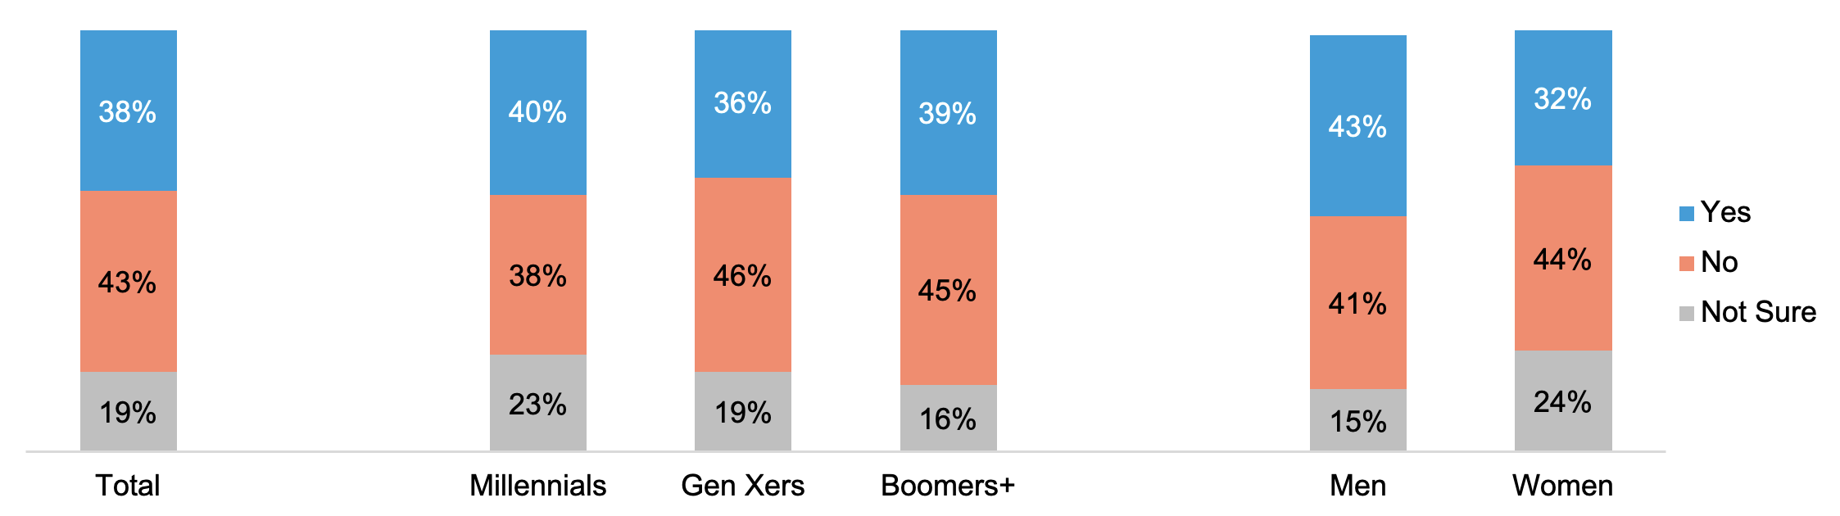
Some Plan On Drawing SS Before FRA
Planning That Social Security Won’t Be There For Them
Almost two in five adults age 26+ not currently receiving SS plan on drawing SS before their full retirement age. Women were significantly less likely to plan on drawing SS before their FRA
Drawing SS Before Full Retirement Age
(among those who aren’t getting SS but expect to in the future)
Women are less likely than men to plan on drawing before reaching FRA
(32% vs. 43%)
Notes:
BASE: Aren’t getting SS but expect to in the future (n=1,026; Millennials (n=456), Gen Xers (n=447), Boomers+ (n=123) ; Men (n=471), Women (n=544))
Q713. Do you plan to draw Social Security benefits before you reach full retirement age? Full retirement age is between age 66 and 67, depending on your year of birth.

Slide 23
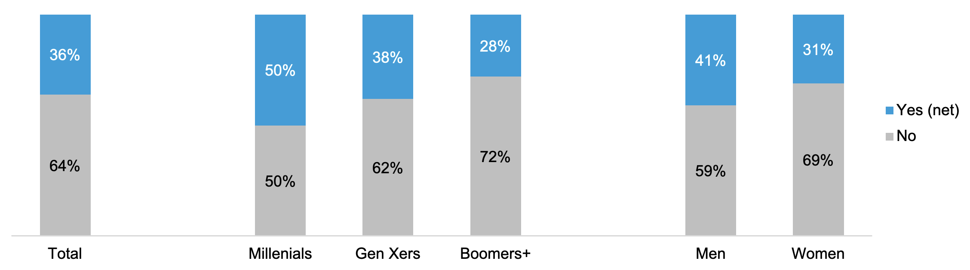
A Little Over One-Third Work with a Financial Professional
Learning More Through Financial Professionals
Younger generations are more likely to work with one, while women are less likely to work with one
Currently Working with a Financial Professional
Millennials are more likely than in 2021 to report they work with a financial professional (50% vs. 42% in 2021)
Women are more likely than men to not be working with a financial professional
(69% vs. 59%)
Notes:
BASE: ALL QUALIFIED RESPONDENTS ((Total 2022 (n=1,372), Total 2021 (n=1,389); Millennials (n=667), Gen Xers (n=525), Boomers+ (n=180); Men (n=926), Women (n=912))
Q800. Do you currently work with a financial professional (e.g., Certified Financial Planner (CFP), broker, financial advisor working at an insurance agency, etc.)?

Slide 24
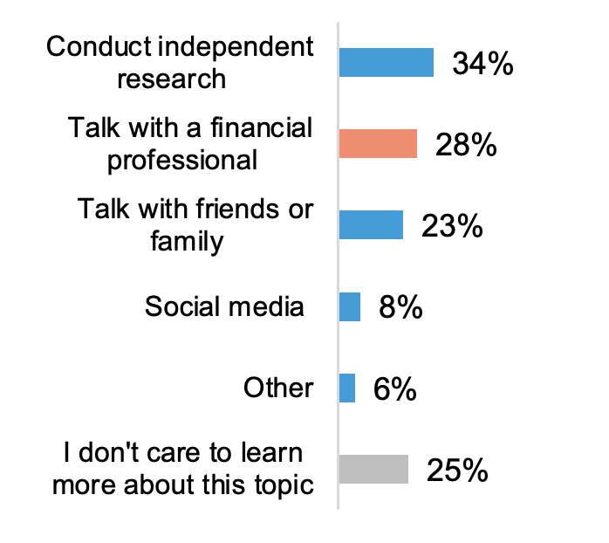
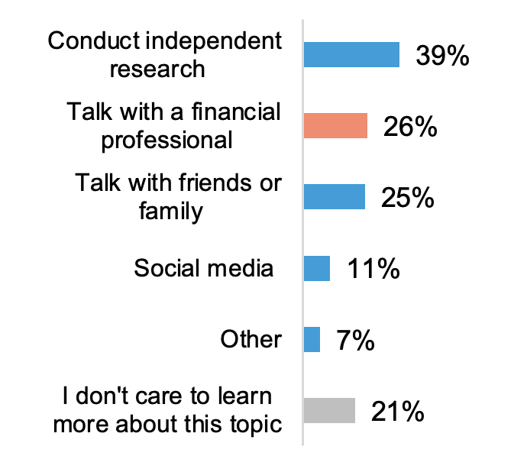
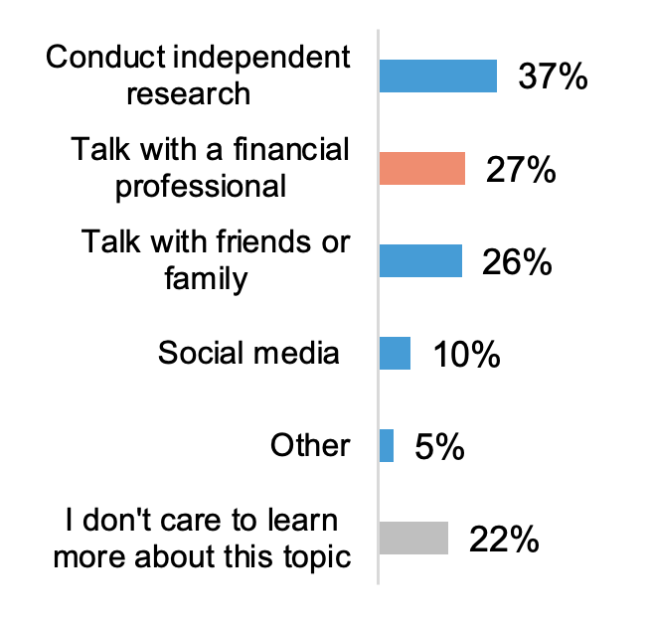
Some Turn To Financial Professionals To Learn About Inflation-related Topics
Learning More Through Financial Professionals
At least a fifth of those age 26+ do care to learn more about each of these inflation-related topics
Who They Turn To To Learn More About:
Impact Of Inflation On Planning for SS Benefits
Learn More About Inflation In General
Managing Inflation/Higher Costs In Retirement
Millennials and Gen Xers are more likely than Boomers+ to talk to a financial professional about these three inflation-related topics
Women are less likely than men to talk to a financial professional about these three inflation-related topics
Notes:
BASE: ALL QUALIFIED RESPONDENTS (n=1,853; Millennials (n=674), Gen Xers (n=576), Boomers+ (n=603); Men (n=926), Women (n=912))
Q7NEW2022. Who do you turn to to learn more about the following? Please select all that apply per topic.
Please see data tables for supporting data for subgroup call-outs

Slide 25
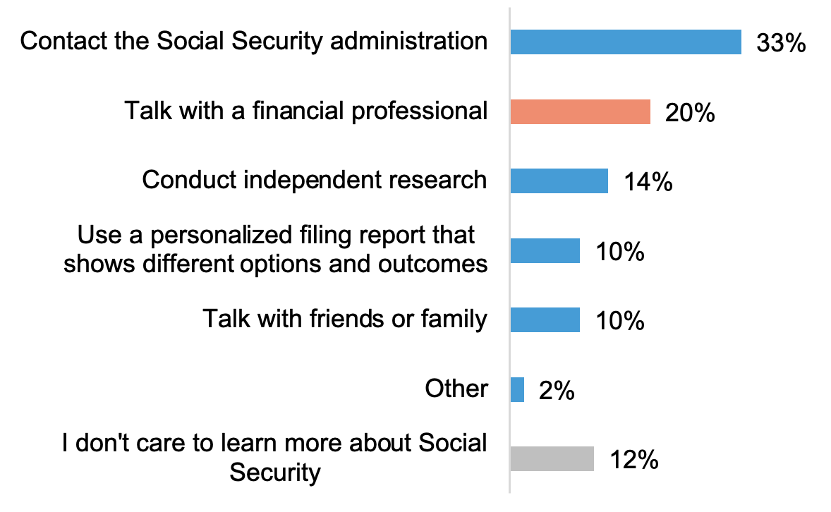
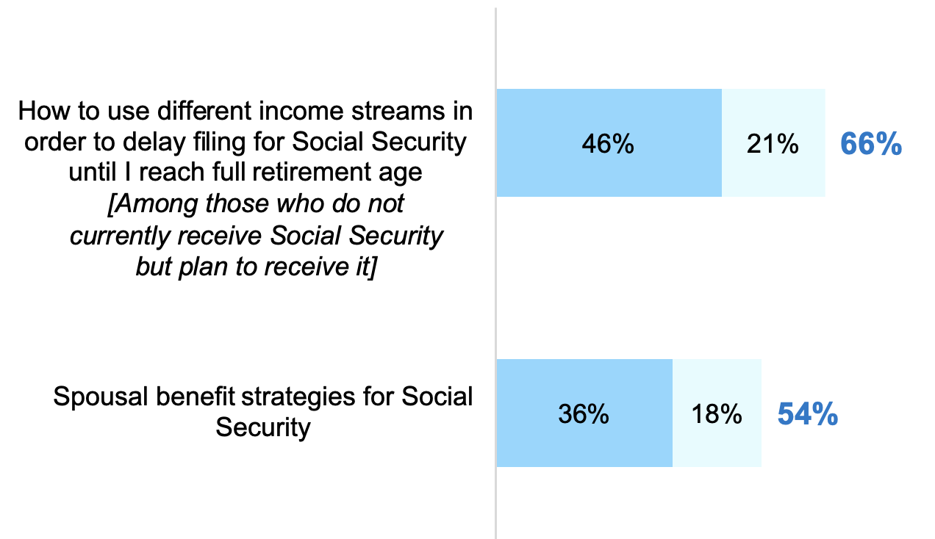
A Fifth Would Turn To A Financial Professional (FP) To Learn More About SS
Learning More Through Financial Professionals
Two-thirds not yet collecting SS are interested in talking with an FP how to use different income streams to delay filing until they reach full retirement plan; more than half of adults age 26+ are interested in discussing spousal benefits strategies for SS with an FP
How They Prefer to Learn More About SS
Interest in Talking to a
Financial Professional About…
Millennials and Gen Xers are more likely than Boomers+ to say they prefer to learn more about Social Security from a financial professional
(30%, 26% vs. 12%)
Millennials and Gen Xers are more likely than Boomers+ to be interested in talking to a FP about either of these two topics
(75%, 66% vs. 52%; and 77%, 62% vs. 37%, respectively)gen
Notes:
BASE: ALL QUALIFIED RESPONDENTS (2022 (n=1,853), 2021 (n=1,931); Millennials (n=674), Gen Xers (n=576), Boomers+ (n=603); Men (n=926), Women (n=912))
NEWQ1025A. How would you prefer to learn more about Social Security? Please select only one response.
Q5NEW2021. How interested are you in the following?
BASE: NOT CURRENTLY RECEIVING SS (n=1,026; Millennials (n=456), Gen Xers (n=447), Boomers+ (n=123))
Q5NEW2021. How interested are you in the following?

Slide 26
Disclaimers
This material is not a recommendation to buy or sell a financial product or to adopt an investment strategy. Investors should discuss their specific situation with their financial professional.
Nationwide and Harris Poll are separate and non-affiliated companies.
Nationwide Investment Services Corporation (NISC), member FINRA, Columbus, OH. Nationwide Retirement Institute is a division of NISC.
Nationwide, the Nationwide N and Eagle, and Nationwide Retirement Institute are service marks of Nationwide Mutual Insurance Company © 2023 Nationwide

Slide 27
Access more Social Security insights at http://nationwide.com/SocialSecurity
NFM-20936AO.3 (06/23)

