Slide 1

The Nationwide Retirement Institute®
2026 Long-term Care Survey
June 2026

Slide 2
Method Statement & Sampling Precision/Error
INTRODUCTION
Method Statement (to be included in all press materials):
The research was conducted online in the United States by The Harris Poll on behalf of Nationwide among 1,208 adults aged 30+ who were the primary or shared financial decision-makers for their household. Respondents also had a household income of $75K+. The survey was conducted April 11-29, 2026.
Data are weighted where necessary by age, gender, race/ethnicity, region, education, marital status, household size, household income, and political party affiliation to bring them in line with their actual proportions in the population.
Respondents for this survey were selected from among those who have agreed to participate in our surveys. The sampling precision of Harris online polls is measured by using a Bayesian credible interval. For this study, the sample data is accurate to within ± 3.9 percentage points using a 95% confidence level. This credible interval will be wider among subsets of the surveyed population of interest.
All sample surveys and polls, whether or not they use probability sampling, are subject to other multiple sources of error which are most often not possible to quantify or estimate, including, but not limited to coverage error, error associated with nonresponse, error associated with question wording and response options, and post-survey

Slide 3
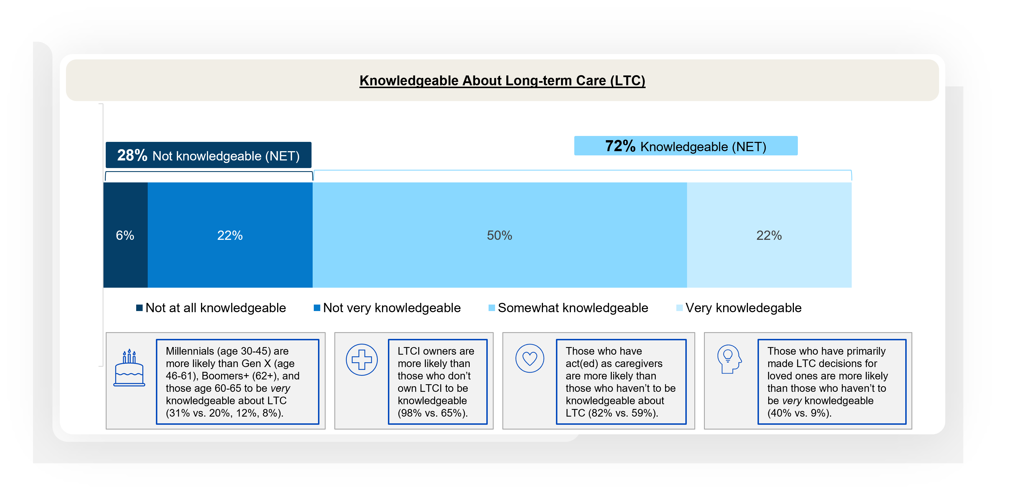
A majority of Americans age 30+ feel knowledgeable about LTC, including over a fifth who say they are very knowledegable
General Knowledge, Actions, Plans for Long-term Care
Notes:
BASE: ALL QUALIFIED RESPONDENTS (n=1208)
Q2026A25 How knowledgeable about long-term care would you say you are?

Slide 4
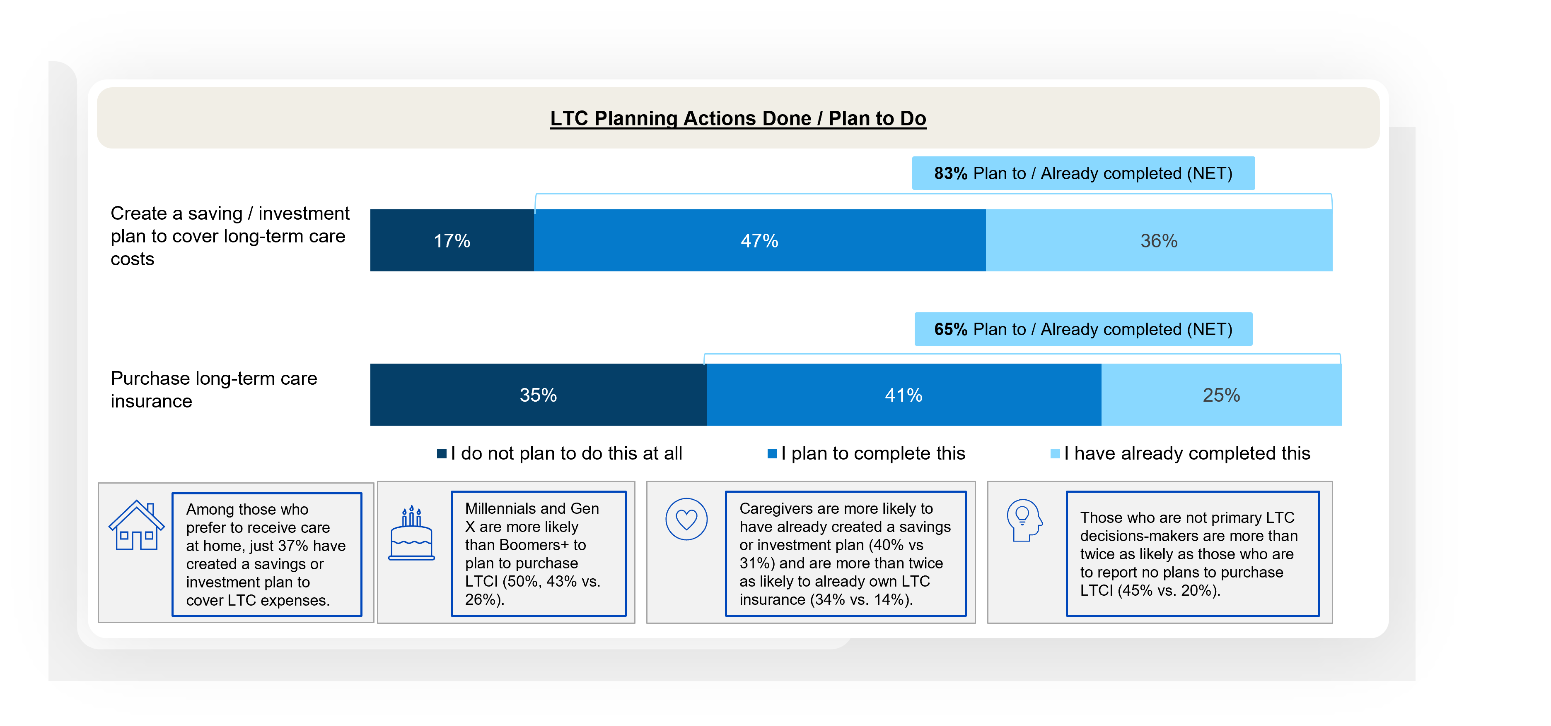
Over 4 in 5 say they have either created a saving / investment plan to cover LTC costs or plan to do so in the future
General Knowledge, Actions, Plans for Long-term Care
Notes:
BASE: ALL QUALIFIED RESPONDENTS (n=1208)
Q600 Which of the following actions have you done or do you plan to do for your long-term care?
1. Purchase long-term care insurance
3. Create a saving/investment plan to cover long-term care costs

Slide 5
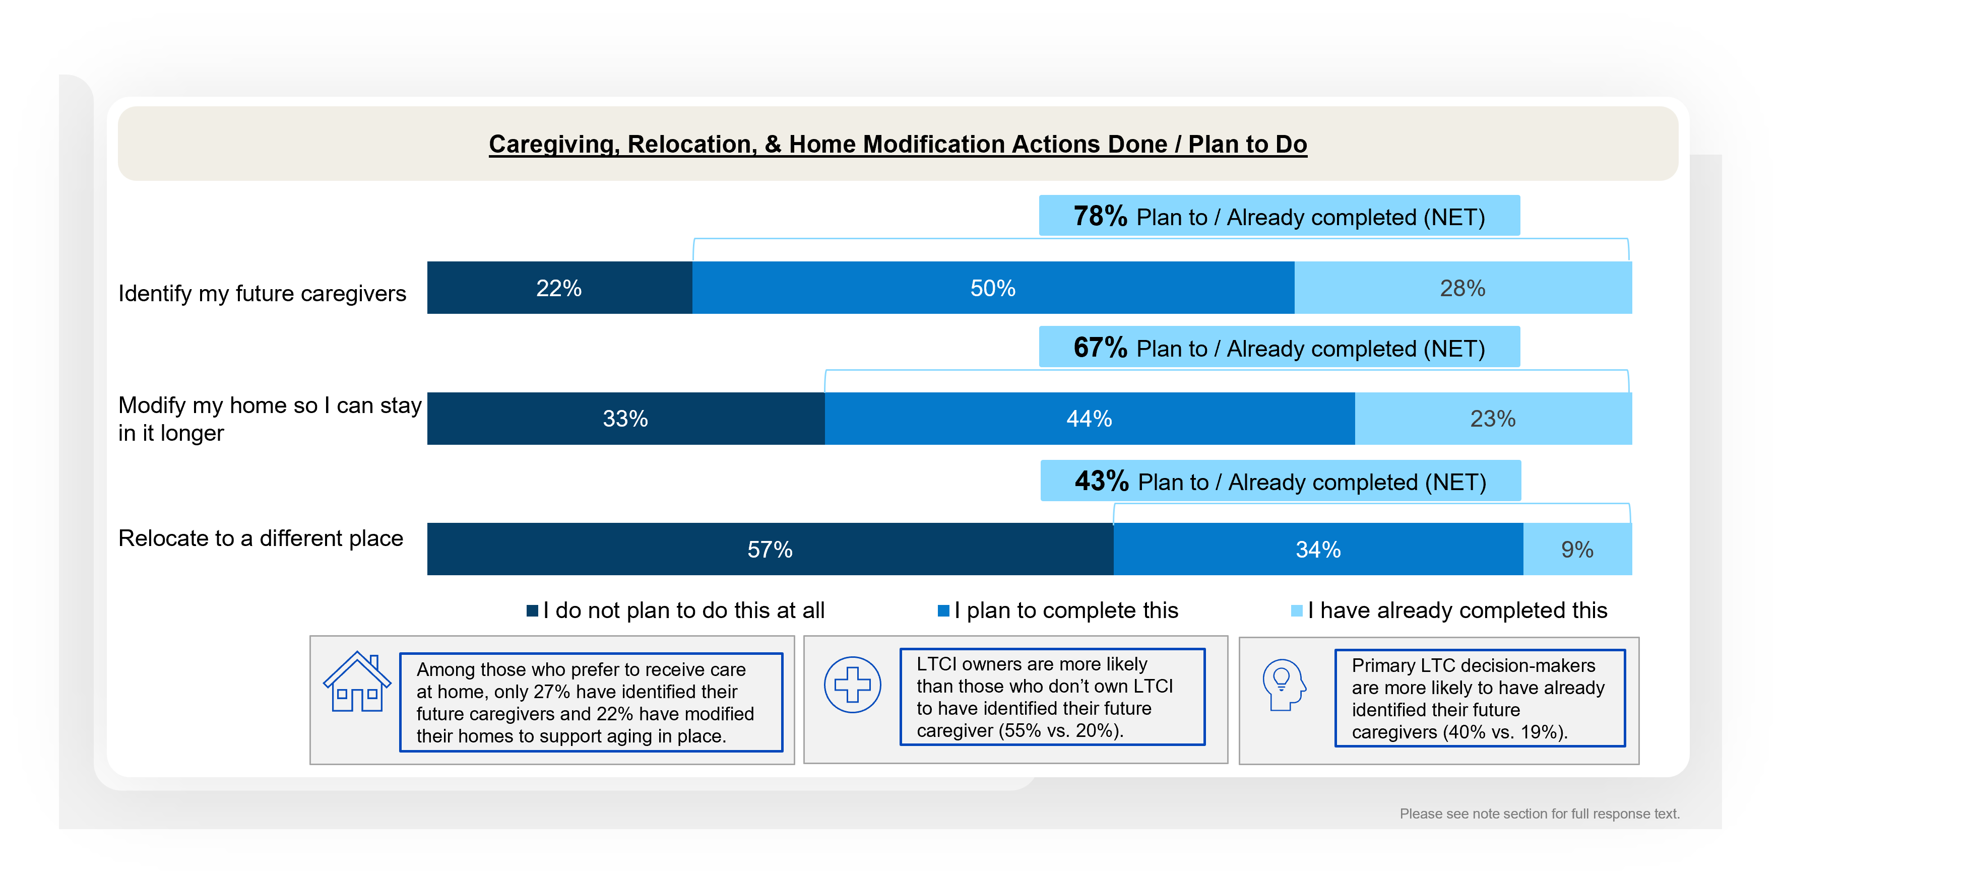
Over three quarters have already or plan to identify their future caregivers
Personal Caregiving Experiences
Notes:
BASE: ALL QUALIFIED RESPONDENTS (n=1208)
Q600 Which of the following actions have you done or do you plan to do for your long-term care?
2. Identify my future caregivers (e.g., family, friends, professionals)
10. Relocate to a different place (e.g., my child’s home, a different state, closer to a hospital/doctor’s office(s))
11. Modify my home so I can stay in it longer

Slide 6
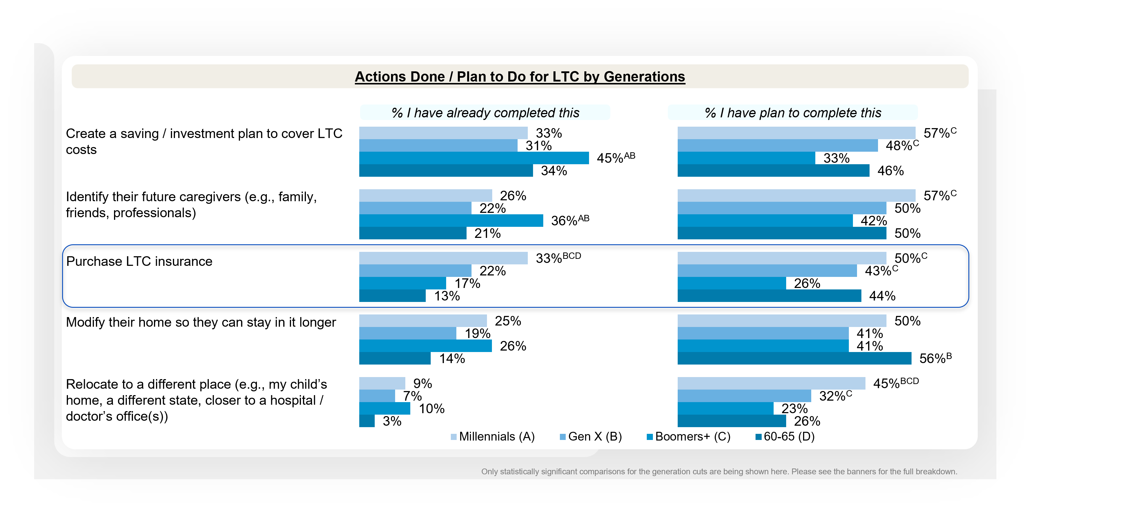
Millennials are more likely than Boomers+ to have purchased LTCI or plan to do so in the future
General Knowledge, Actions, Plans for Long-term Care
Notes:
BASE: ALL QUALIFIED RESPONDENTS (MILLENNIALS (n=401); GEN X (n=404); BOOMERS+ (n=403); Age 60-65 (n=120))
Q600 Which of the following actions have you done or do you plan to do for your long-term care?

Slide 7
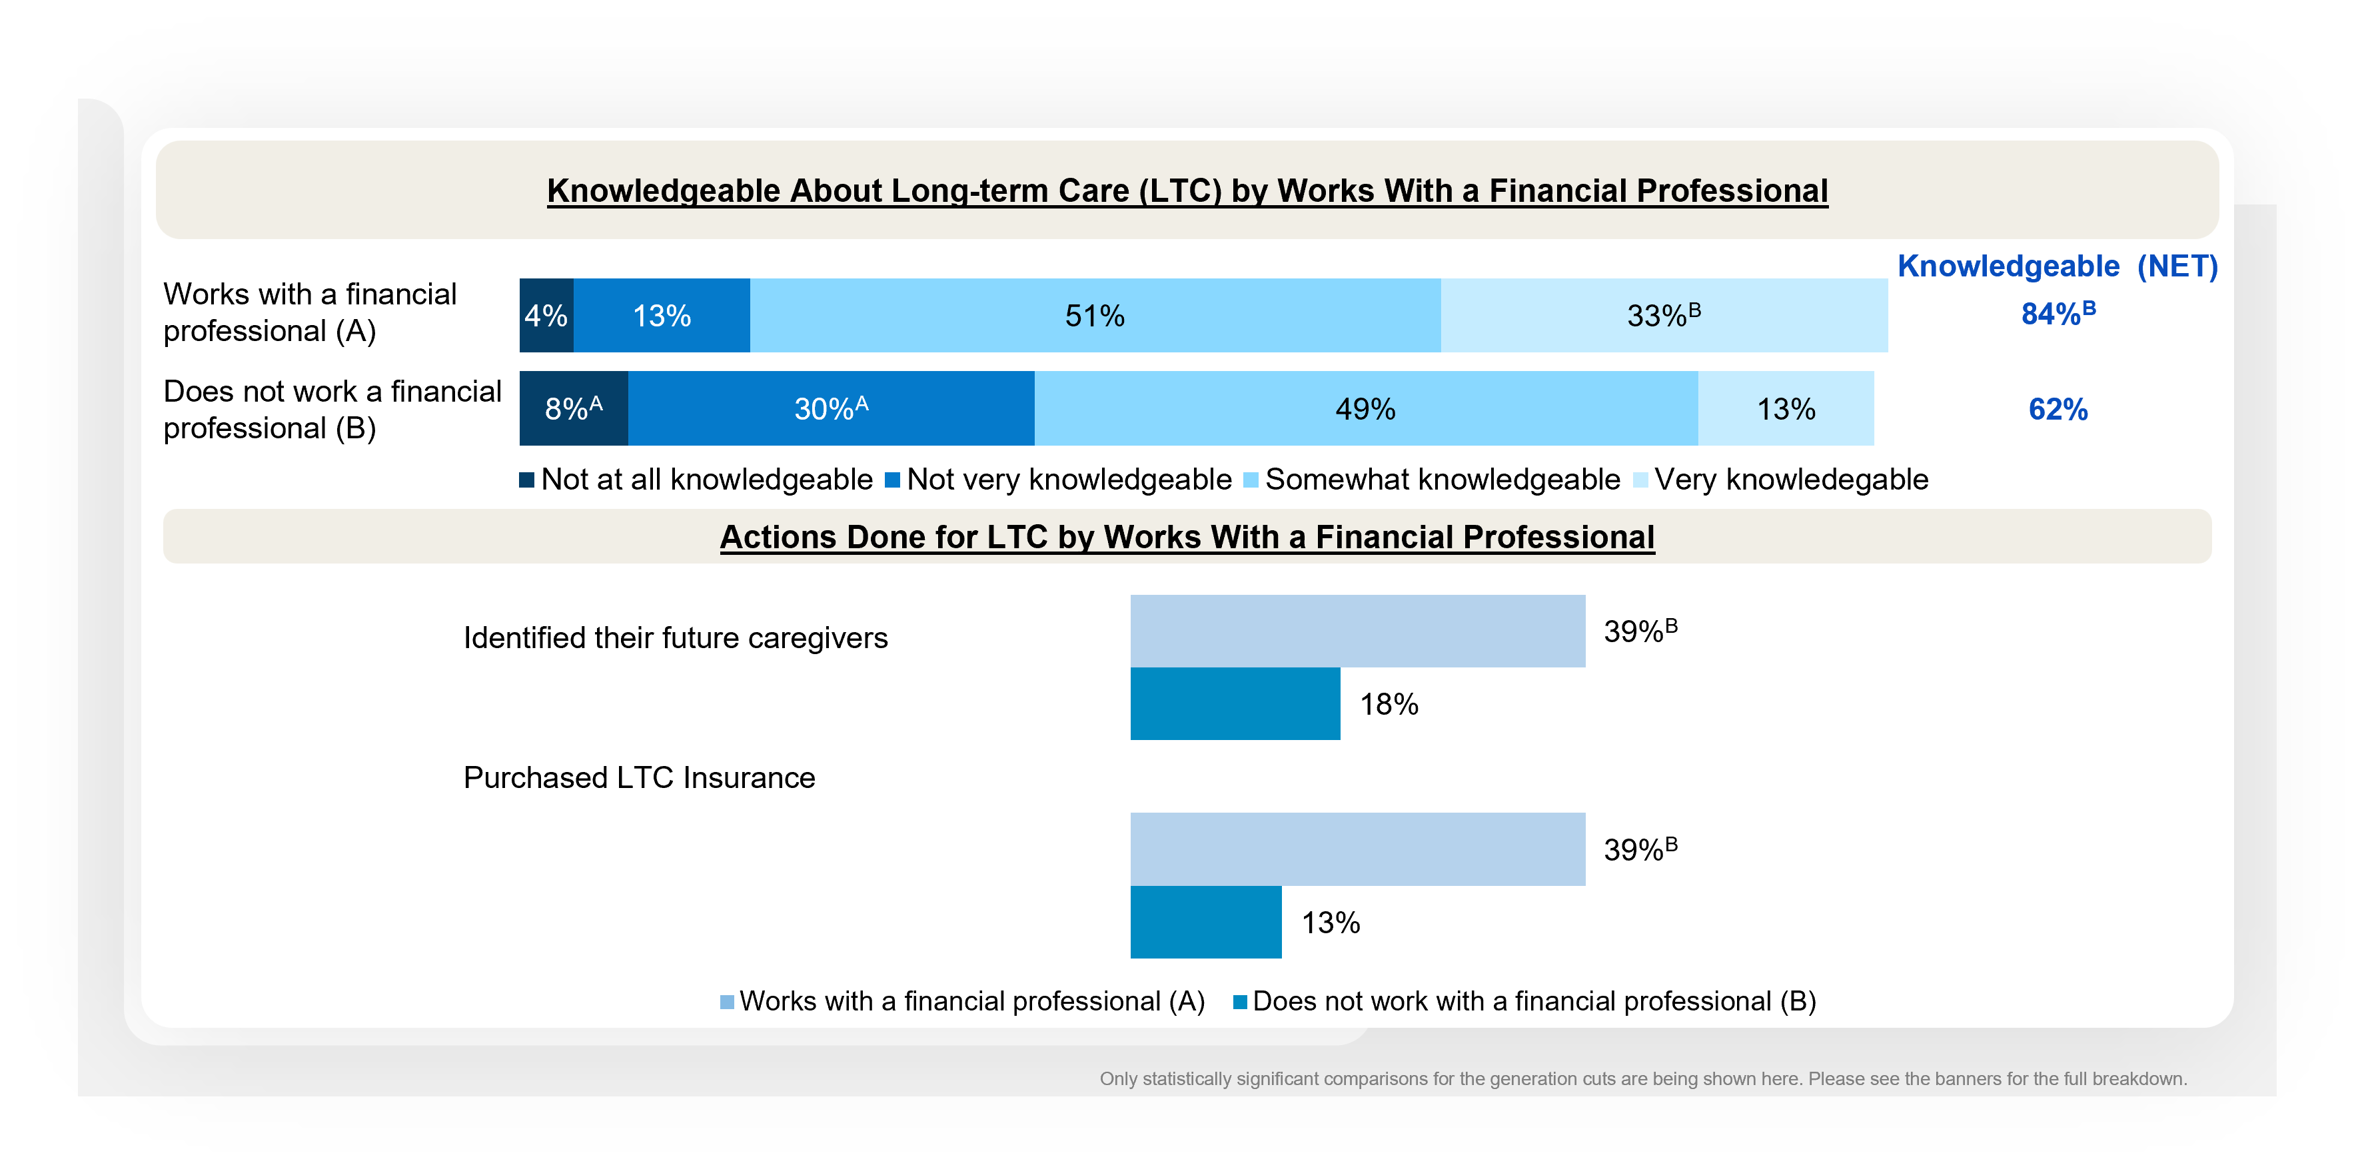
Those who work with a financial professional are more knowledgeable about and prepared for LTC
Long-term Care for Loved Ones
Notes:
BASE: ALL QUALIFIED RESPONDENTS (n=1208); WORKS WITH FP (n=540); DOES NOT WORK WITH FP (n=668))
Q2026A25 How knowledgeable about long-term care would you say you are?
Q600 Which of the following actions have you done or do you plan to do for your long-term care?

Slide 8
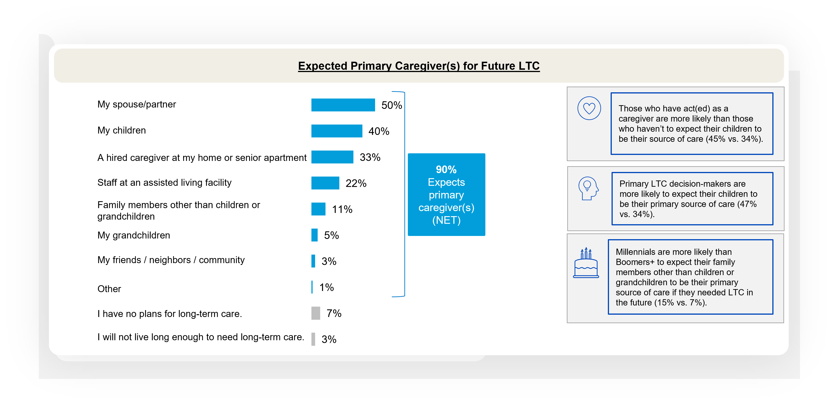
Partners and children top the list of expected primary caregiver(s)
General Knowledge, Actions, Plans for Long-term Care
Notes:
BASE: ALL QUALIFIED RESPONDENTS (n=1208)
Q605 If you were to need long-term care in the future, who do you expect to be your primary source of care? Please select all that apply.

Slide 9
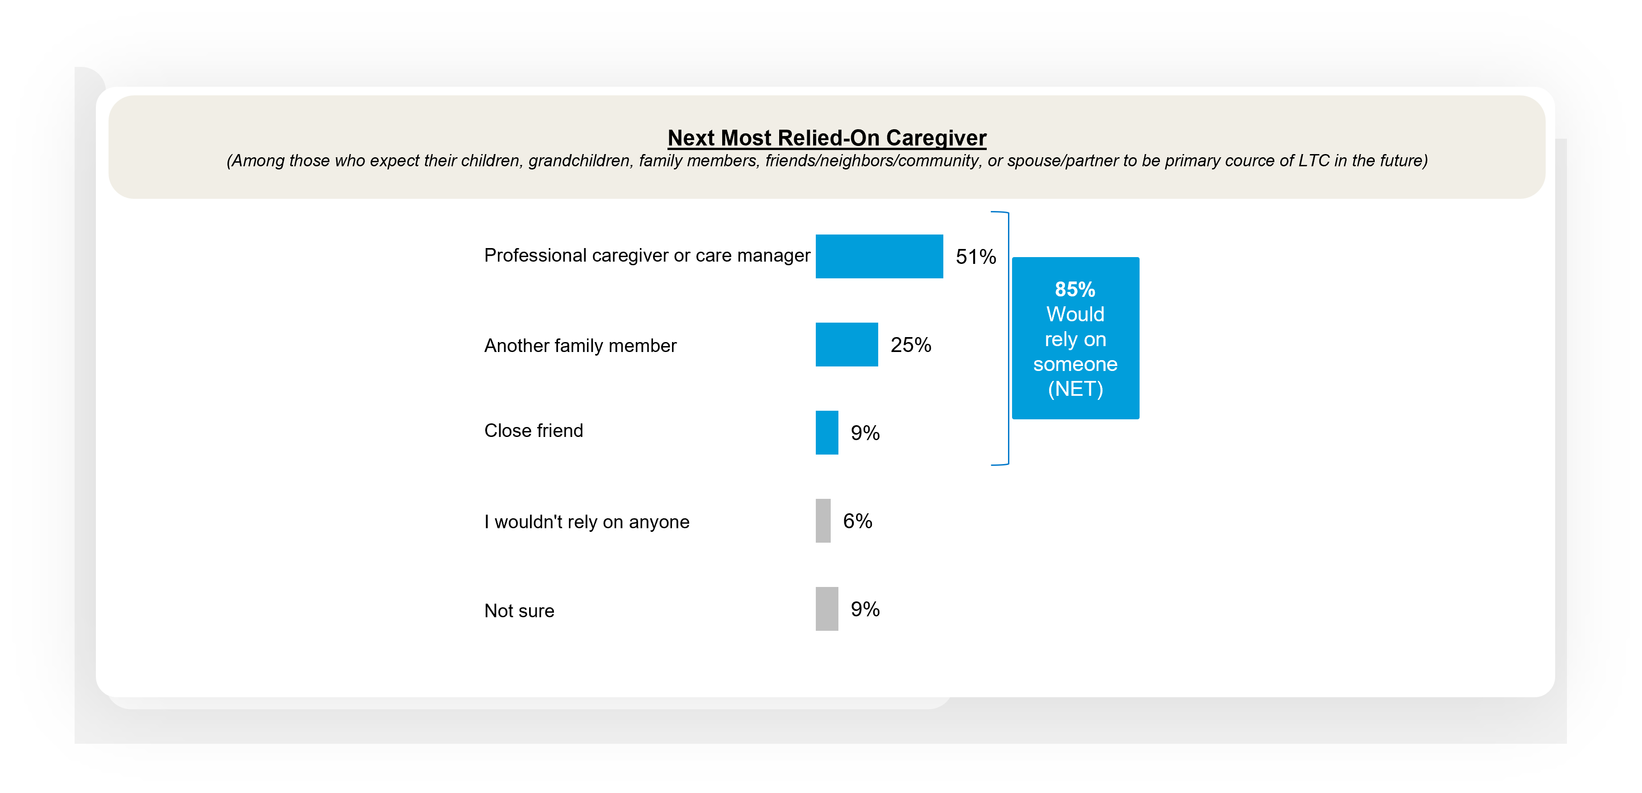
Half would rely on professional caregiver or care managers most if their loved one could not be a primary source of LTC in the future
General Knowledge, Actions, Plans for Long-term Care
Notes:
BASE: EXPECT THEIR CHILDREN, GRANDCHILDREN, FAMILY MEMBERS, FRIENDS/NEIGHBORS/COMMUNITY, SPOUSE/PARTNER TO BE PRIMARY SOURCE OF LTC IN THE FUTURE (n=836)
Q2026A1. If that person/those people were not able to care for you, who would you next rely on the most? Please select one.

Slide 10
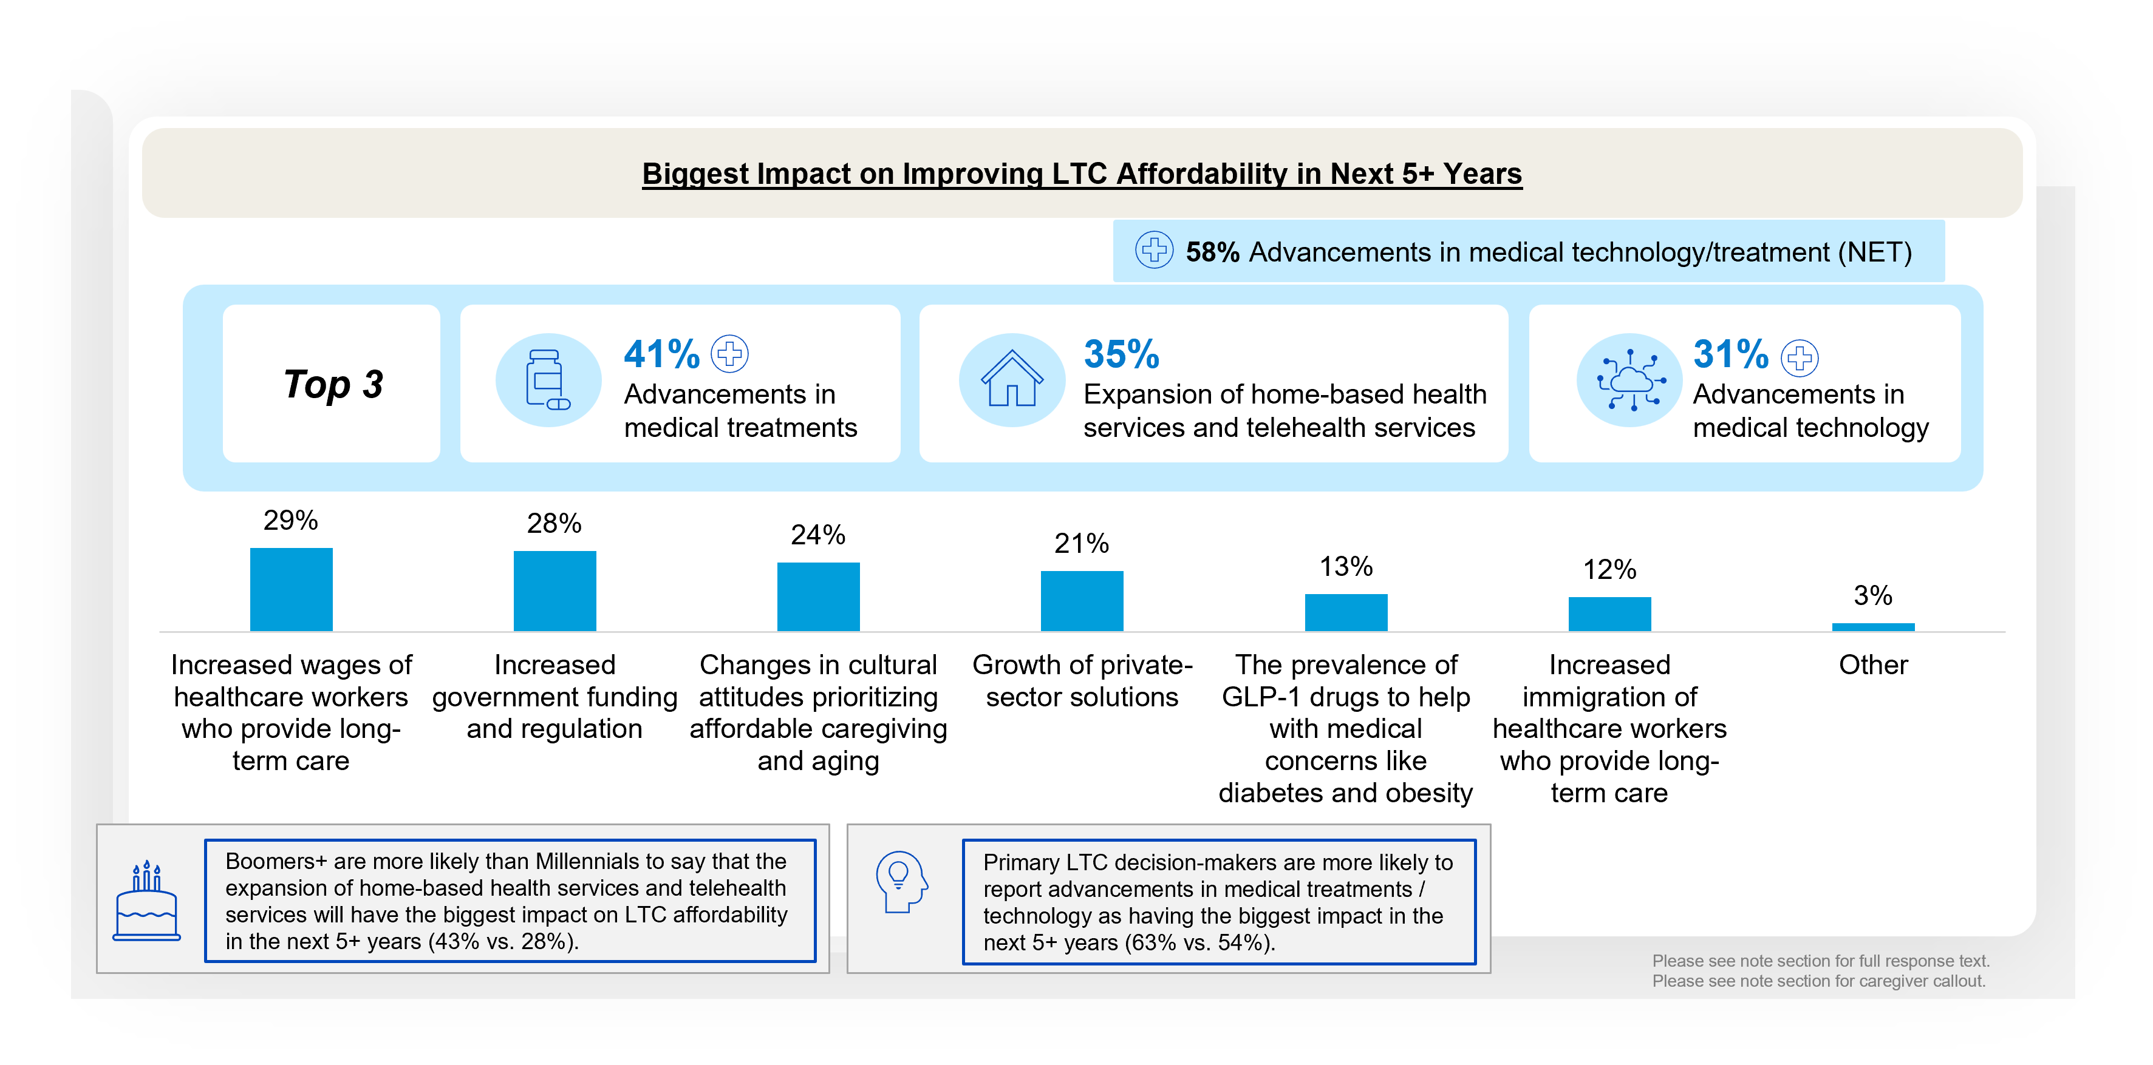
Innovation and home care are seen as the future of affordable LTC in the next 5+ years
Long-term Care Concerns and Beliefs
Notes:
BASE: ALL QUALIFIED RESPONDENTS (n=1208)
Q2026A28 Which of the following do you think will have the biggest impact on improving long-term care affordability in the next 5+ years? Please select up to three.
1. Advancements in medical technology (e.g., artificial intelligence (AI), robotics)
2. Advancements in medical treatments (e.g., Alzheimer's/Dementia treatment, cancer treatment)
3. Expansion of home-based health services and telehealth services
4. Increased government funding and regulation
5. Growth of private-sector solutions (e.g., private insurance, senior living communities)
6. Changes in cultural attitudes prioritizing affordable caregiving and aging
7. Increased immigration of healthcare workers who provide long-term care
8. Increased wages of healthcare workers who provide long-term care
9. The prevalence of GLP-1 drugs to help with medical concerns like diabetes and obesity
Other
####
Subgroup callout:
Those who have act(ed) as a caregiver are more likely than those who have not to report that increased wages of workers who provide long-term care will have the greatest impact on improving long-term care affordability in the next 5+ years (34% vs. 22%).

Slide 11
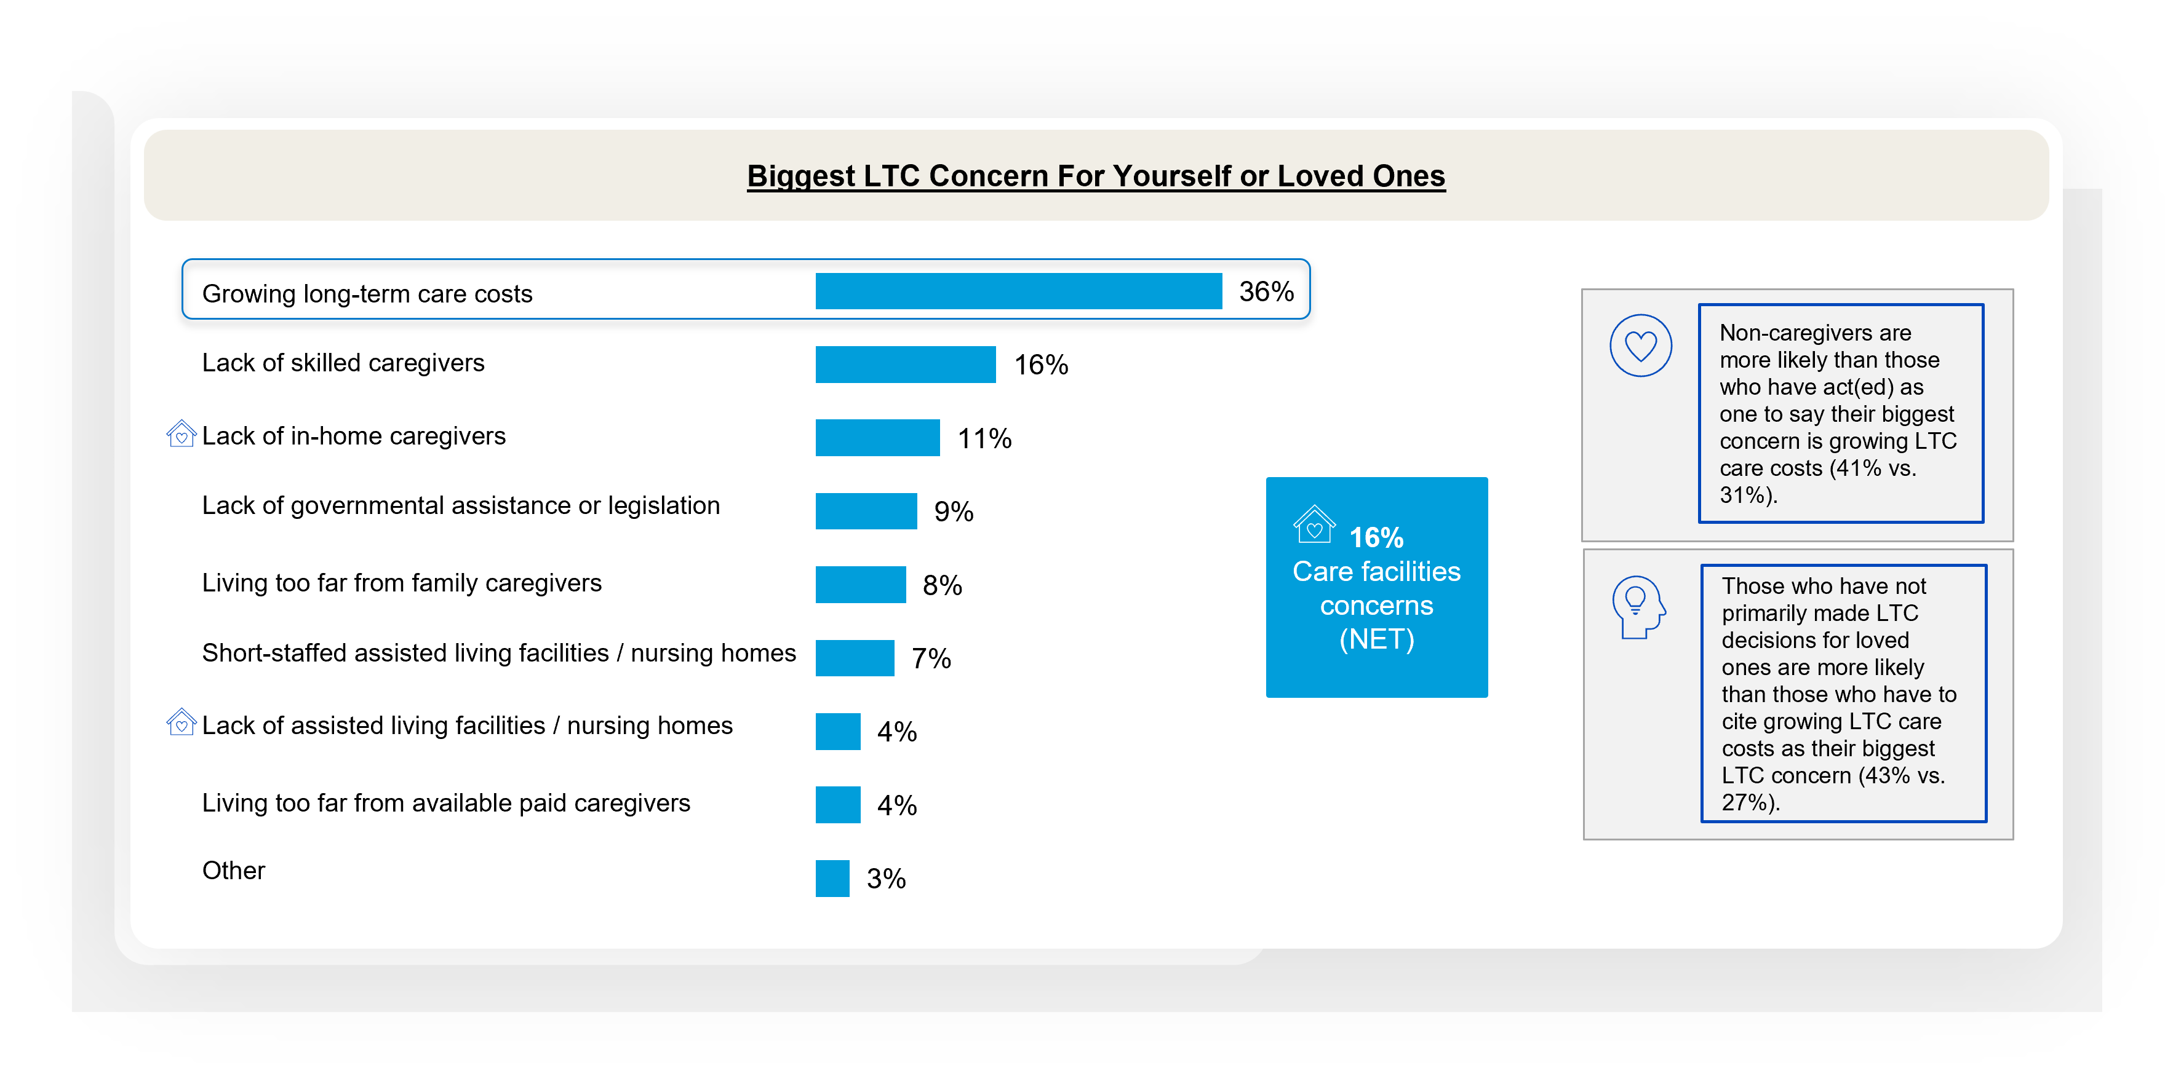
Cost is the leading concern around LTC
Long-term Care Concerns and Beliefs
Notes:
BASE: ALL QUALIFIED RESPONDENTS (n=1208)
Q1425 What is your biggest concern when it comes to long-term care (either for yourself or loved ones)? Please select one.
1. Lack of in-home caregivers
2. Lack of assisted living facilities/nursing homes
3. Short-staffed assisted living facilities/nursing homes
4. Lack of skilled caregivers
5. Living too far from family caregivers
6. Growing long-term care costs (e.g., costs of skilled caregivers, assisted living/nursing home fees, medication/treatments)
7. Lack of governmental assistance or legislation
8. Living too far from available paid caregivers
96. Other

Slide 12
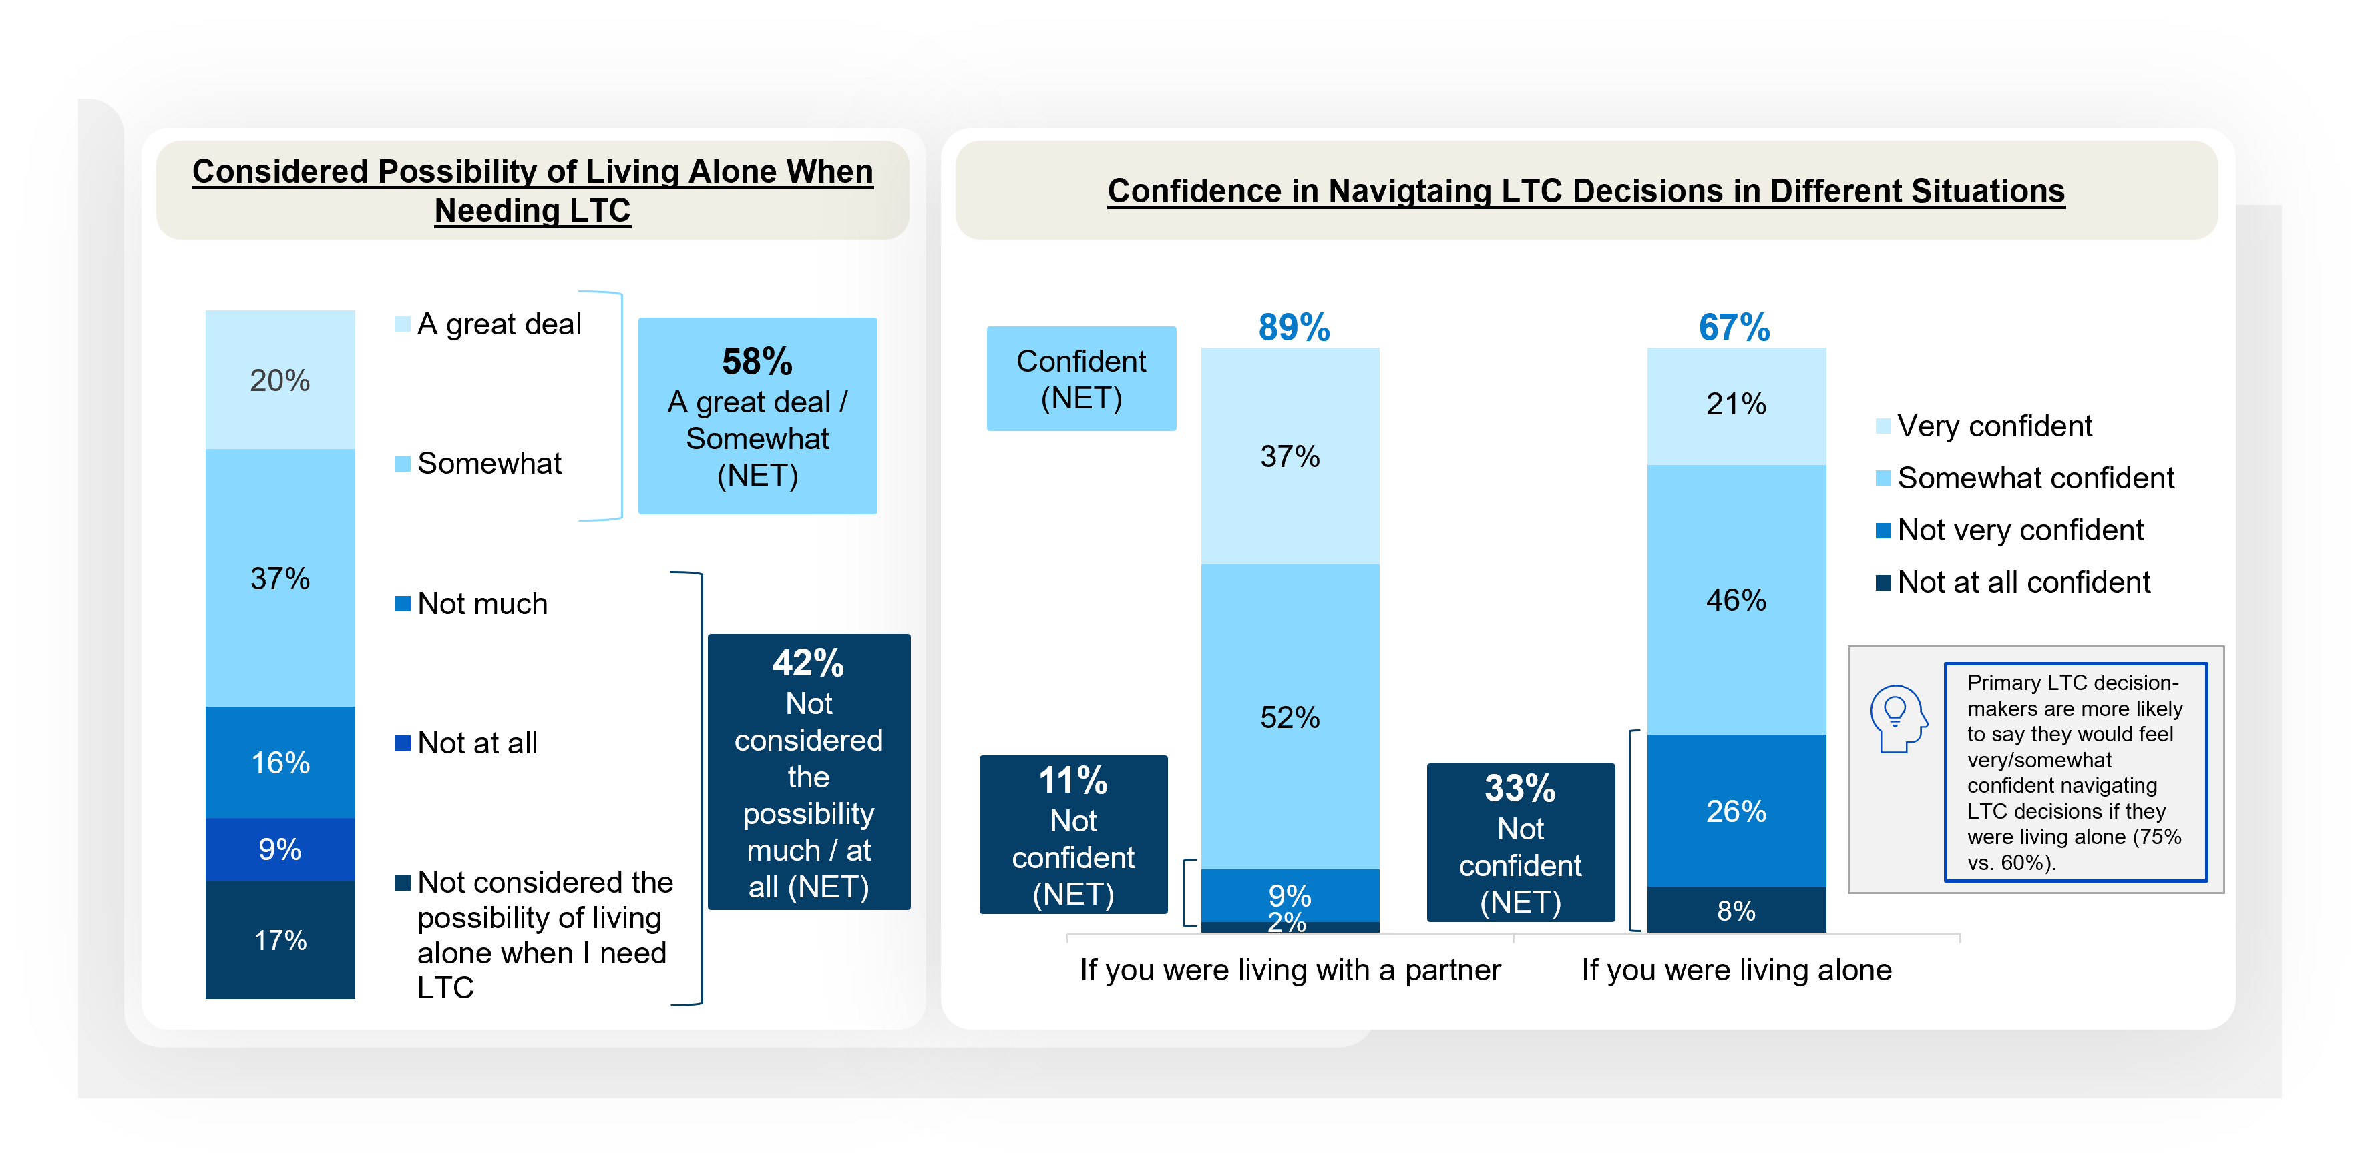
Clear majorities feel confident navigating LTC decision-making. More adults would feel confident with a partner.
Solo Aging
Notes:
BASE: ALL QUALIFIED RESPONDENTS (n=1208)
Q2026A18. How much have you considered the possibility of living alone when you need long-term care?
Q2026A23. How confident would you feel navigating long-term care decisions in each of the following situations?

Slide 13
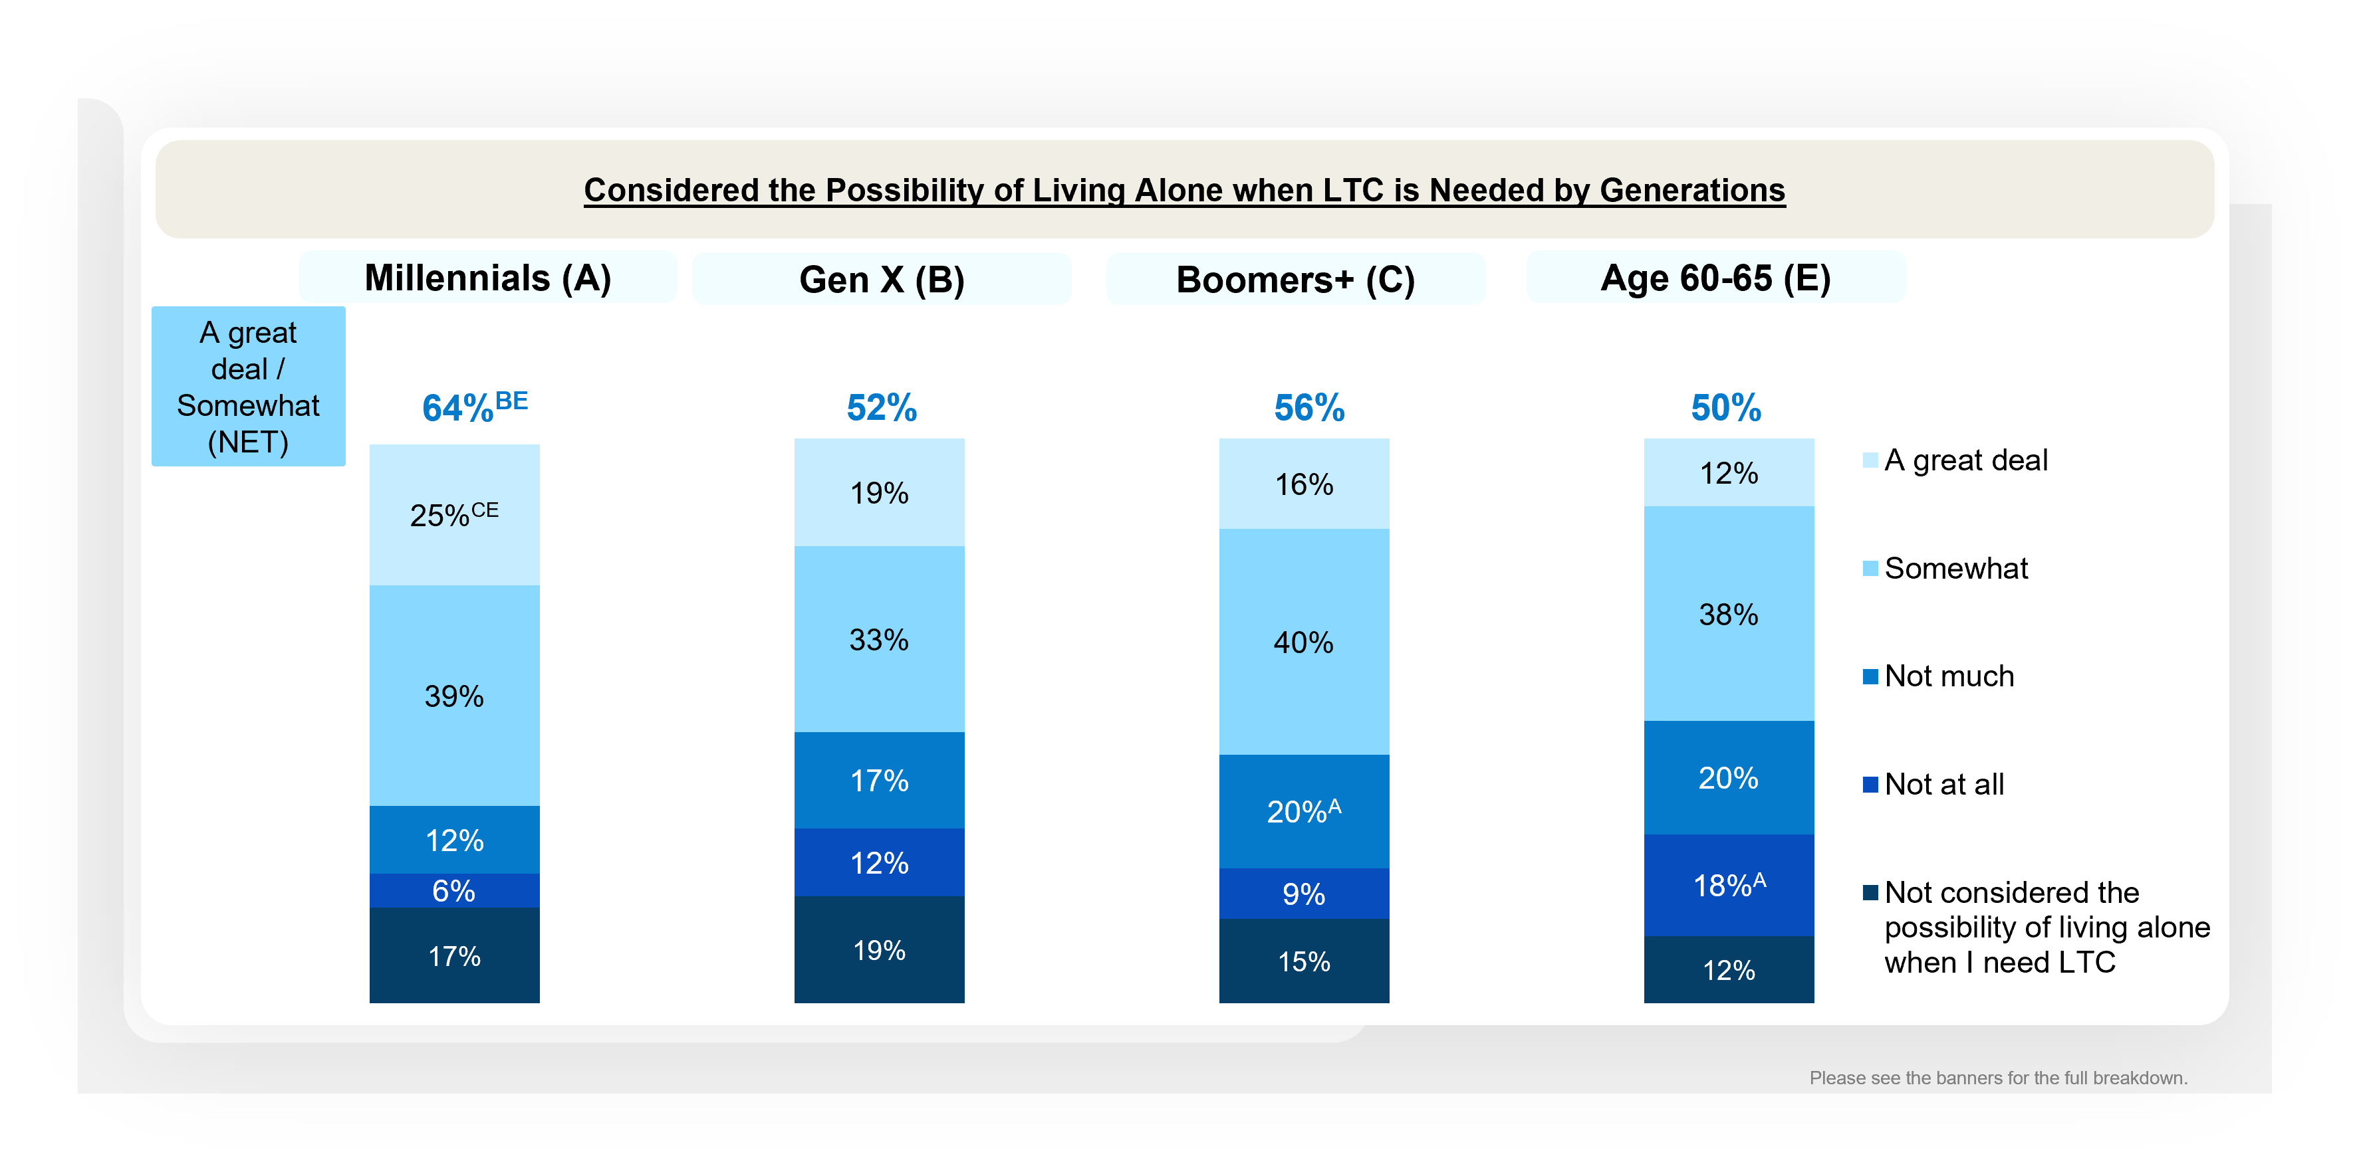
Millennials are more likely to have considered the possibility of living alone when they need LTC compared to Gen X and those age 60-65
Solo Aging
Notes:
BASE: ALL QUALIFIED RESPONDENTS (MILLENNIALS (n=401); GEN X (n=404); BOOMERS+ (n=403); Those age 60-65 (n=120))
Q2026A18 How much have you considered the possibility of living alone when you need long-term care?

Slide 14
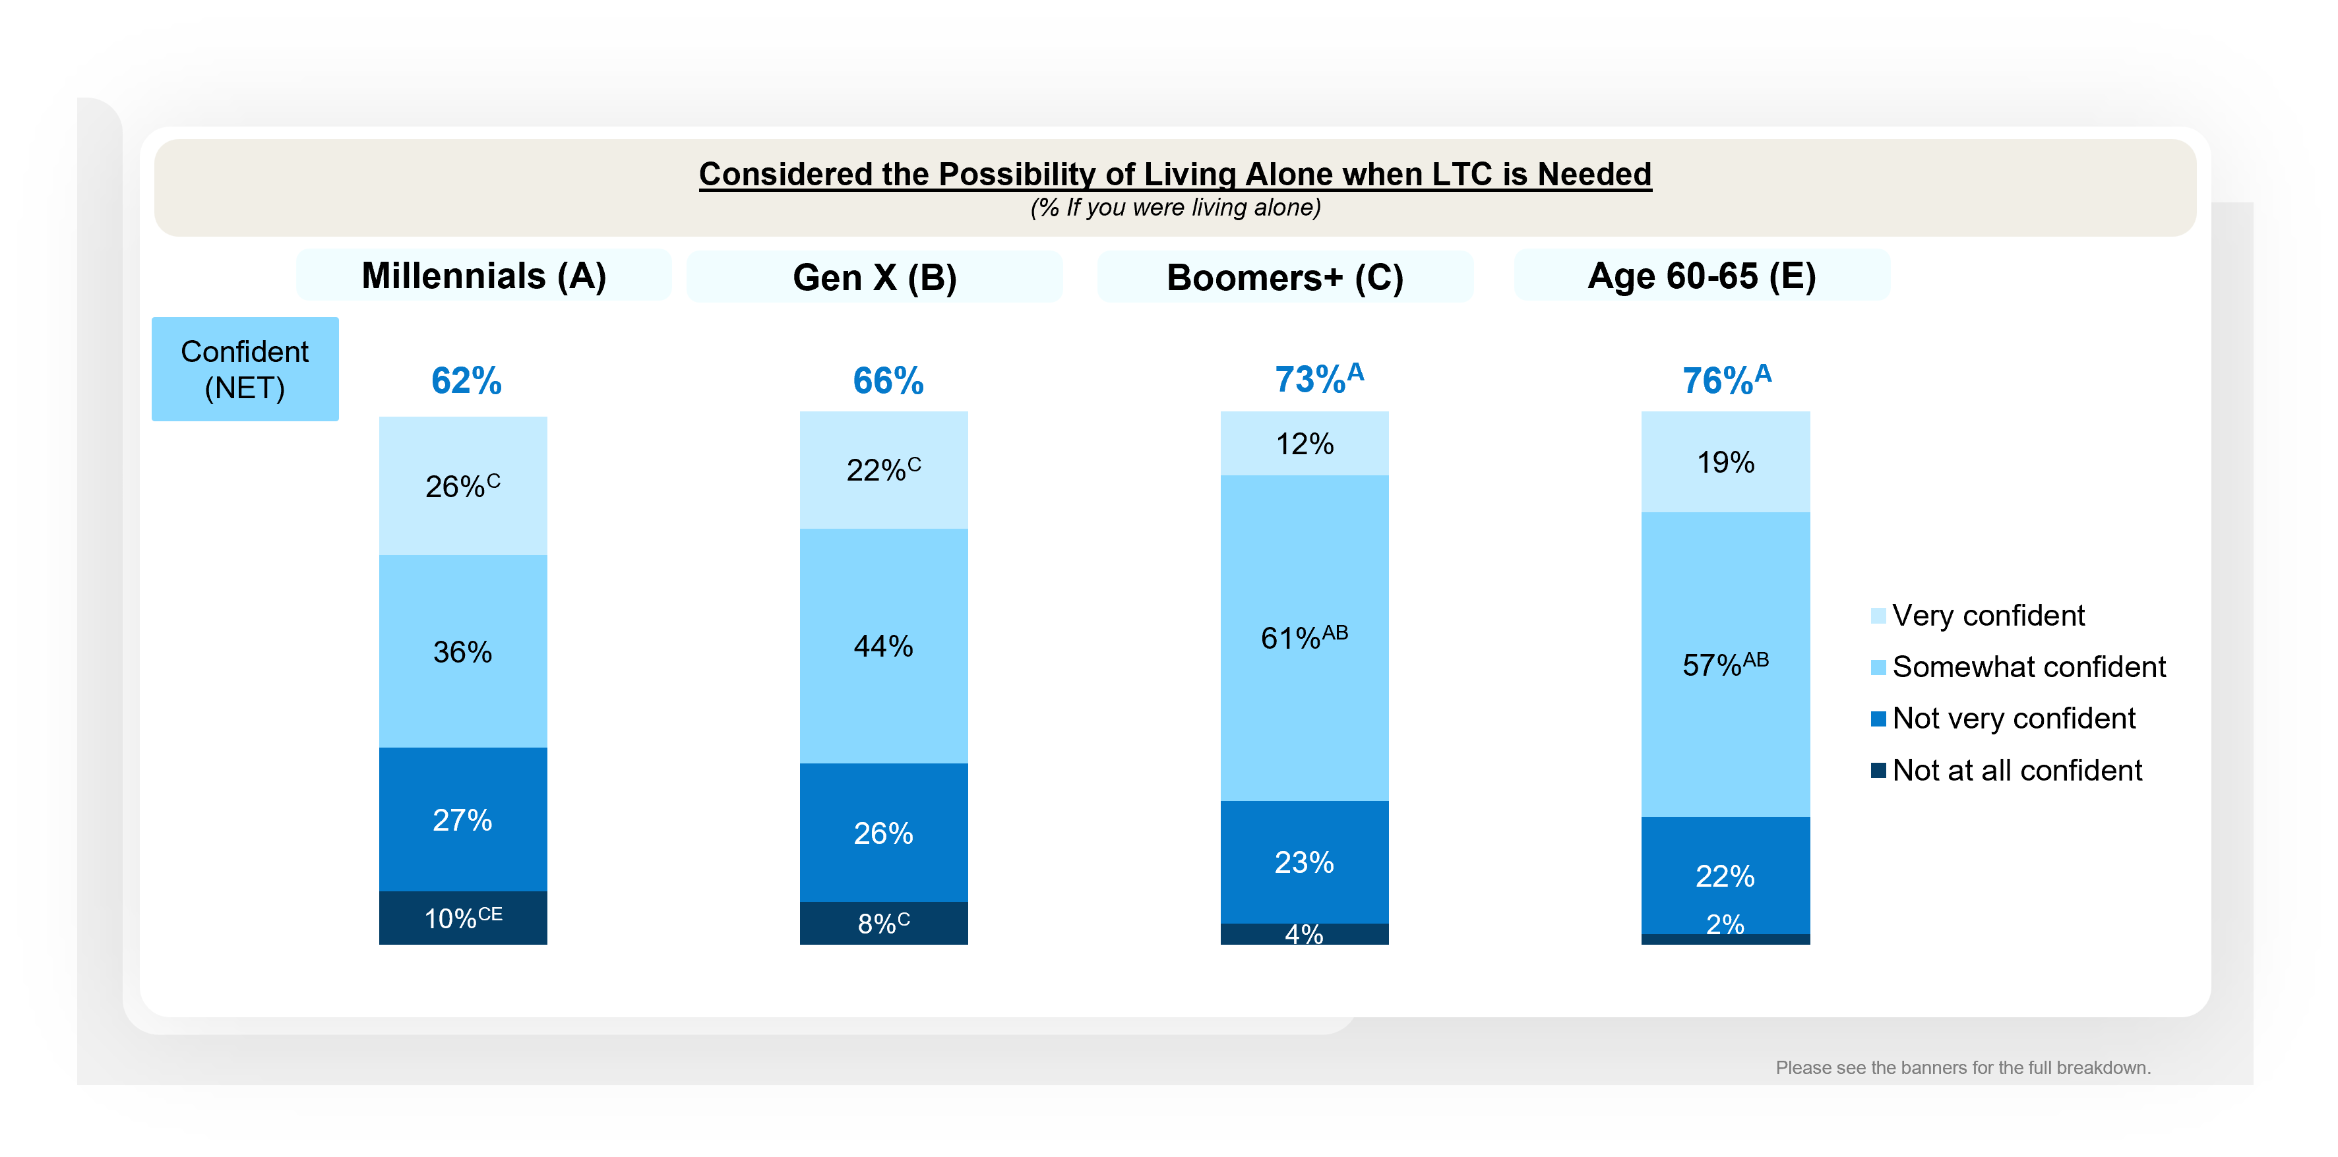
Boomers+ and those age 60-65 are more likely than Millennials to feel confident navigating LTC decision if they were living alone
Solo Aging
Notes:
BASE: ALL QUALIFIED RESPONDENTS (n=1208); MILLENNIALS (n=401); GEN X (n=404); BOOMERS+ (n=403)
Q2026A23 How confident would you feel navigating long-term care decisions in each of the following situations?
If you were living with a partner
If you were living alone

Slide 15
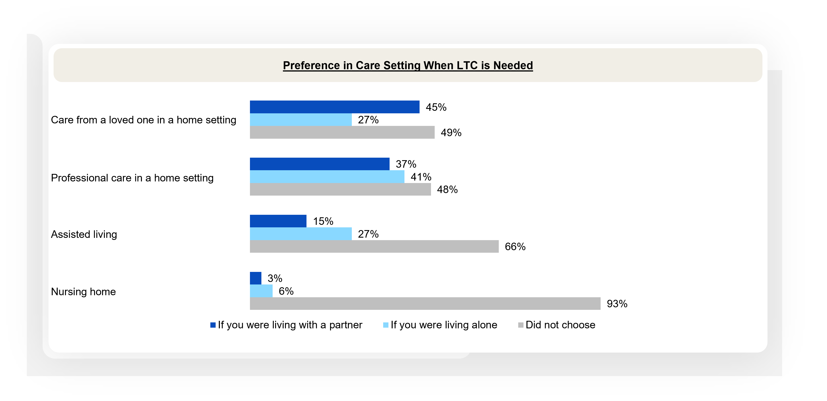
Very few would chose to live in a nursing home if they needed LTC no matter if they were living with a partner or alone
Solo Aging
Notes:
BASE: ALL QUALIFIED RESPONDENTS (n=1208)
Q2026A24. Which of the following would you prefer in each scenario if you needed long-term care?

Slide 16
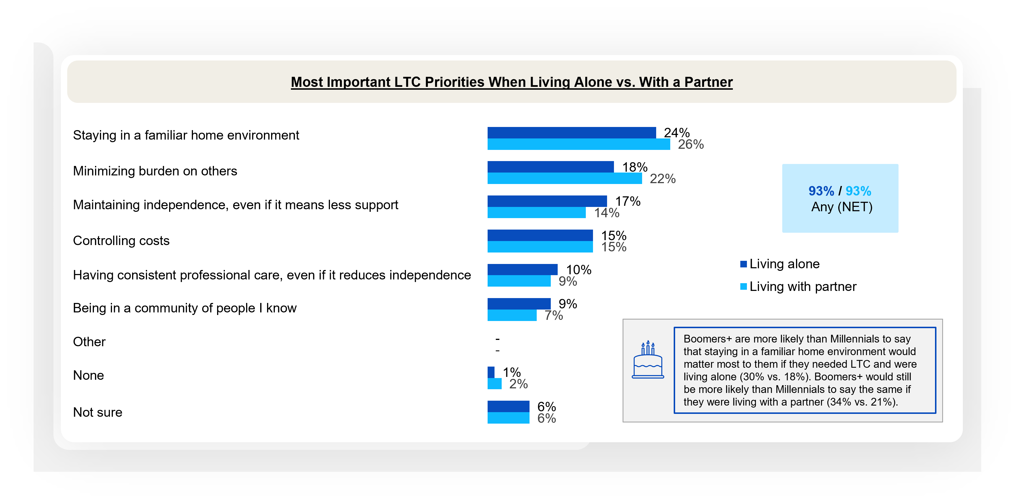
Staying in a familiar home environment matters most to Americans age 30+ regardless of if they live alone or with a partner if they need LTC
Solo Aging
Notes:
BASE: ALL QUALIFIED RESPONDENTS (n=1208)
Q2026A20. Regardless of your current status, if you need long-term care and you were living alone, which of the following would matter to you most? Please select one.
Q2026A21. Regardless of your current status, if you need long-term care and you were living with a partner, which of the following would matter to you most? Please select one.

Slide 17
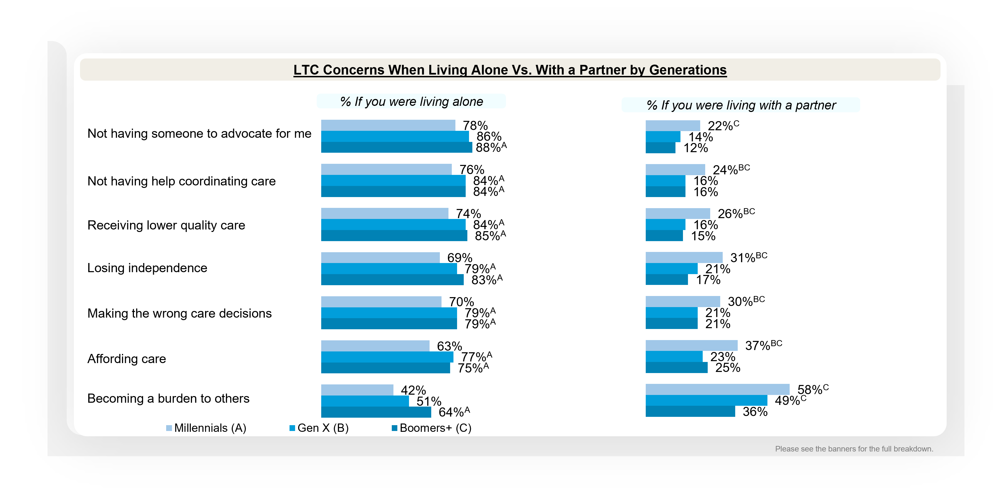
Gen X and Boomers+ seem to be more concerned about a variety of different LTC scenarios if they were living alone
Solo Aging
Notes:
BASE: ALL QUALIFIED RESPONDENTS (MILLENNIALS (n=401); GEN X (n=404); BOOMERS+ (n=403))
Q2026A22 Which of the following would you be more concerned about if you were living alone vs. if you were living with a partner when facing long-term care?

Slide 18
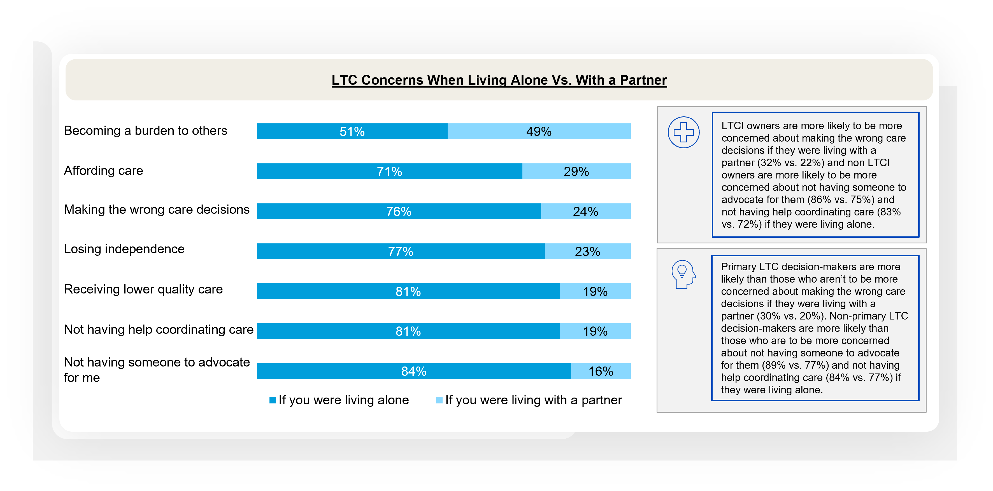
~4 in 5 are concerned most about not having help coordinating care or not having someone advocate for them if they were living alone when facing LTC
Solo Aging
Notes:
BASE: ALL QUALIFIED RESPONDENTS (n=1208)
Q2026A22. Which of the following would you be more concerned about if you were living alone vs. if you were living with a partner when facing long-term care?
####
Caregiver subgroup:
Those who have act(ed) as a caregiver are more likely than those who haven’t to be concerned about making the wrong care decisions if they were living with a partner (29% vs. 19%). Non-caregivers are more likely than caregivers to be more concerned about not having someone to advocate for them (89% vs. 79%), not having help coordinating care (85% vs. 78%), and receiving lower quality care (84% vs. 78%) if they were living alone.

Slide 19
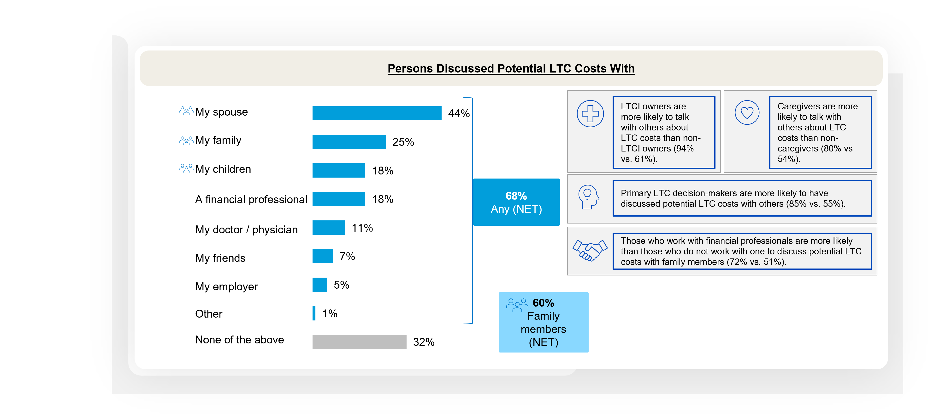
Discussion around potential LTC costs are often had with family members
Financial Professionals and Long-term Care Planning
Notes:
BASE: ALL QUALIFIED RESPONDENTS (n=1208)
Q705 Have you discussed your potential long-term care costs with any of the following people? Please select all that apply.

Slide 20
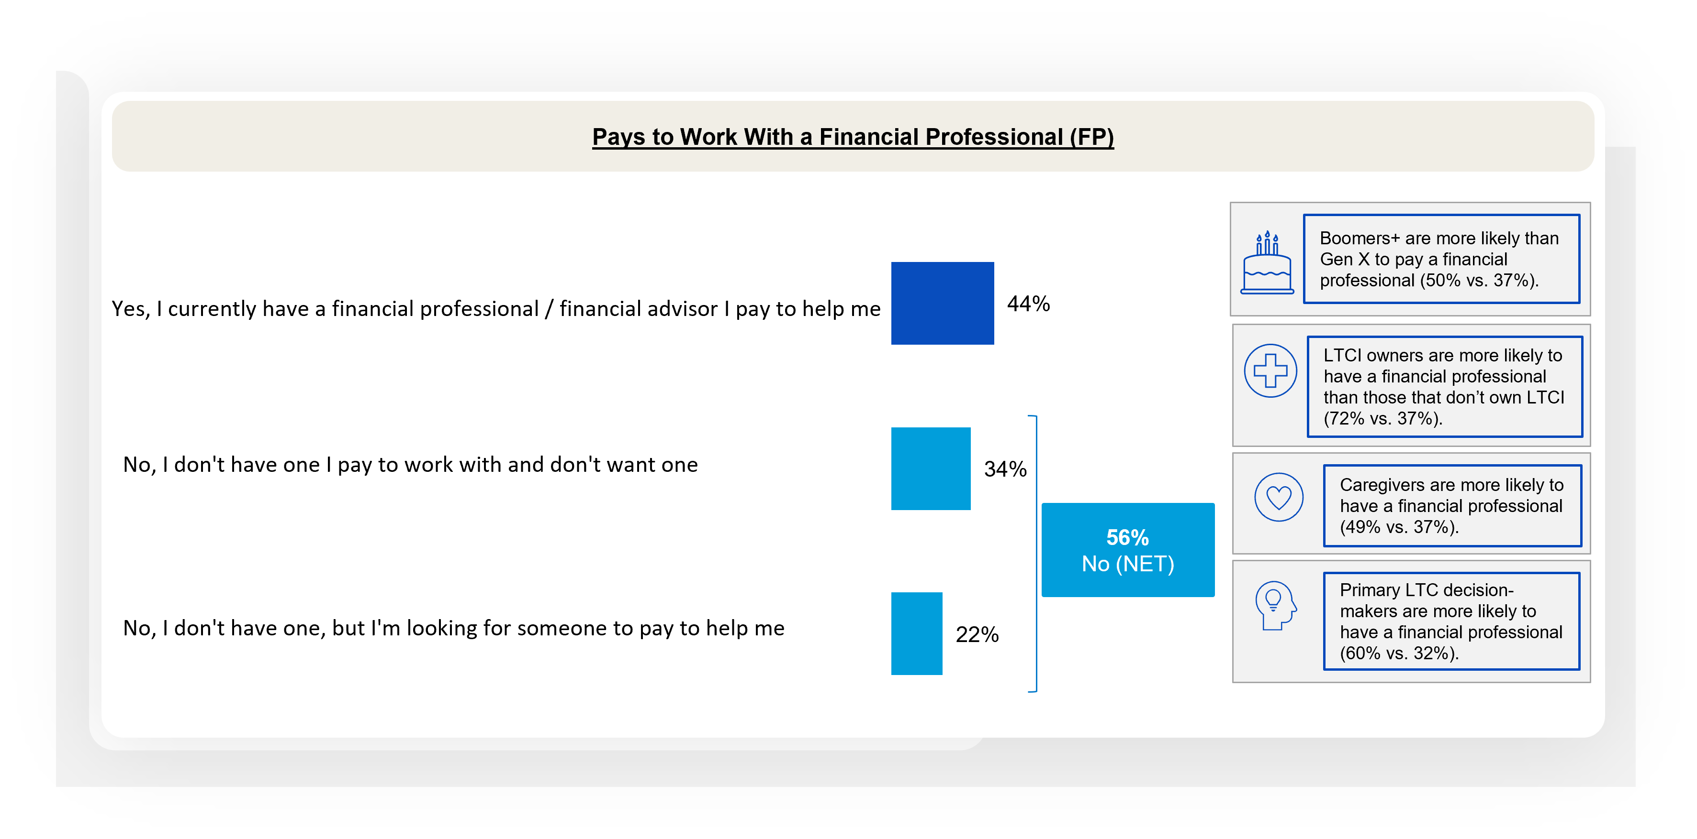
Over 2 in 5 have an FP they pay to help with their financial plans, and more than a fifth are looking for one
Financial Professionals and Long-term Care Planning
Notes:
BASE: ALL QUALIFIED RESPONDENTS (n=1208)
Q700 Do you currently pay a financial professional/financial advisor for help with your financial plans?

Slide 21
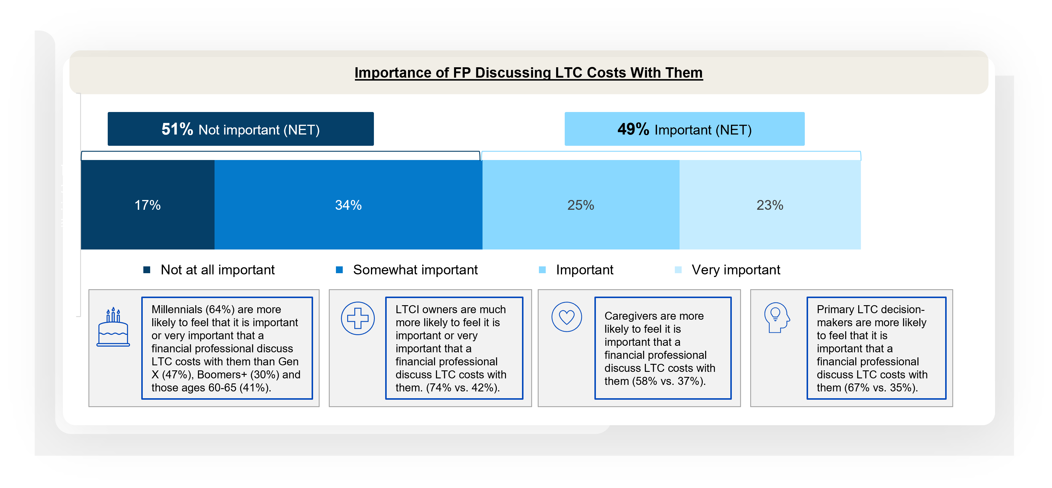
Americans 30+ are split opinion on the importance of FPs discussing LTC with clients, highlighting an opportunity for FPs to show their value in these conversations
Financial Professionals and Long-term Care Planning
Notes:
BASE: ALL QUALIFIED RESPONDENTS (n=1208)
Q720 How important is it that a financial professional discusses long-term care costs with you?

Slide 22
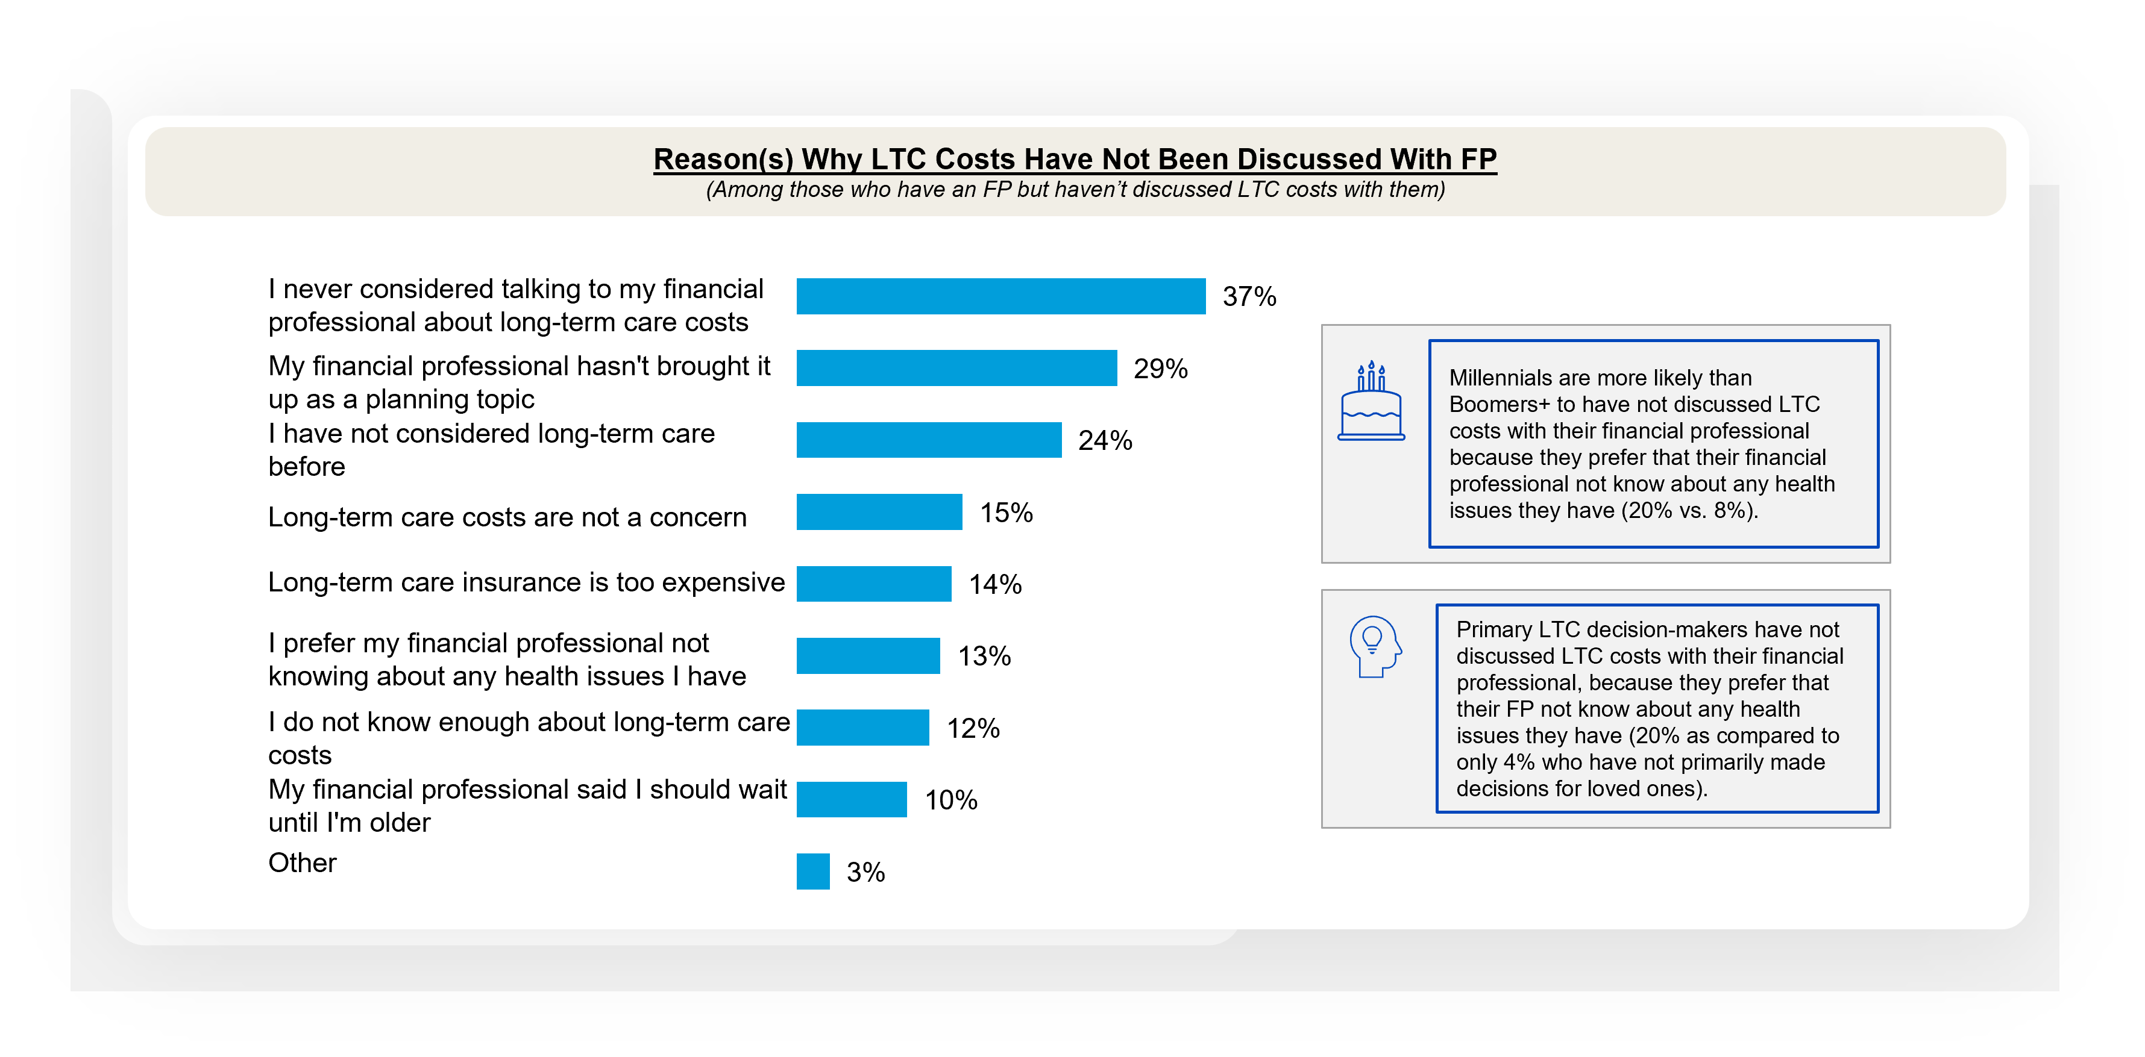
LTC planning is being overlooked. Nearly 4 in 10 haven’t discussed LTC costs with their FP as they never considered it
Financial Professionals and Long-term Care Planning
Notes:
BASE: HAVE A FINANCIAL PROFESSIONAL BUT HAVE NOT DISCUSSED LTC COSTS WITH THEM (n=343)
Q710 Why have you not discussed long-term care costs with your financial professional? Please select all that apply.

Slide 23
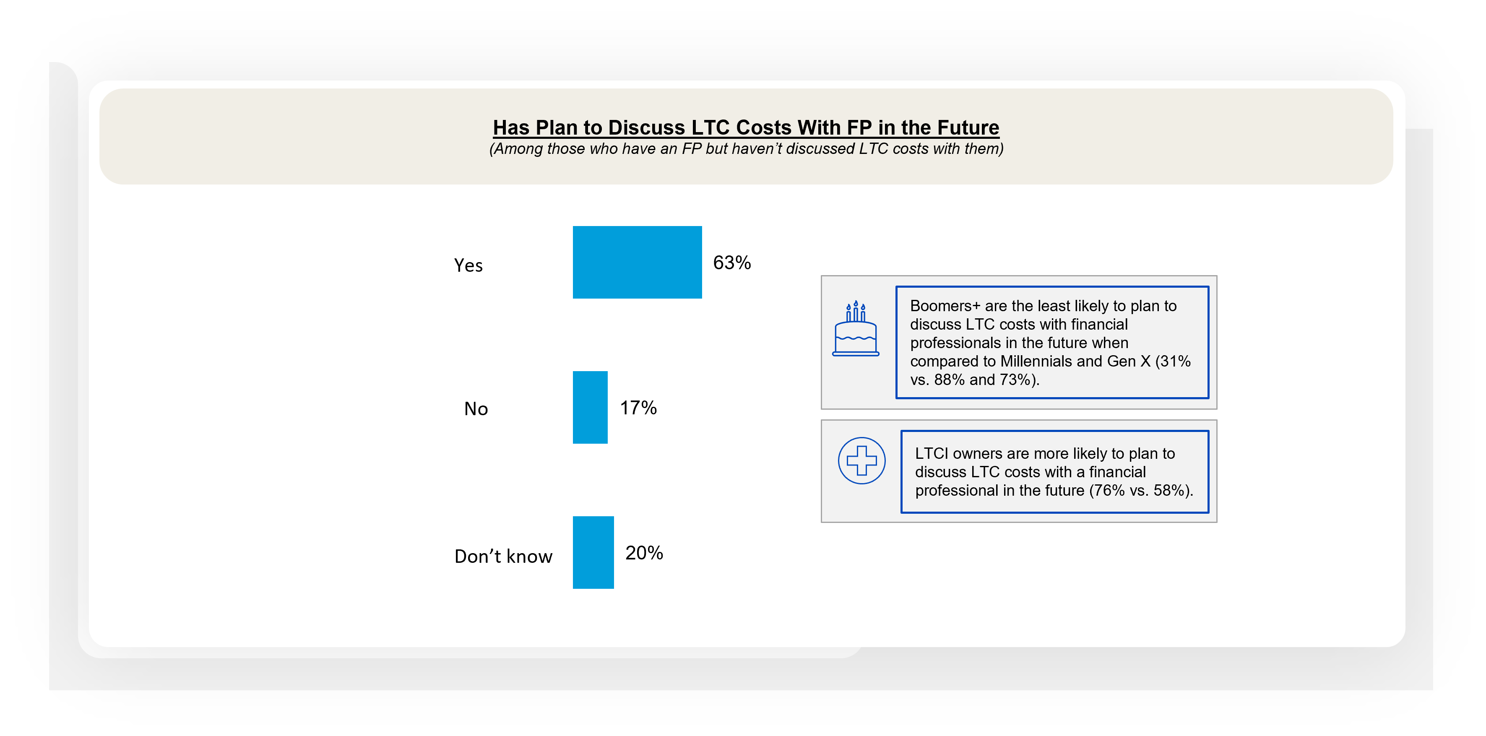
A majority of those with an FP plan to discuss LTC costs with an FP in the future
Financial Professionals and Long-term Care Planning
Notes:
BASE: HAVE A FINANCIAL PROFESSIONAL BUT HAVE NOT DISCUSSED LTC COSTS WITH THEM (n=343)
Q715 Do you plan to discuss long-term care costs with a financial professional in the future?

Slide 24
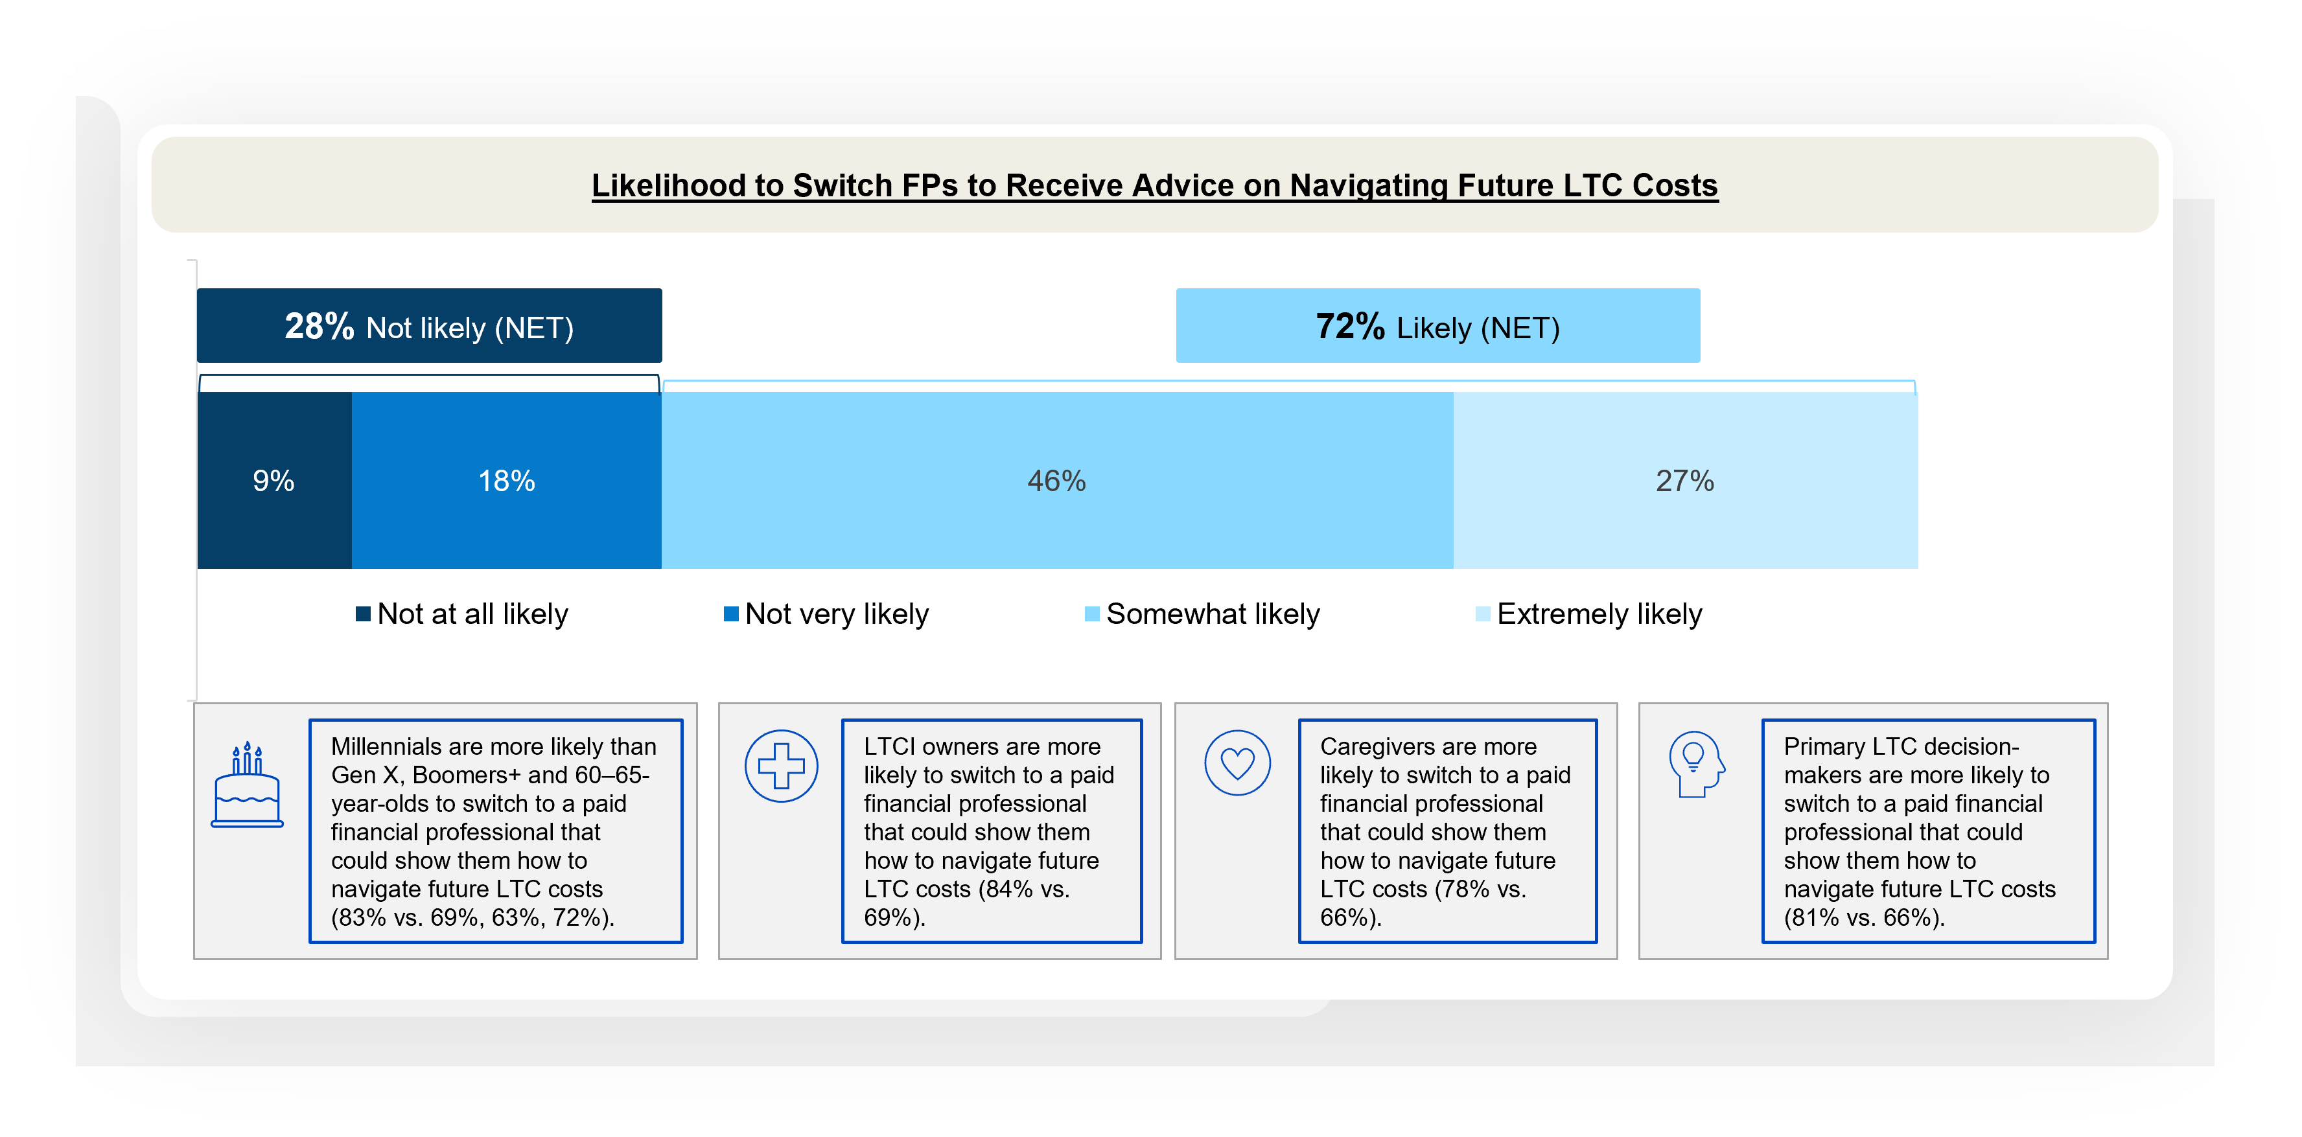
Nearly 3 in 4 are likely to switch FPs to one who could show them how to navigate future LTC costs if theirs could not
Financial Professionals and Long-term Care Planning
Notes:
BASE: ALL QUALIFIED RESPONDENTS (n=1208)
Q2026A3 If a paid financial professional could not show you how to navigate your future long-term care costs, how likely would you be to switch to one who could?

Slide 25
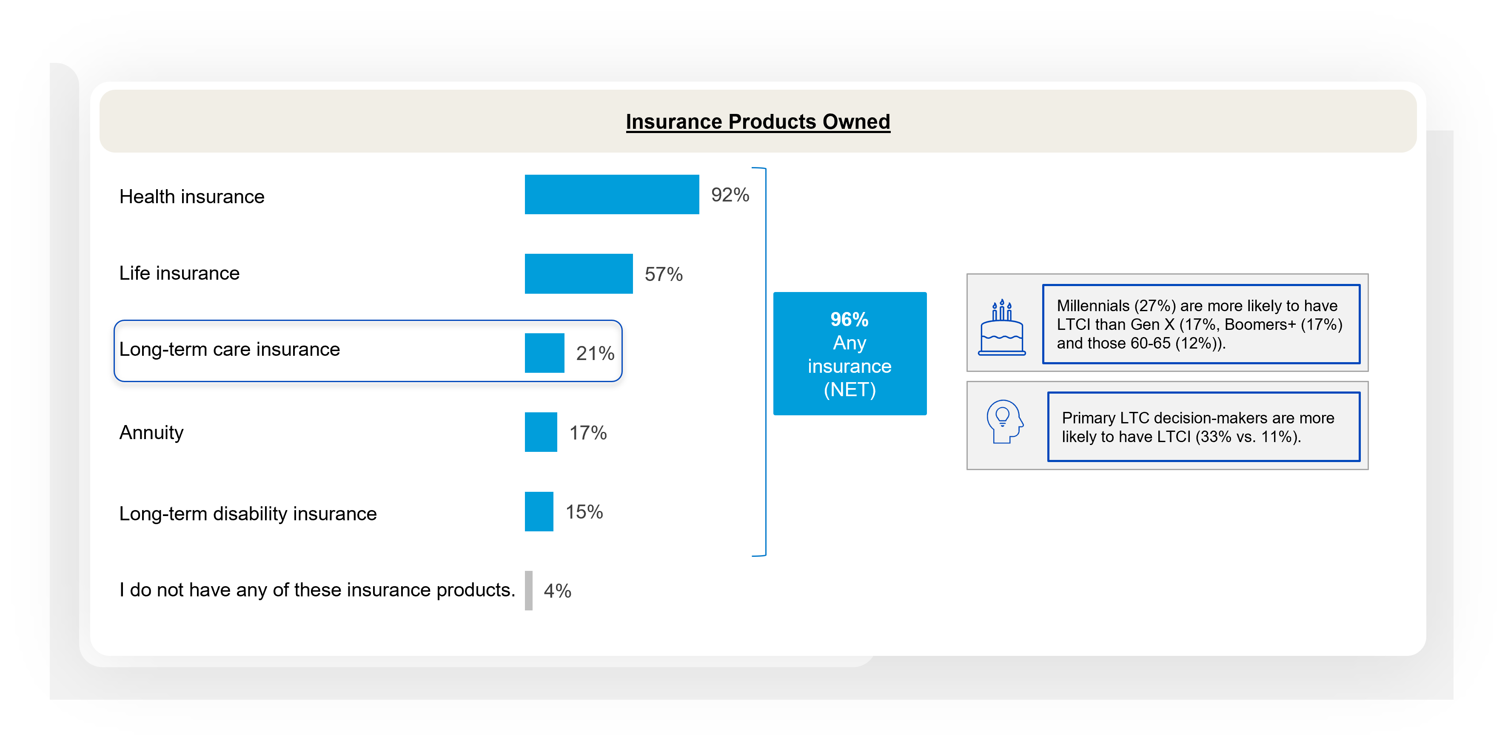
Just about one in five indicate that they own long-term care insurance (LTCI)
Current and Future Plans for Long-term Care Insurance
Notes:
BASE: ALL QUALIFIED RESPONDENTS (n=1208)
Q300 Which of the following insurance product(s) do you currently have? Please select all that apply.

Slide 26
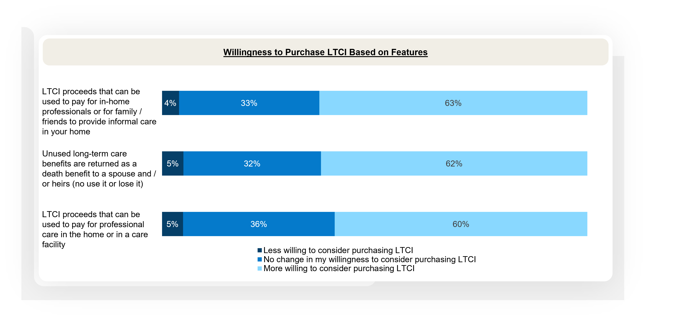
Willingness to purchase LTCI increases when benefits support in-home care access and heir protection
Current and Future Plans for Long-term Care Insurance
Notes:
BASE: ALL QUALIFIED RESPONDENTS (n=1208)
Q2026A2 Long-term care insurance (LTCI) product features are evolving in the marketplace. Please rate each feature below if any would cause you to be more or less willing to consider purchasing LTCI for yourself.

Slide 27
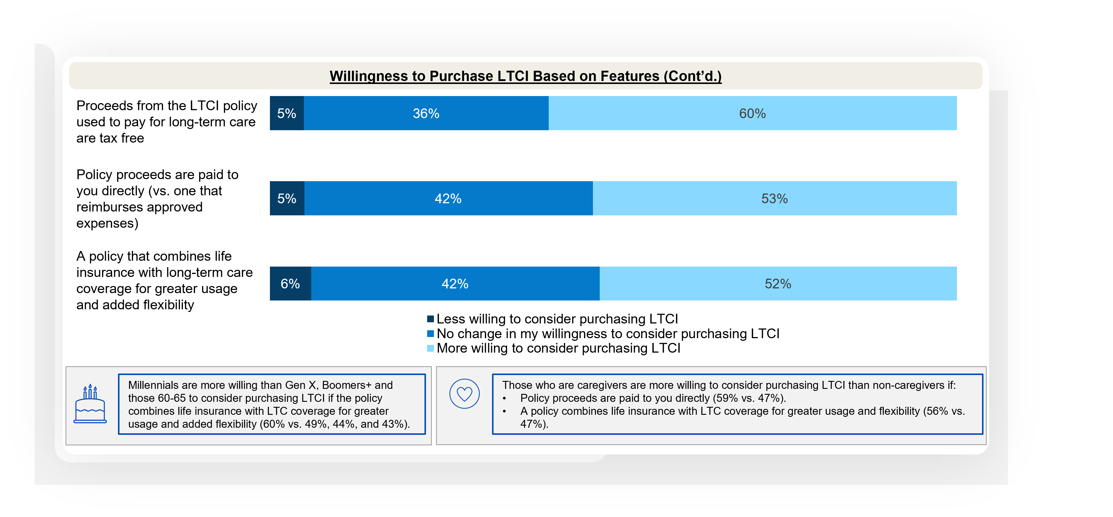
Tax-free benefits, direct payouts, and greater usage and flexibility increase willingness to purchase LTCI
Current and Future Plans for Long-term Care Insurance
Notes:
BASE: ALL QUALIFIED RESPONDENTS (n=1208)
Q2026A2 Long-term care insurance (LTCI) product features are evolving in the marketplace. Please rate each feature below if any would cause you to be more or less willing to consider purchasing LTCI for yourself.

Slide 28
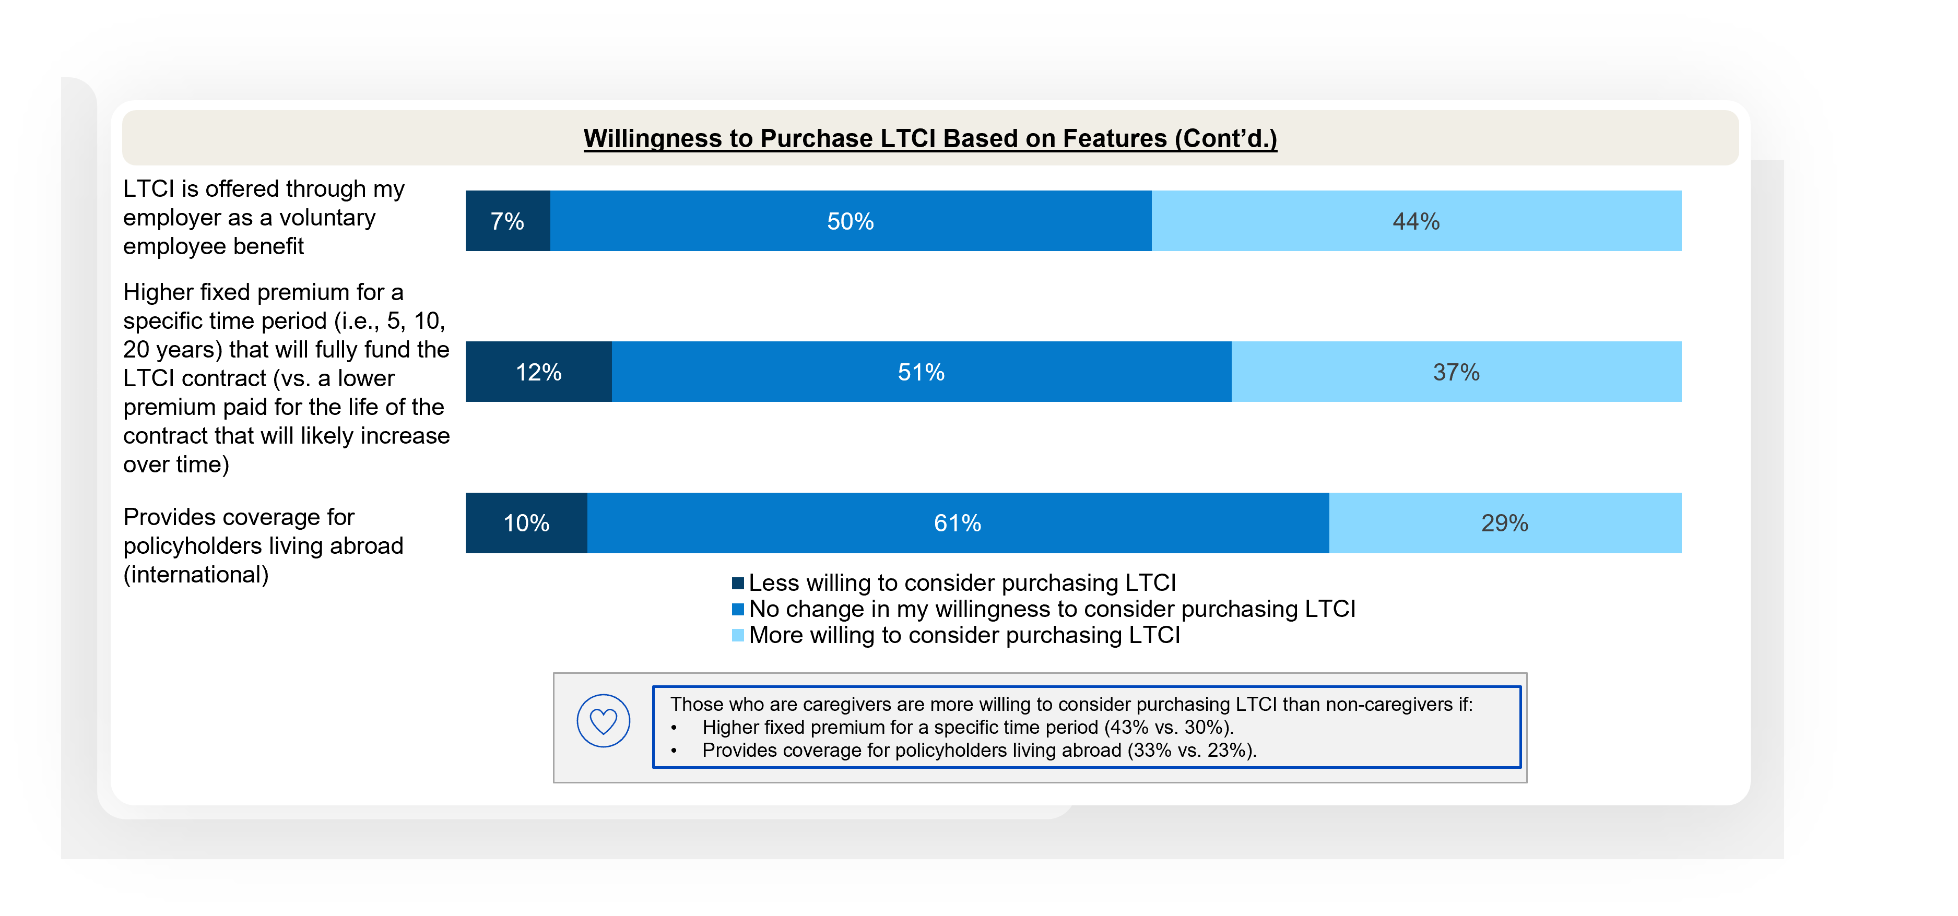
Employer access, fixed premiums, and international coverage do little to shift LTCI interest
Current and Future Plans for Long-term Care Insurance
Notes:
BASE: ALL QUALIFIED RESPONDENTS (n=1208)
Q2026A2 Long-term care insurance (LTCI) product features are evolving in the marketplace. Please rate each feature below if any would cause you to be more or less willing to consider purchasing LTCI for yourself.

Slide 29
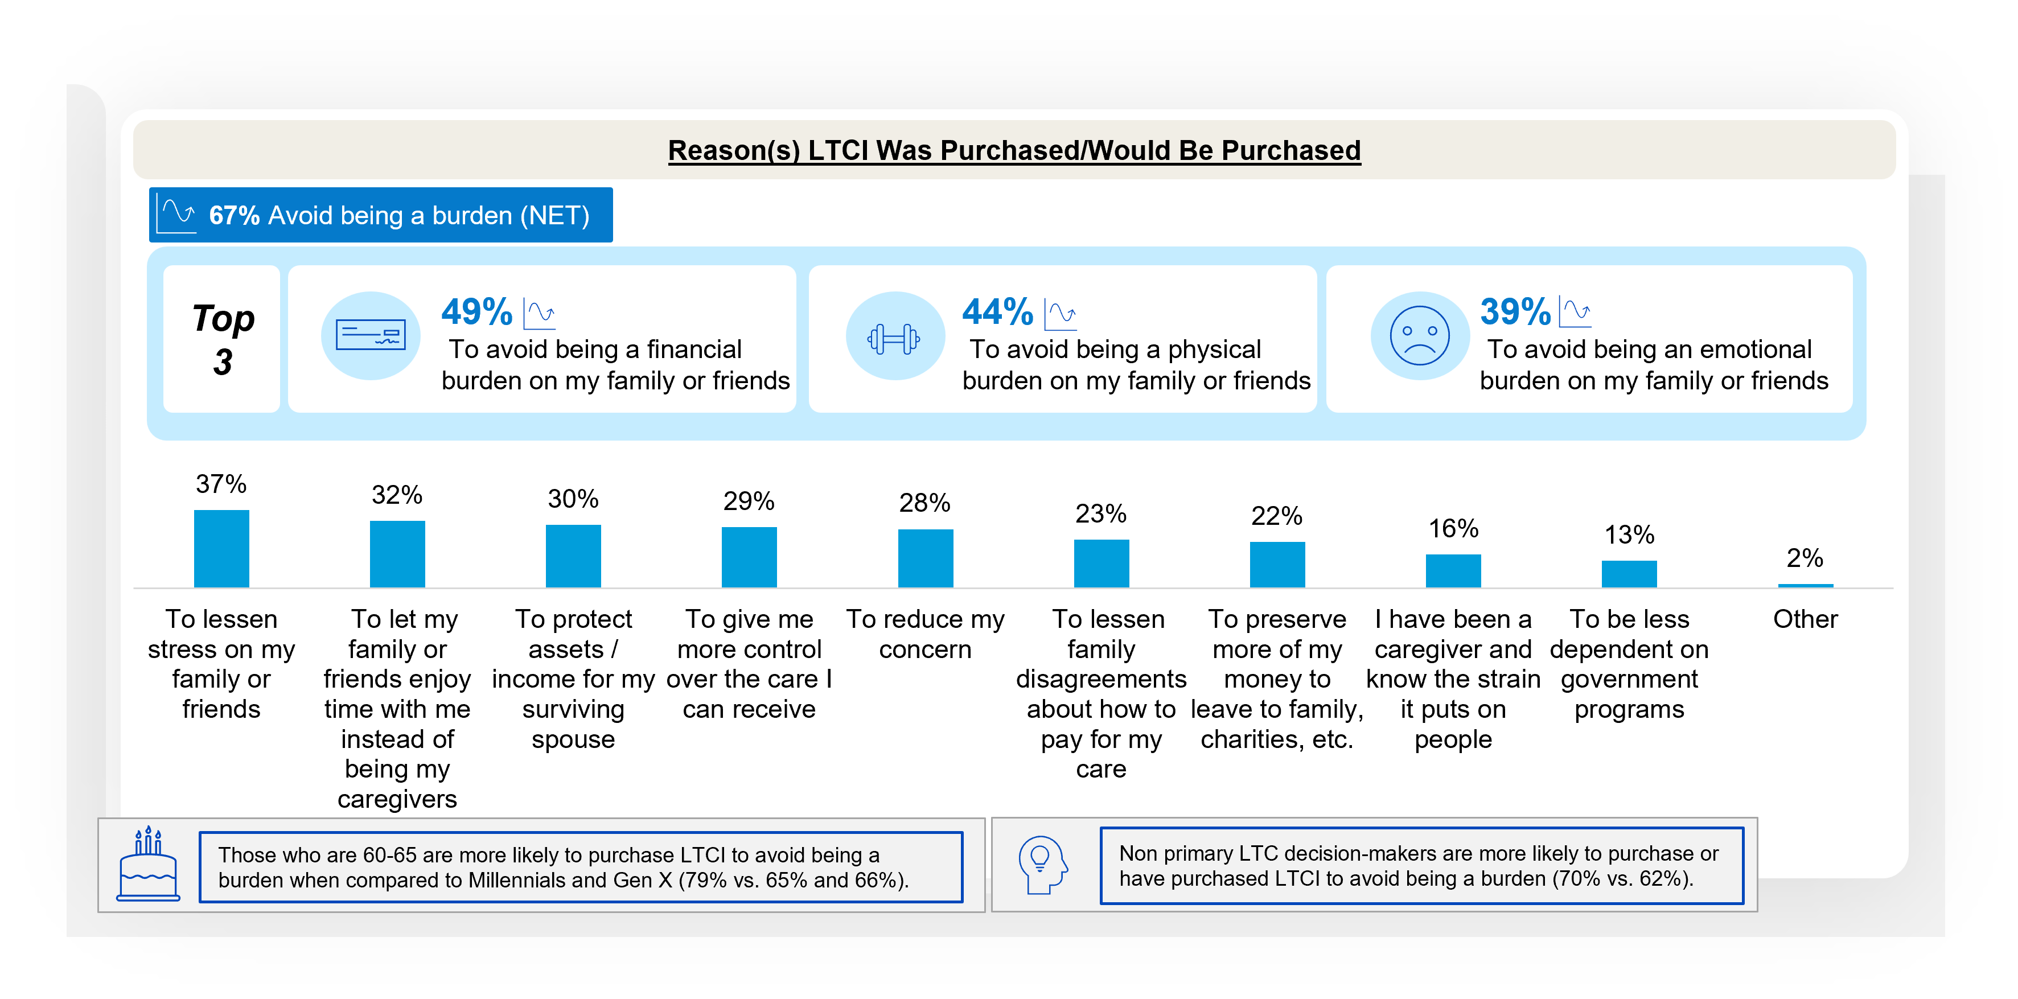
Avoiding being a burden tops the list of reasons to purchase LTCI
Current and Future Plans for Long-term Care Insurance
Notes:
BASE: ALL QUALIFIED RESPONDENTS (n=1208)
Q620 Moving on, which of the following are reasons you purchased or would purchase long-term care insurance (LTCI)? Please select all that apply.

Slide 30
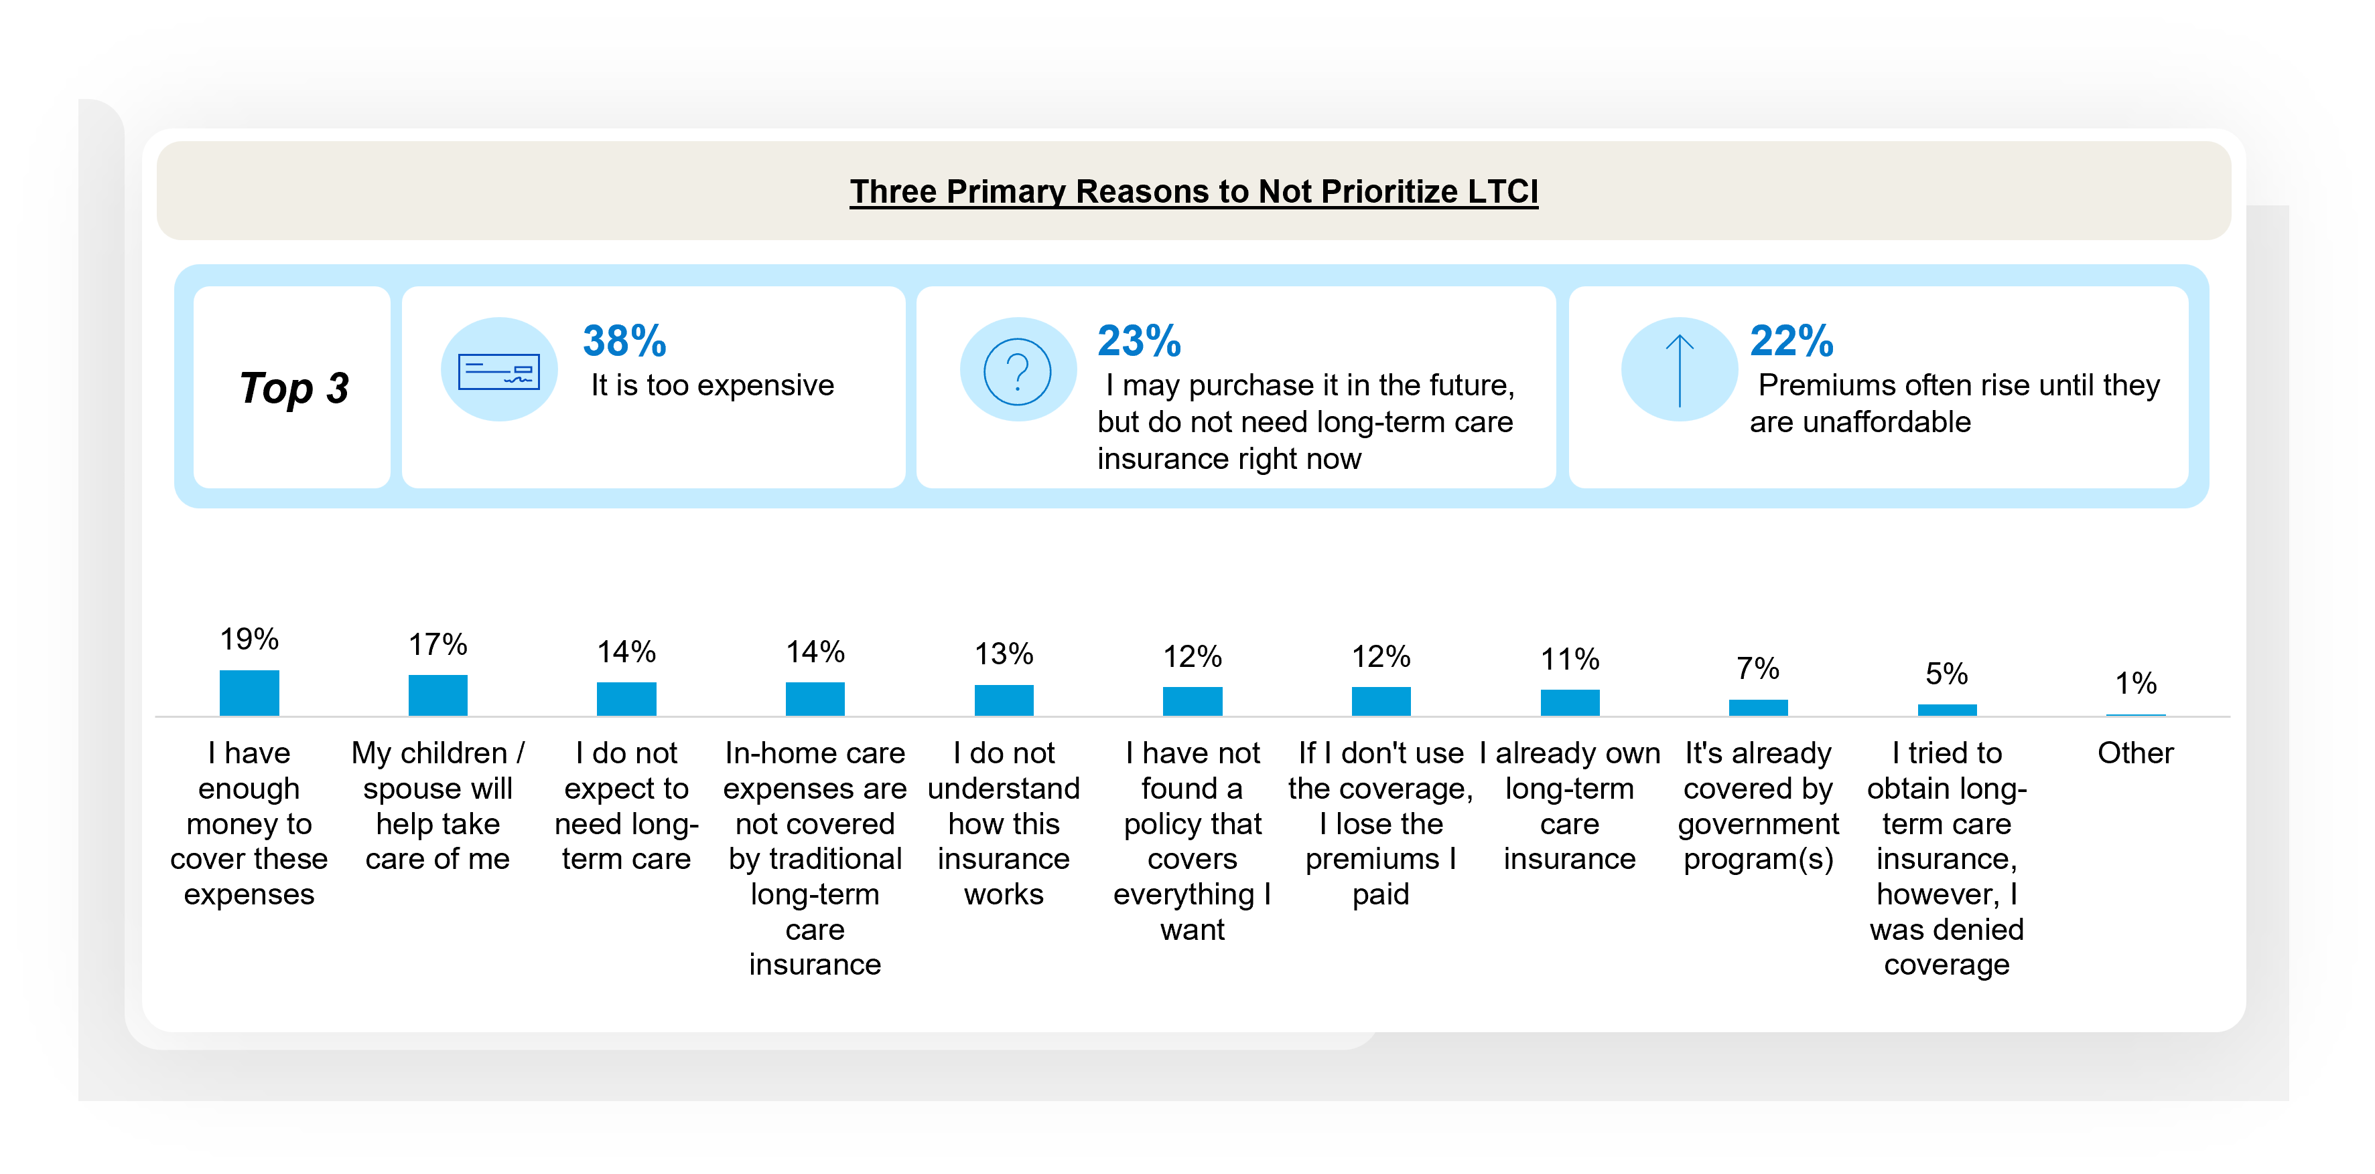
Affordability and lack of immediate need are primary reasons why Americans age 30+ would not prioritize having LTCI
Current and Future Plans for Long-term Care Insurance
Notes:
BASE: ALL QUALIFIED RESPONDENTS (n=1208)
Q400 Which of the following are the three primary reasons why you would not prioritize having long-term care insurance? Please select up to three.

Slide 31
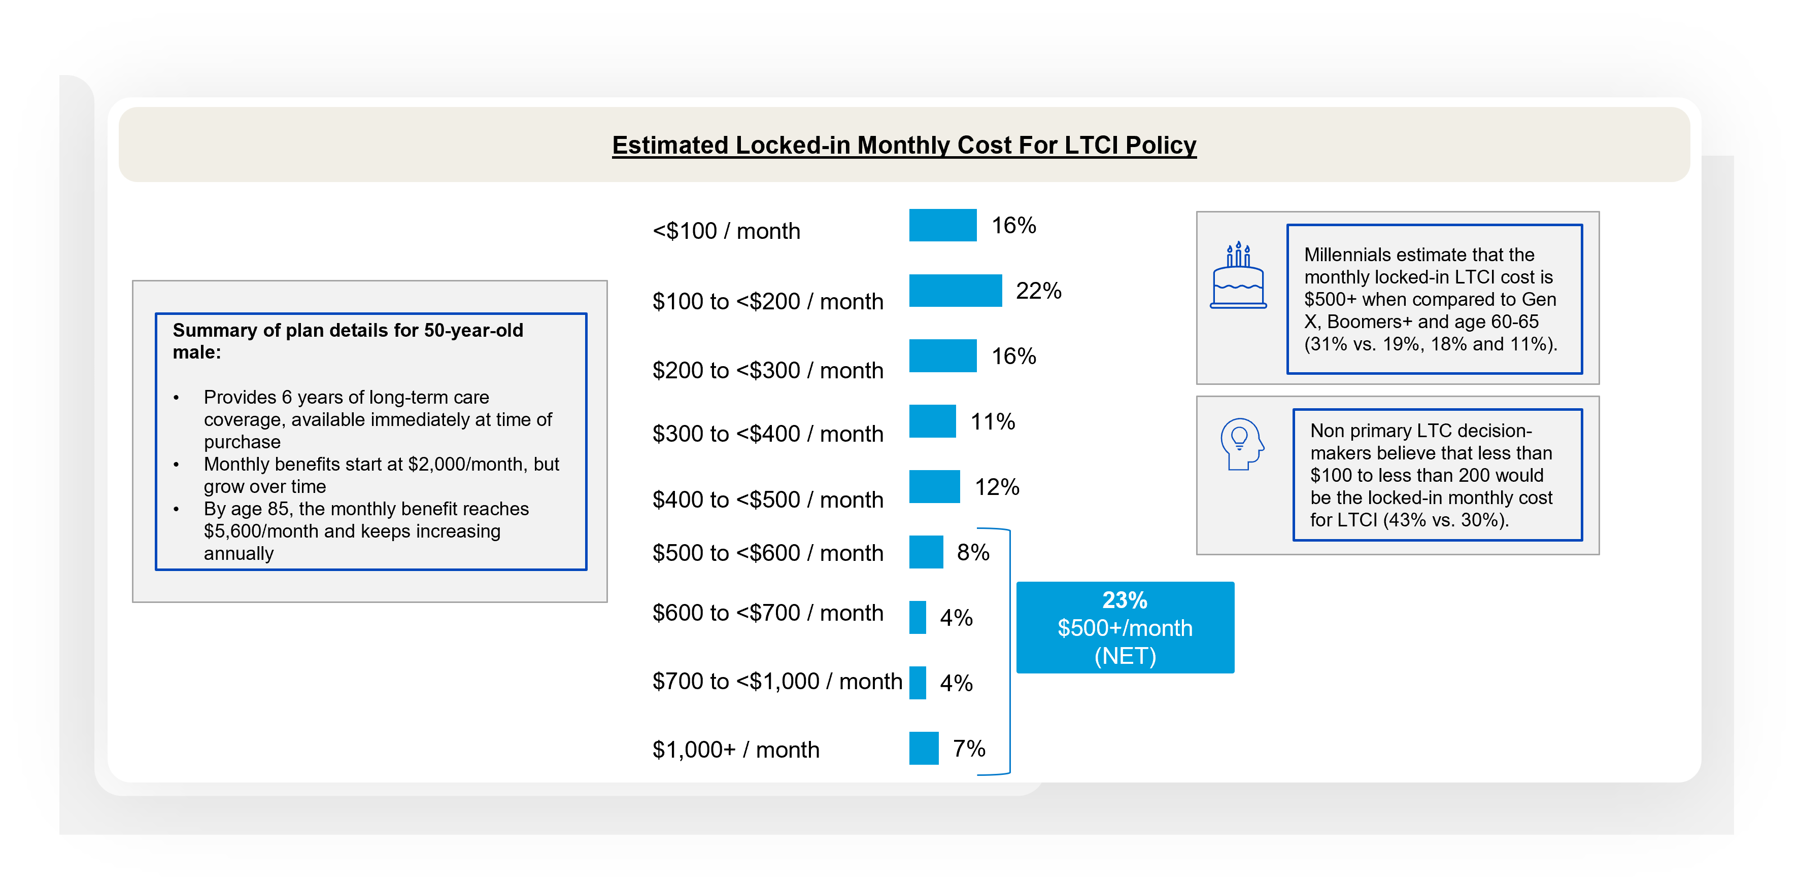
Most overestimated the monthly cost of a specific LTCI scenario
Current and Future Plans for Long-term Care Insurance
Notes:
BASE: ALL QUALIFIED RESPONDENTS (n=1208)
Q630 Thinking about long-term care insurance (LTCI) for a 50-year-old male, how much would you estimate the locked-in monthly cost to be for a long-term care insurance (LTCI) policy with the following details? Your best estimate is fine.
Summary of plan details for 50-year-old male:
• Provides 6 years of long-term care coverage, available immediately at time of purchase
• Monthly benefits start at $2,000/month, but grow over time
• By age 85, the monthly benefit reaches $5,600/month and keeps increasing annually

Slide 32
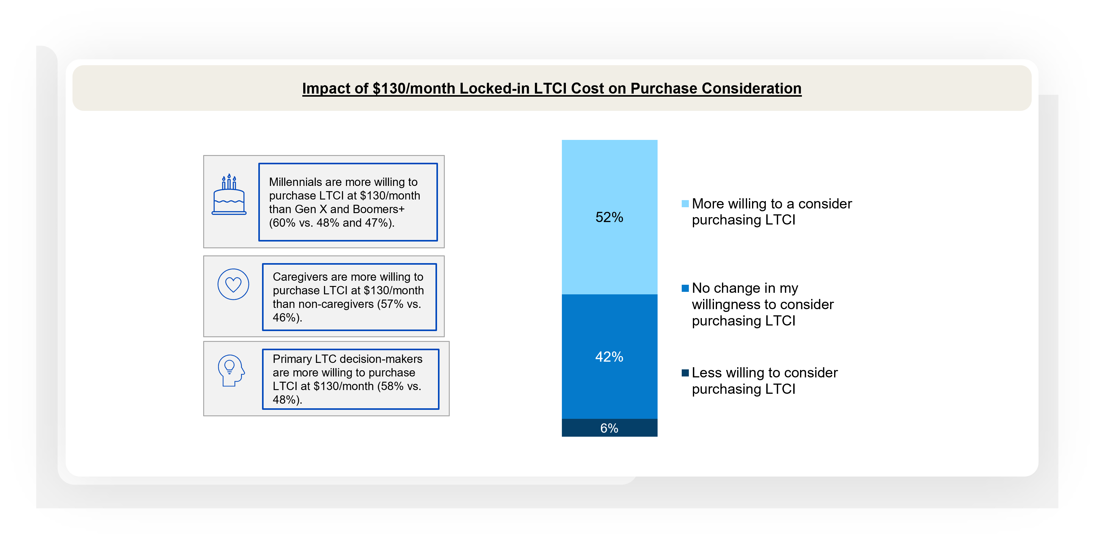
After seeing the price of a LTCI scenario, over half are willing to consider purchasing a similar LTCI plan for themselves
Current and Future Plans for Long-term Care Insurance
Notes:
BASE: ALL QUALIFIED RESPONDENTS (n=1208)
Q635 Still thinking about the same policy for the 50-year-old male, if you knew the cost for his long-term care insurance (LTCI) policy is a locked-in cost of $130/month (as of 3/1/2026), would you be more or less willing to consider purchasing similar LTCI for yourself?
HYPERLINK: Summary of plan details for 50-year-old male:
• Provides 6 years of long-term care coverage, available immediately at time of purchase
• Monthly benefits start at $2,000/month, but grow over time
• By age 85, the monthly benefit reaches $5,600/month and keeps increasing annually

Slide 33
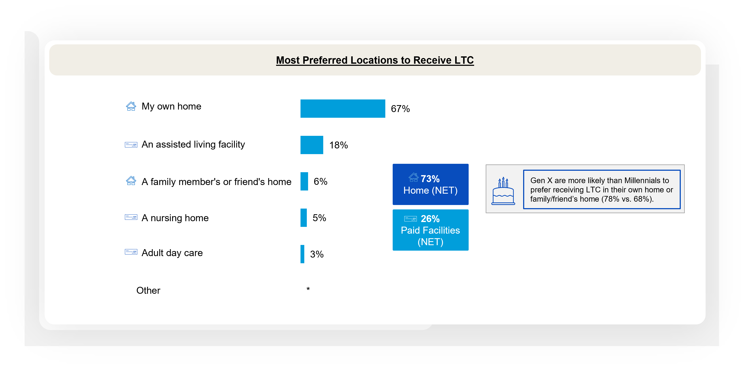
Home, either one’s own or a loved one’s, is the most preferred location to receive LTC if needed
Current and Future Plans for Long-term Care Insurance
Notes:
BASE: ALL QUALIFIED RESPONDENTS (n=1208)
Q900 If you needed it, where would you most prefer to receive long-term care?

Slide 34
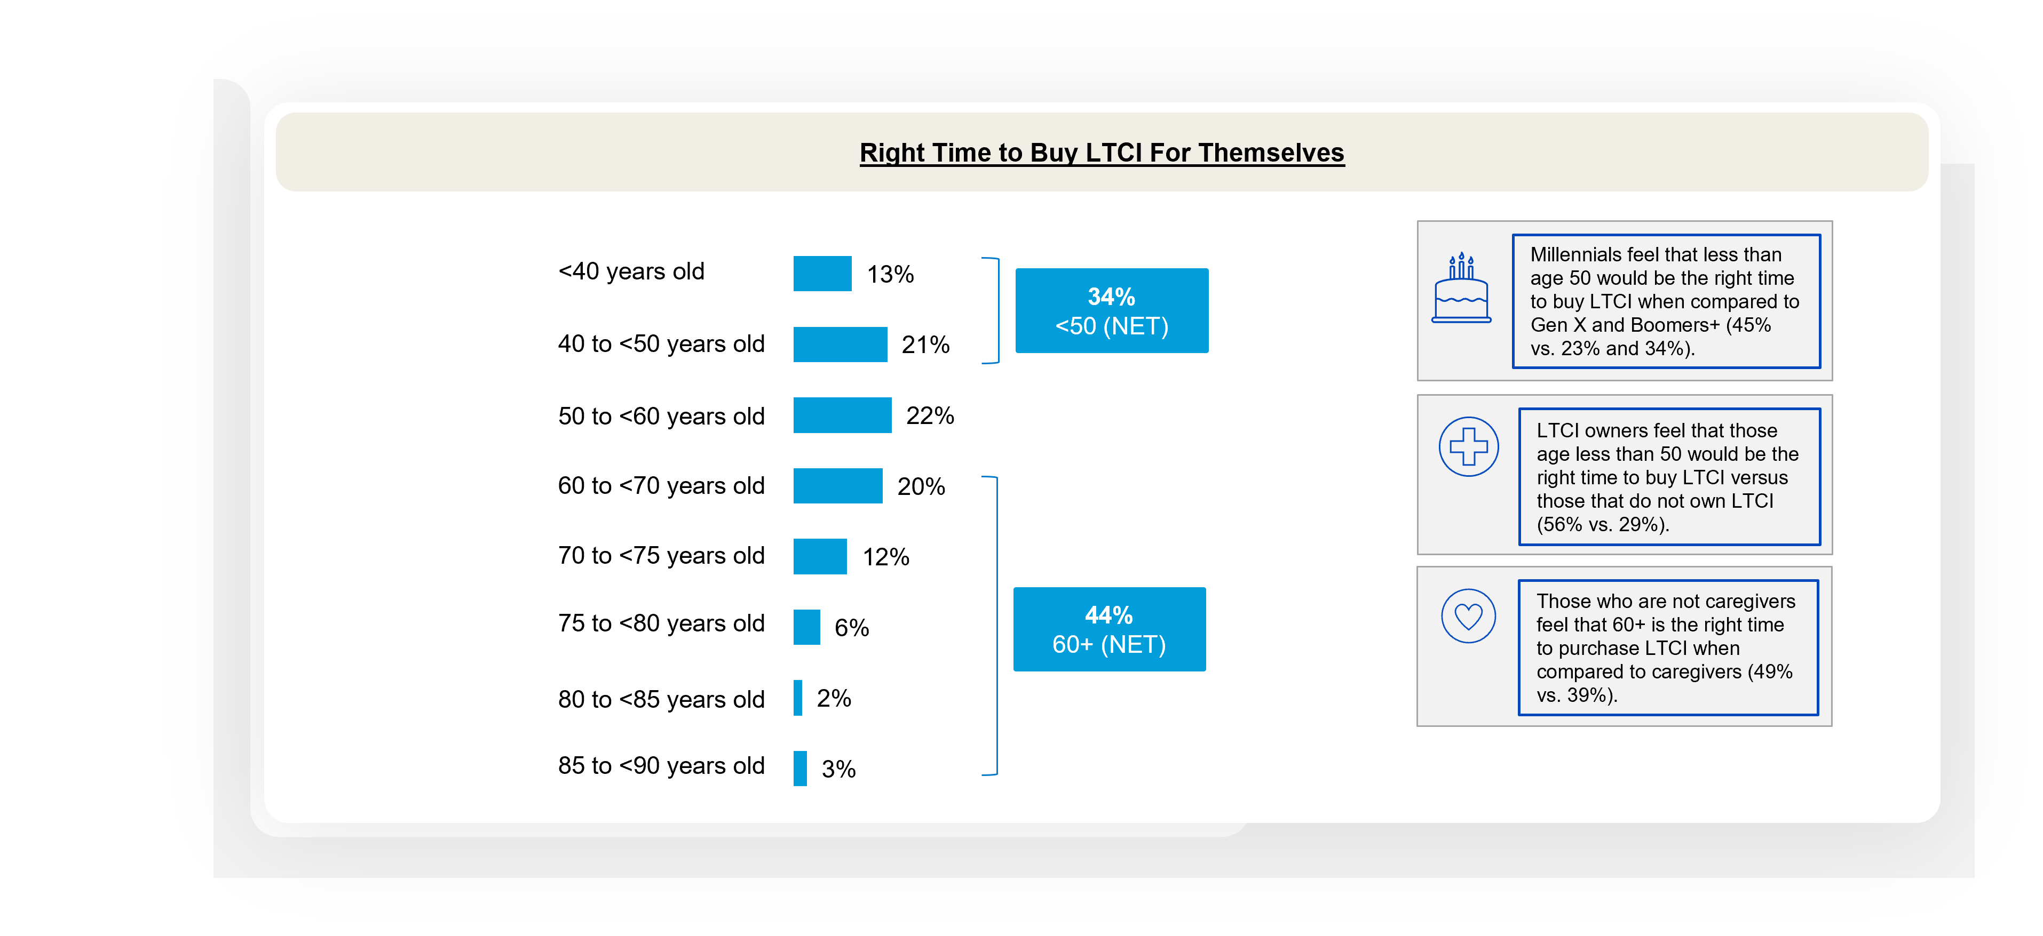
More than 2 in 5 believe that age 60 or older is the right time for them to buy LTCI regardless of whether they plan to buy it
Current and Future Plans for Long-term Care Insurance
Notes:
BASE: ALL QUALIFIED RESPONDENTS (n=1208)
Q625 Regardless of whether you plan to buy it, which of the following do you feel is the right time for you to buy long-term care insurance (LTCI)? Your best estimate is fine. Please select one.

Slide 35
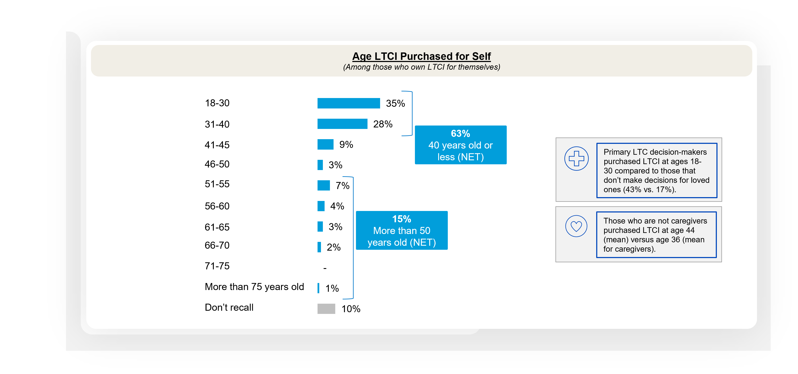
Among those who own LTCI, more than 3 in 5 say they purchased it at 40 years old or less
Current and Future Plans for Long-term Care Insurance
Notes:
BASE: OWNS LTC INSURANCE FOR THEMSELF (n=254)
Q8n2020 At what age did you purchase long-term care insurance for yourself?

Slide 36
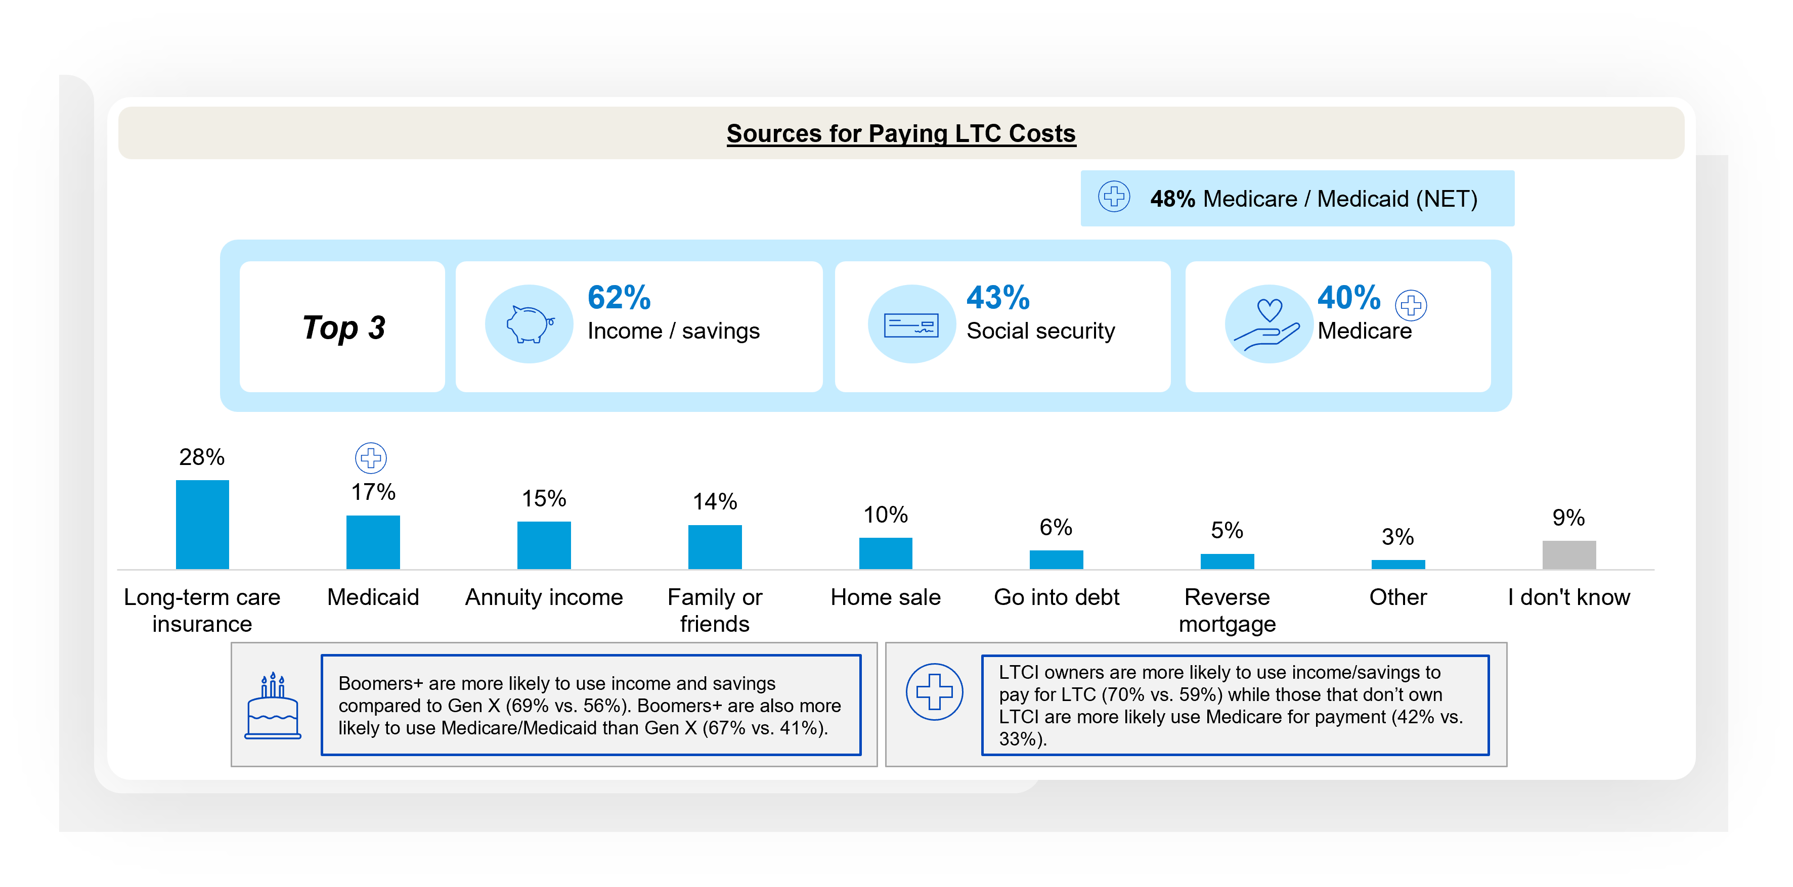
Income / savings, followed by Social Security, top the list for how Americans age 30+ plan to pay for LTC costs
Current and Future Plans for Long-term Care Insurance
Notes:
BASE: ALL QUALIFIED RESPONDENTS (n=1208)
Q210 If you needed long-term care, what sources do you plan to use to pay for your own long-term care costs? Please select all that apply.

Slide 37
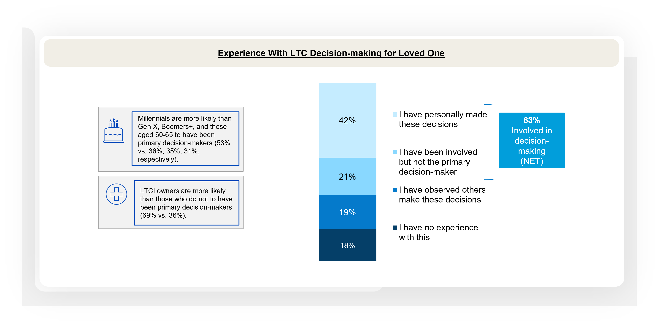
Nearly two-thirds have been involved in LTC decision-making for a loved one
Long-term Care for Loved Ones
Notes:
BASE: ALL QUALIFIED RESPONDENTS (n=1208)
Q2026A11. What is your experience with making long-term care decisions for a loved one? Please select one.

Slide 38
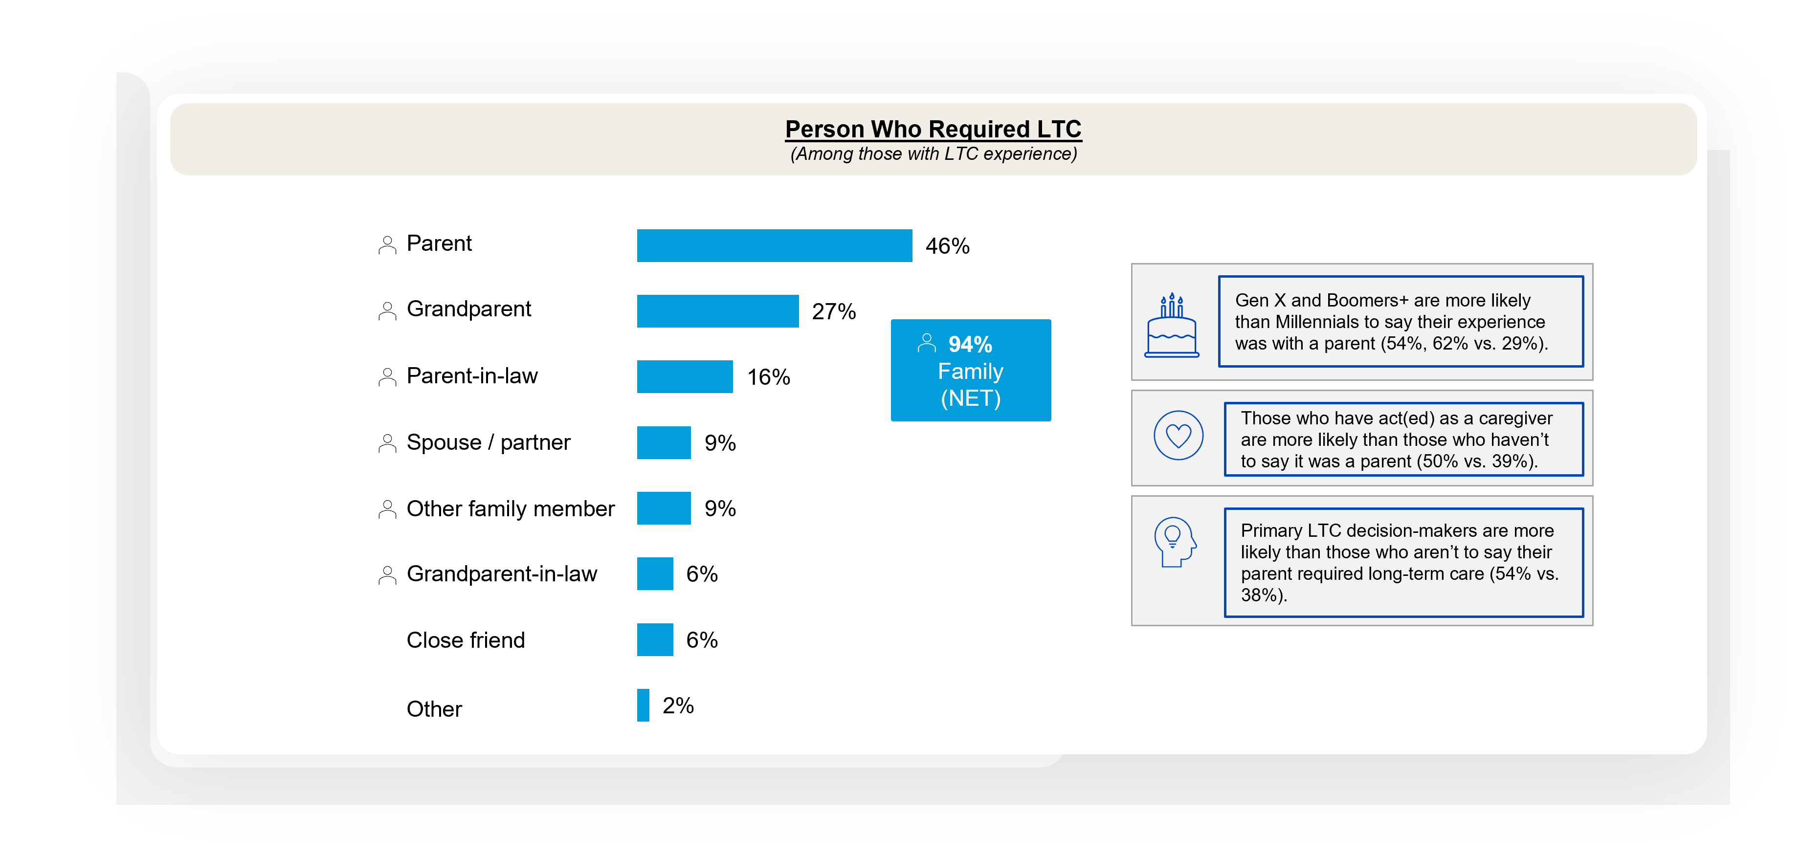
A family member is typically the one who requires LTC, especially a parent
Long-term Care for Loved Ones
Notes:
BASE: THOSE WITH LTC EXPERIENCE (n=971)
Q2026A12. Who required long-term care? Please select all that apply.

Slide 39
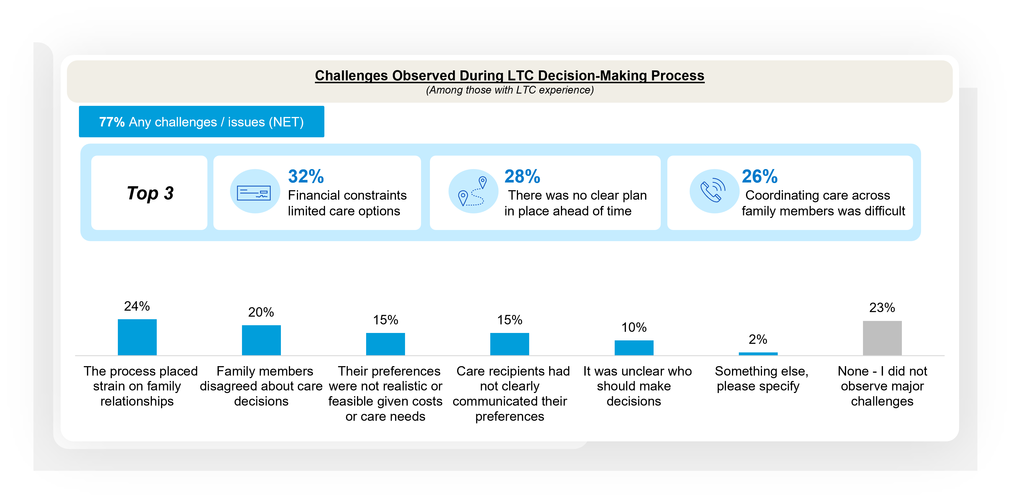
Financial constraints and lack of clear planning were top challenges observed during the LTC decision-making process
Long-term Care for Loved Ones
Notes:
BASE: THOSE WITH LTC EXPERIENCE (n=971)
Q2026A13. Thinking about that experience, which of the following challenges or issues did you observe during the long-term care decision-making process? Please select up to three.

Slide 40
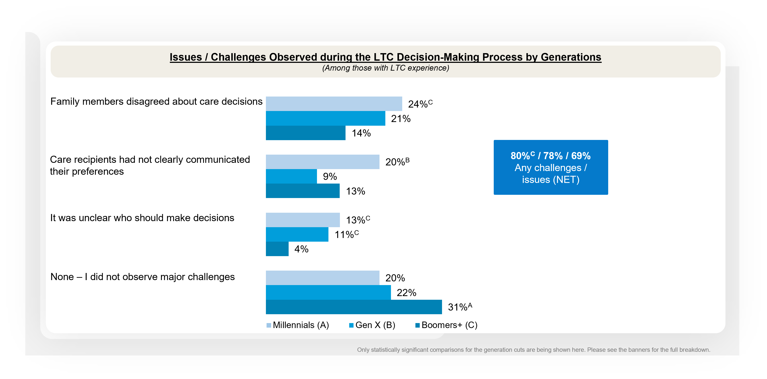
Millennials are more likely than Boomers+ to say they faced any challenges during the LTC decision-making process
Long-term Care for Loved Ones
Notes:
BASE: THOSE WITH LTC EXPERIENCE (MILLENNIALS (n=348); GEN X (n=320); BOOMERS+ (n=303))
Q2026A13 Thinking about that experience, which of the following challenges or issues did you observe during the long-term care decision-making process?

Slide 41
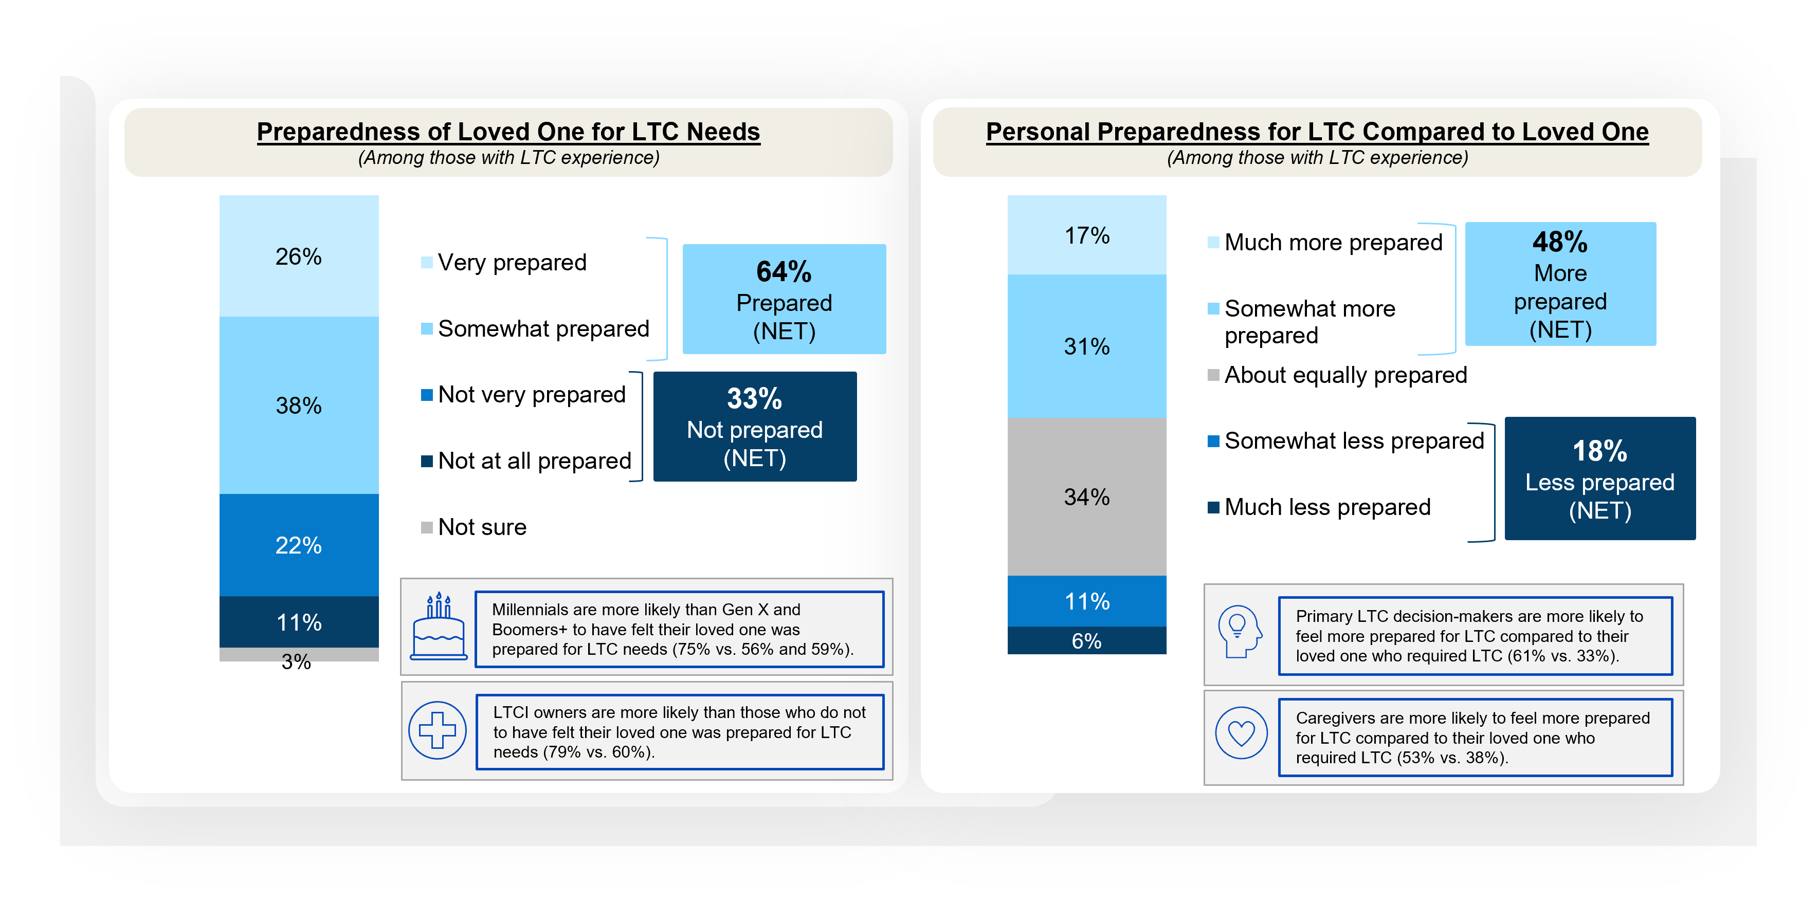
While a majority with LTC experience say their loved one was prepared for their LTC needs, less than half feel more prepared for LTC compared to their loved one
Long-term Care for Loved Ones
Notes:
BASE: THOSE WITH LTC EXPERIENCE (n=971)
Q2026A16. Thinking about your loved one who required long-term care, how prepared do you believe they were for long-term care needs?
Q2026A17. Do you believe you are more, less, or about equally prepared for long-term care compared to your loved one who required long-term care?

Slide 42
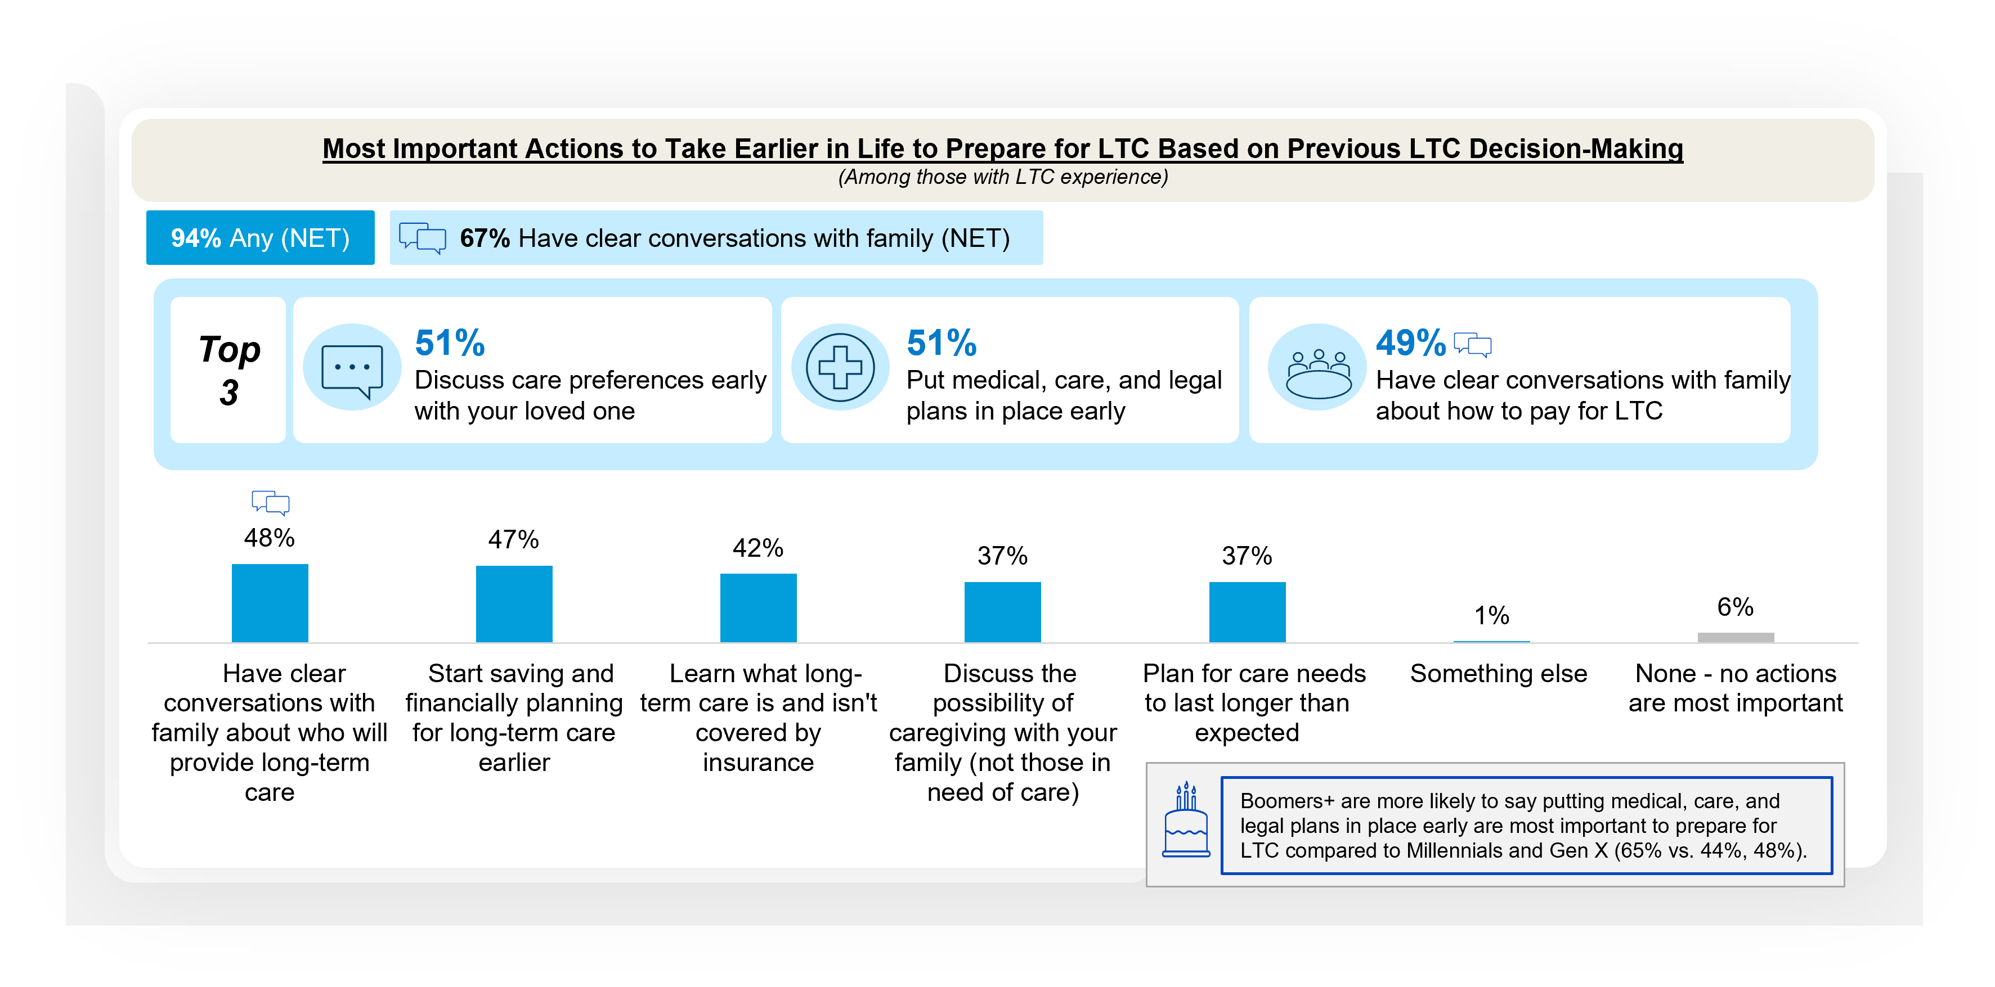
Two-thirds say having clear conversations with family are most important to take earlier in life to prepare for LTC based on their experience
Long-term Care for Loved Ones
Notes:
BASE: THOSE WITH LTC EXPERIENCE (n=971)
Q2026A15. Based on your experience of making long-term care decisions for a loved one, which of the following actions are most important for people to take earlier in life to prepare for long-term care? Please select all that apply.

Slide 43
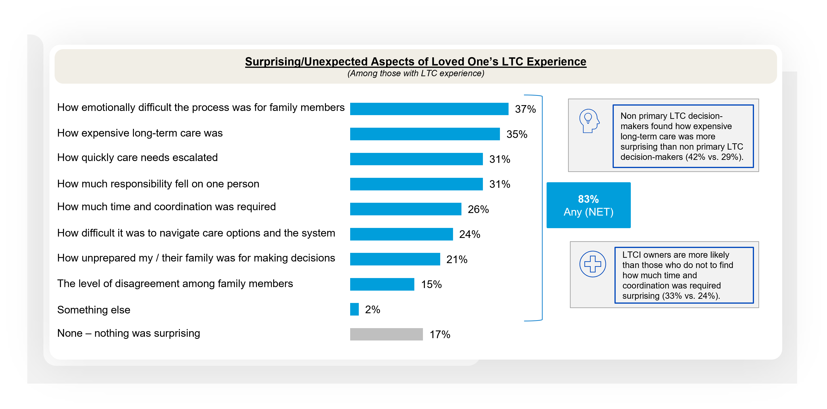
Those with LTC experience cite the emotional toll on family, closely followed by cost of LTC, as the most surprising aspect of their loved one’s experience
Long-term Care for Loved Ones
Notes:
BASE: THOSE WITH LTC EXPERIENCE (n=971)
Q2026A14. What, if anything, about your loved one's long-term care experience did you find most surprising or unexpected? Please select all that apply.

Slide 44
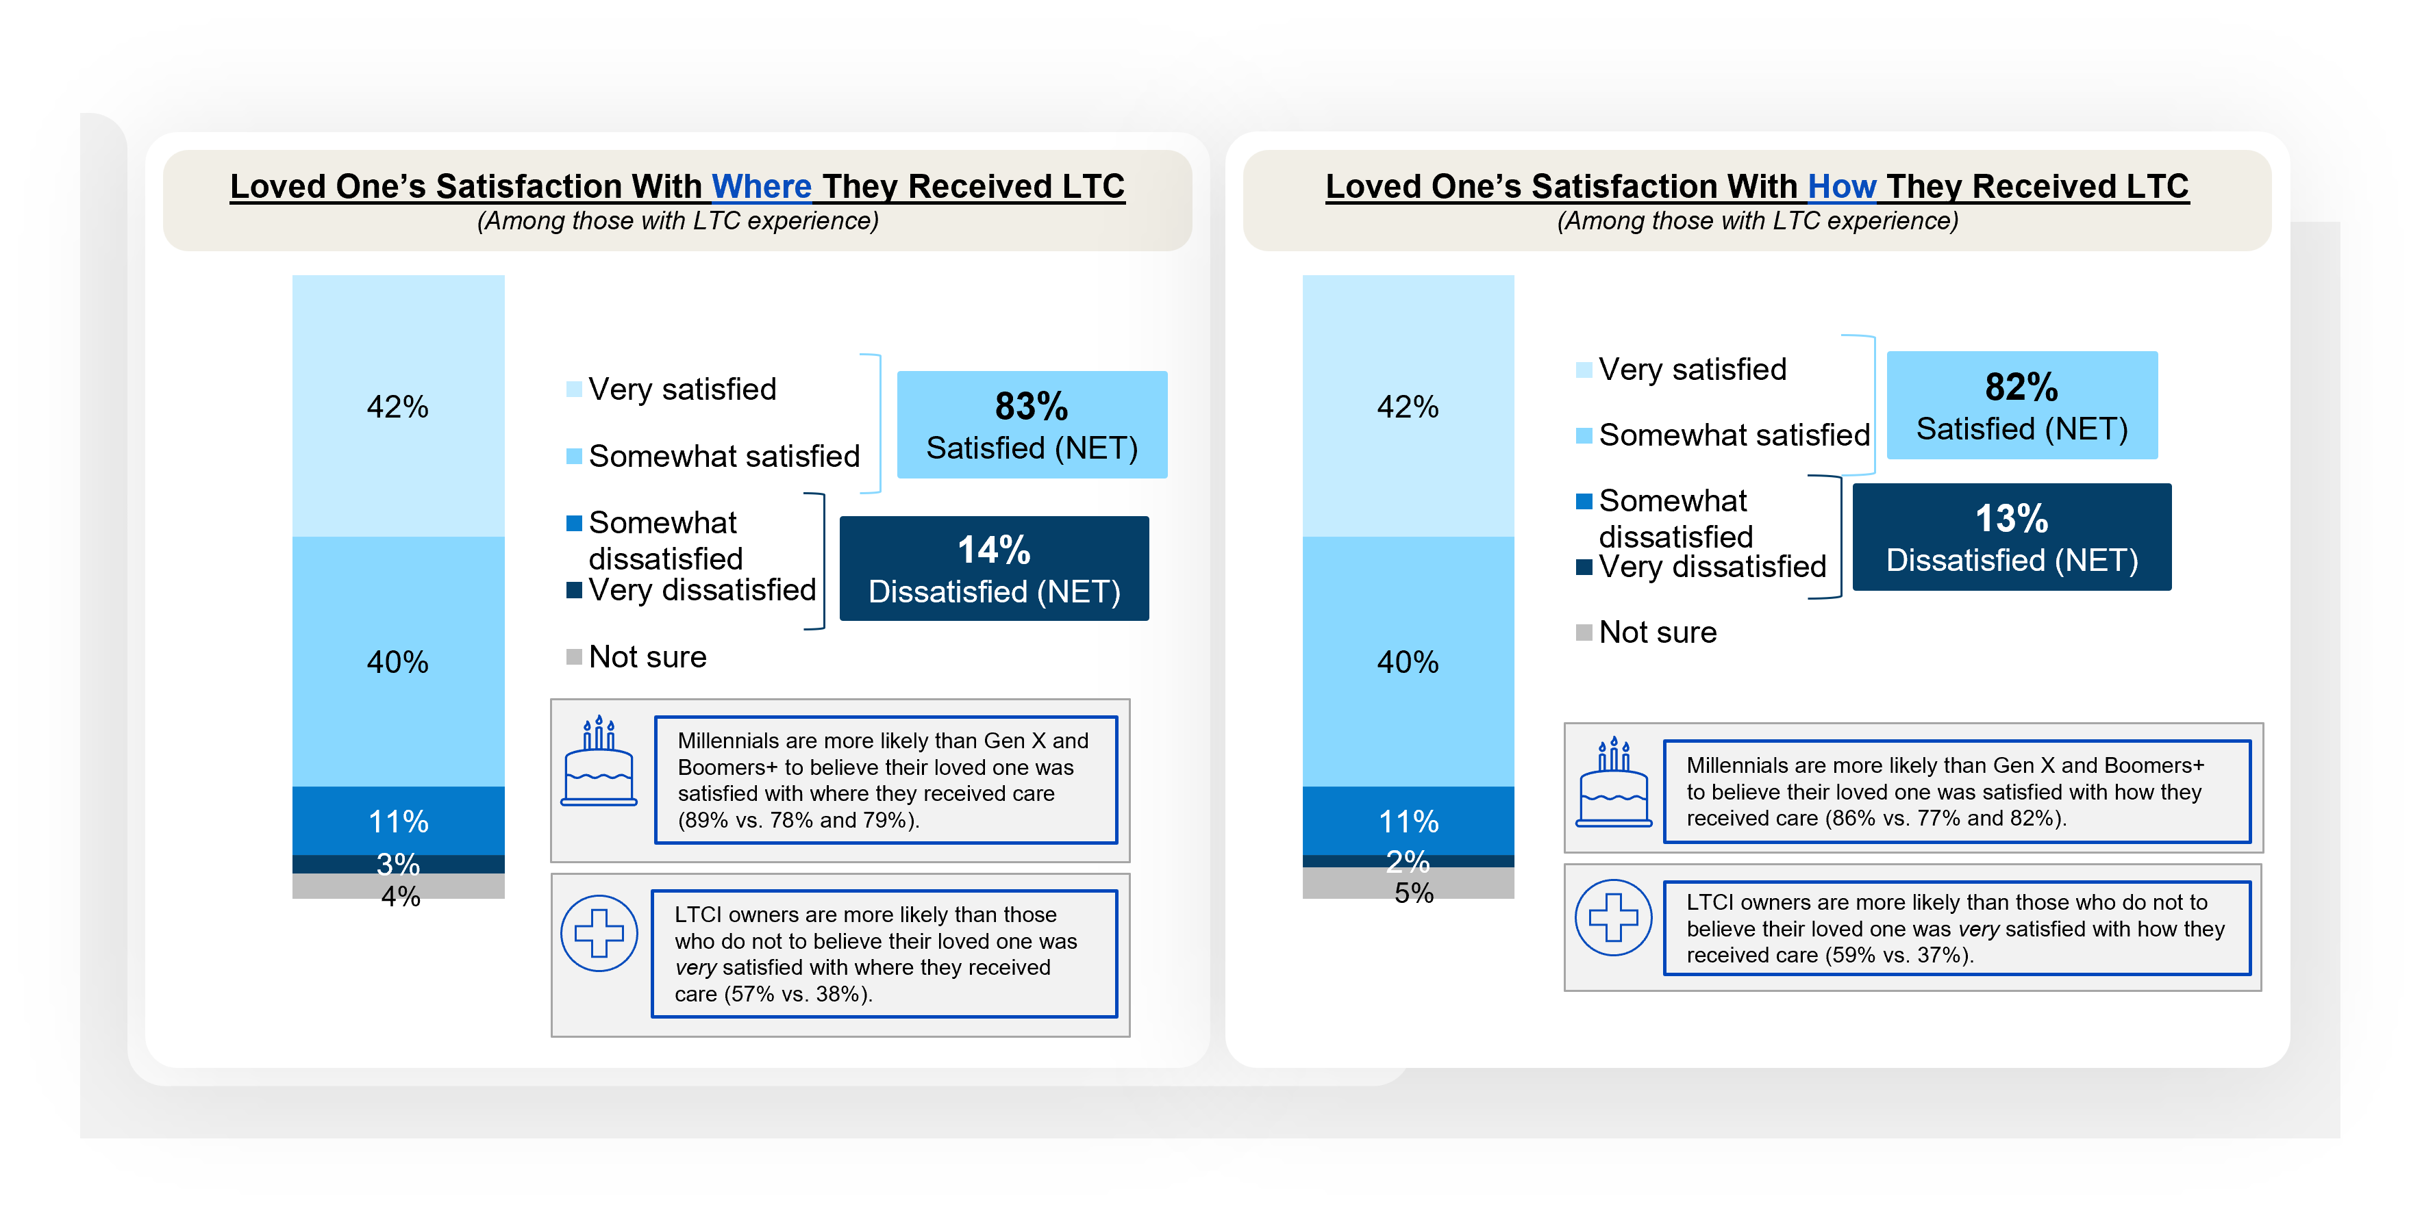
When asked to think of their loved one’s LTC situation, a vast majority believe they were satisfied with where and how they received care
Long-term Care for Loved Ones
Notes:
BASE: THOSE WITH LTC EXPERIENCE (n=971)
Q2026A26. Thinking about your loved one’s long-term care situation, overall how satisfied do you believe they are or were with where they received care? Please select one.
Q2026A29. Thinking about your loved one’s long-term care situation, overall how satisfied do you believe they are or were with how they received care? Please select one.

Slide 45
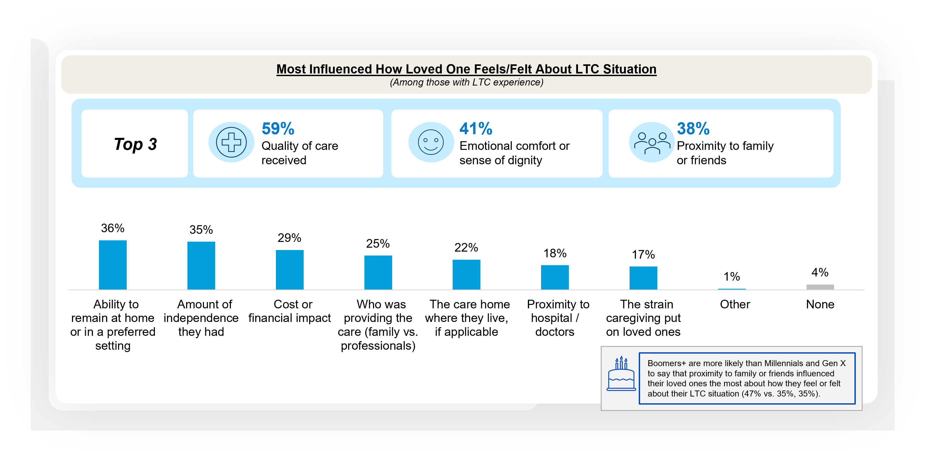
Beyond quality of clinical care, emotional comfort and family proximity remain central to LTC experience
Long-term Care for Loved Ones
Notes:
BASE: THOSE WITH LTC EXPERIENCE (n=971)
Q2026A30. Which of the following most influenced how your loved one feels or felt about their long-term care situation? Please select all that apply.

Slide 46
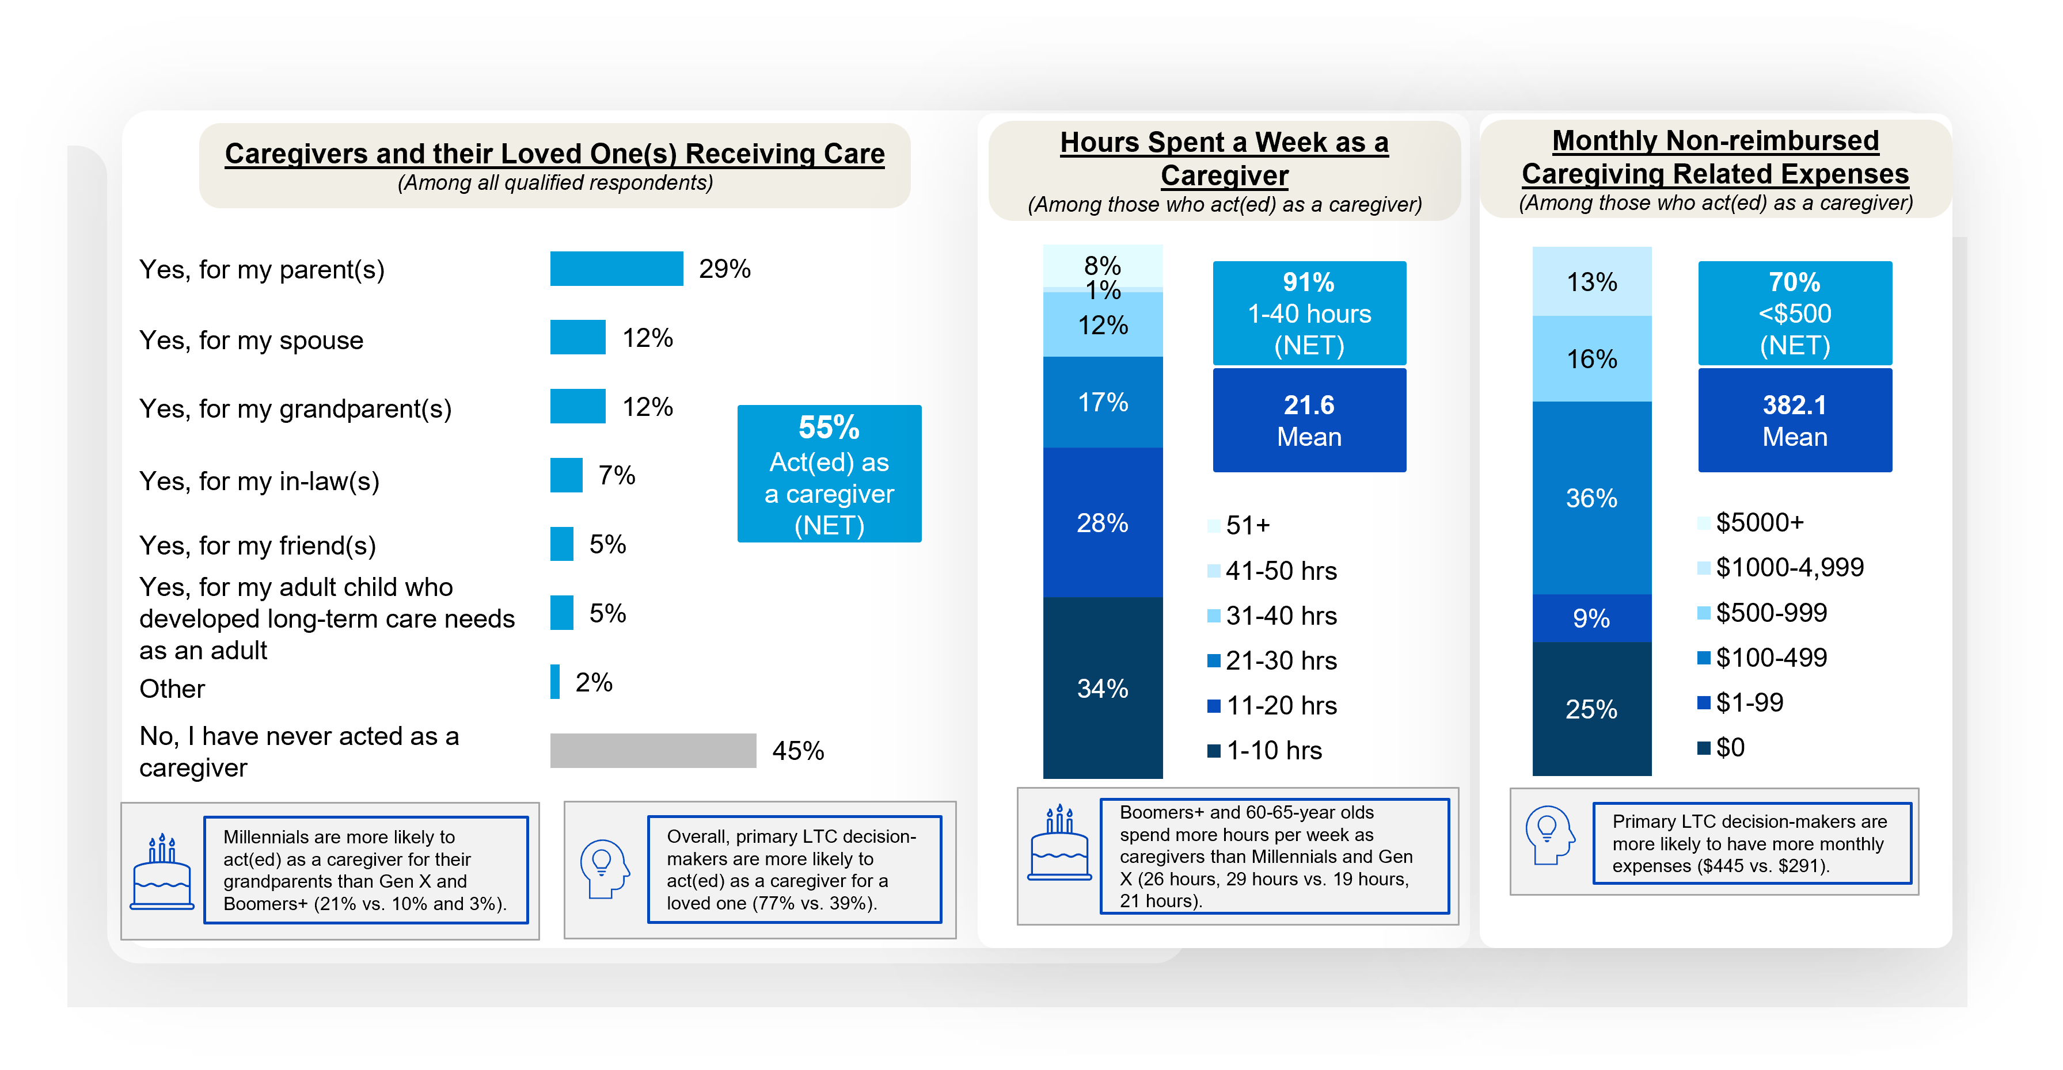
Over half have ever acted as a caregiver, often working 22 hours on average
Personal Caregiving Experiences
Notes:
BASE: ALL QUALIFIED RESPONDENTS (n=1208)
Q2026A4 Do you or have you ever acted as a caregiver for a loved one?
By “caregiver”, we mean spending 10+ hours a week providing paid or unpaid long-term care to a friend or family member (for example, helping someone with activities of daily living like getting around the house, bathing, eating, or keeping them safe if they have severe memory problems), but not through an agency, business, or non-governmental organization.
BASE: ACT(ED) AS CAREGIVER (n=660)
Q1005 How many hours a week do/did you spend as a caregiver (helping someone get around the house, bathe, eat, etc.)? Please round to the nearest whole number of hours. Your best estimate is fine.
Q1010 As a caregiver of someone receiving care at home, what are/were your monthly, non-reimbursed out-of-pocket expenses, if any, for related expenses (e.g., co-pays/prescriptions, gas money/transportation, food, lodging)? Please round to the nearest dollar amount. Your best estimate is fine.

Slide 47
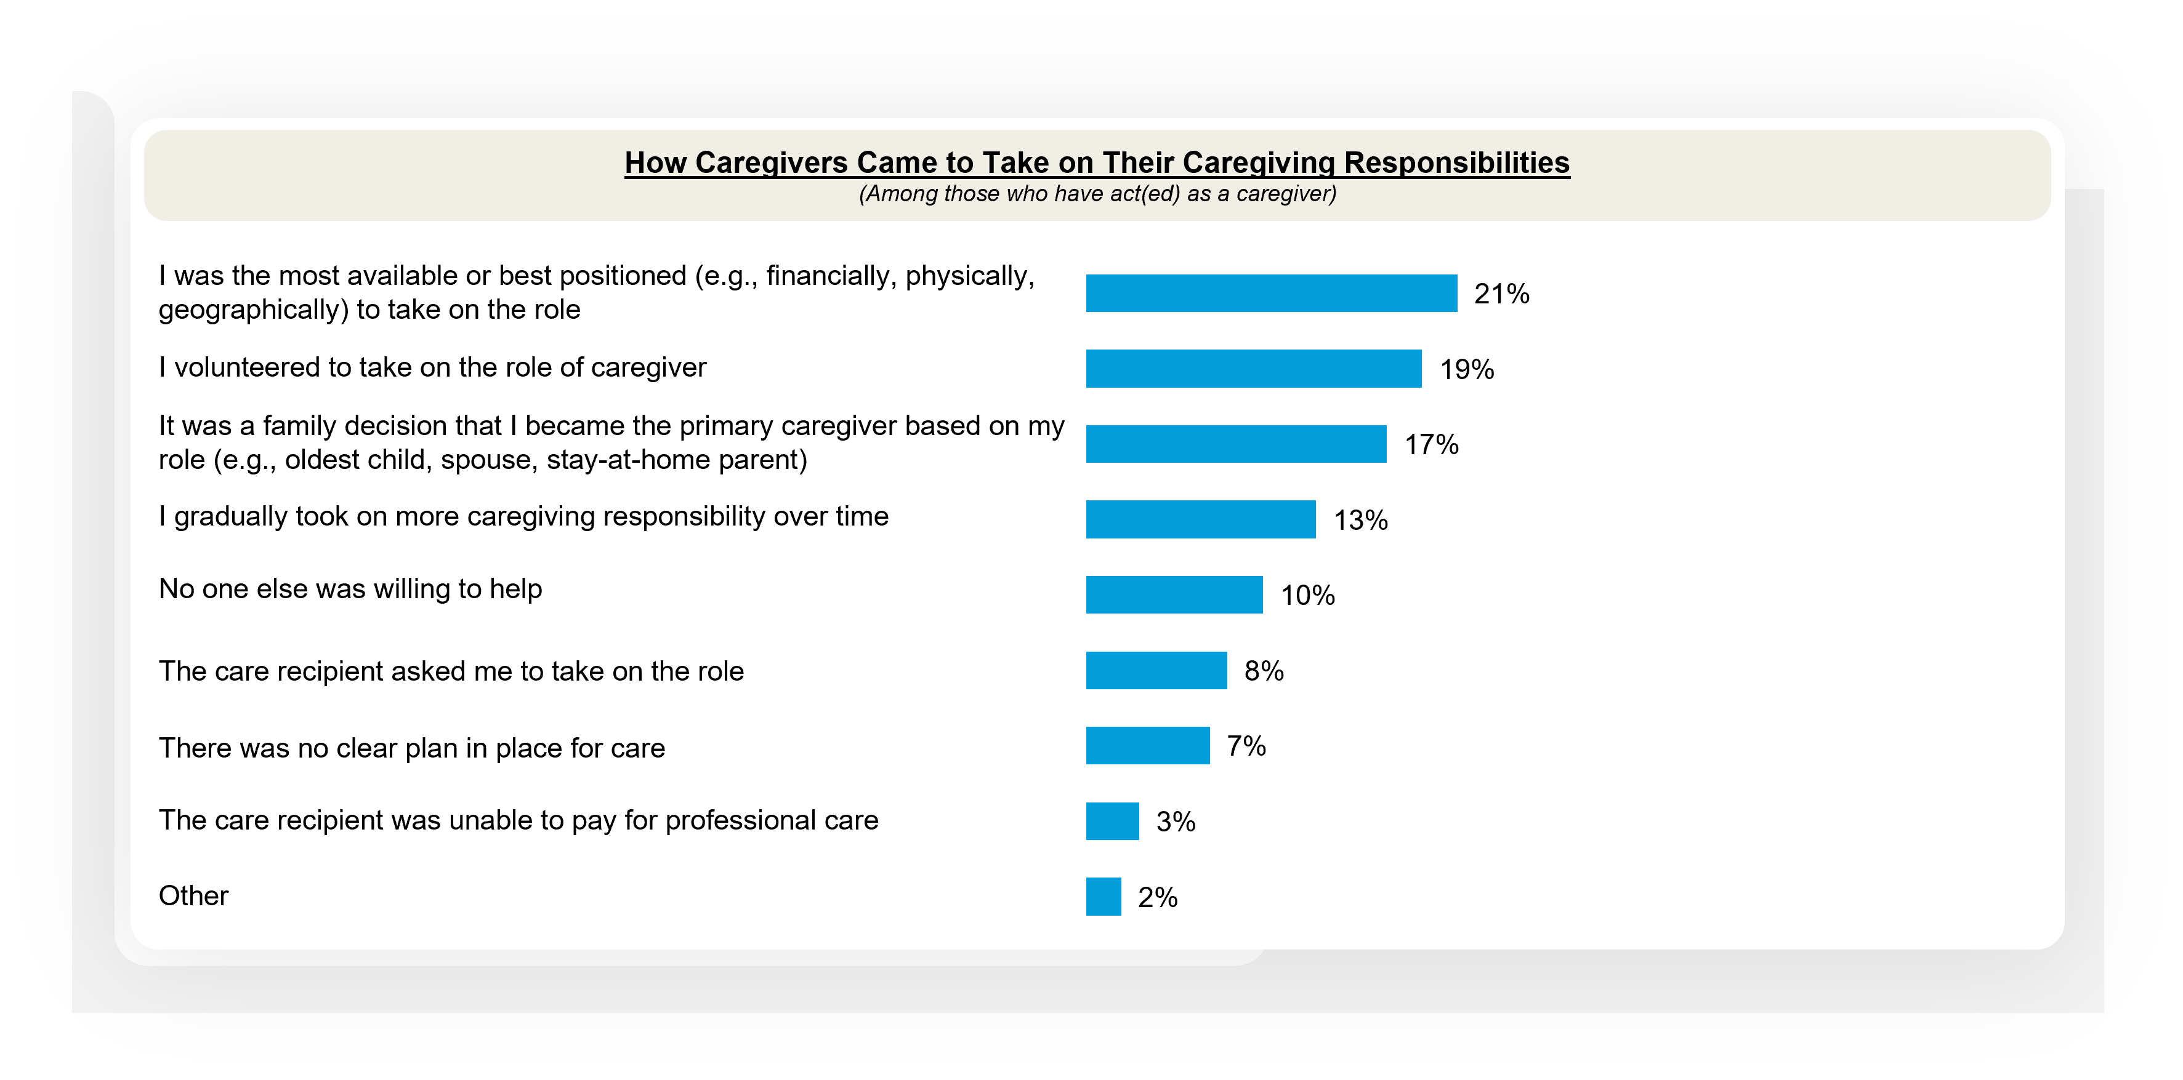
Around a fifth of caregivers become one as they were the best positioned to take the role
Personal Caregiving Experiences
Notes:
BASE: ACT(ED) AS CAREGIVER (n=660)
Q2026A5 Which of the following best describes how you came to take on your caregiving responsibilities? Please select one.

Slide 48
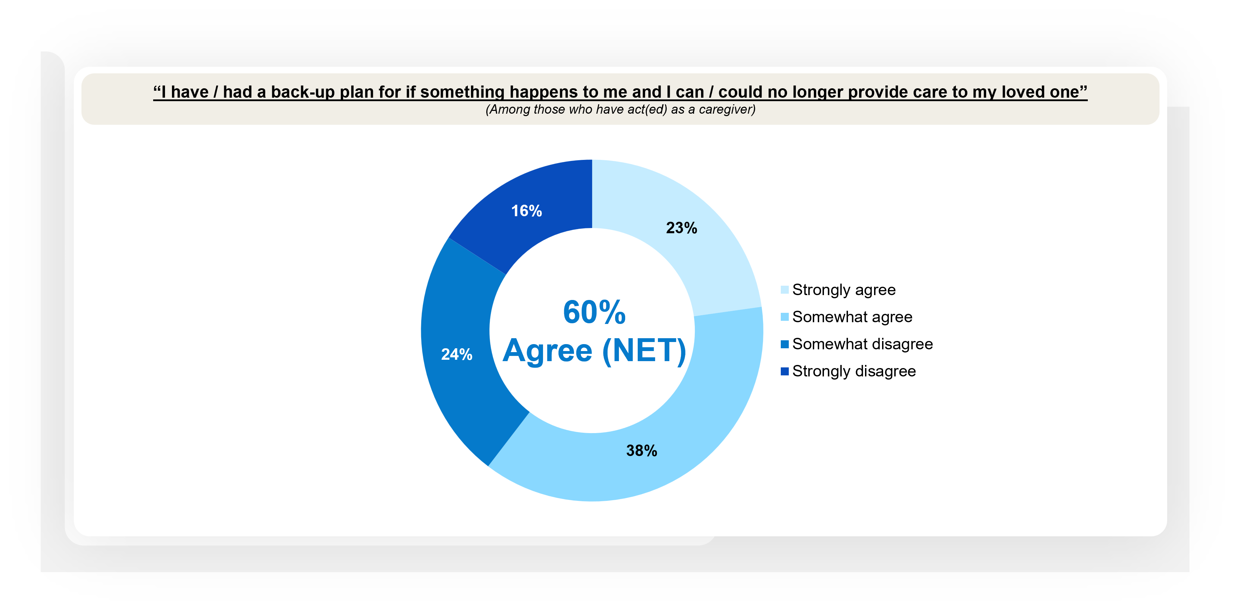
Almost a quarter of caregivers strongly agree that they have a back-up plan if they can no longer provide care to their loved one
Personal Caregiving Experiences
Notes:
BASE: ACT(ED) AS CAREGIVER (n=660)
Q2026A6 Thinking about your experience as a caregiver, how much do you agree or disagree with each of the following statements?

Slide 49
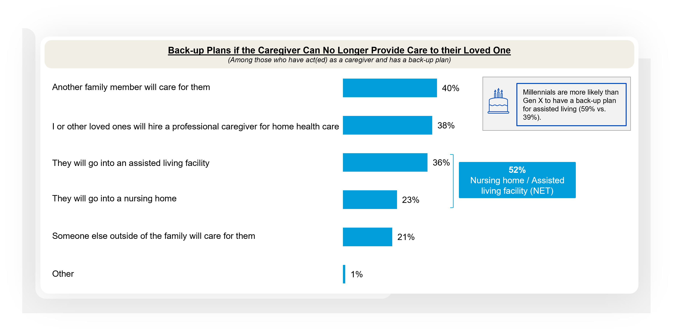
Care facilities are often included in caregiver back-up plan for their loved one’s LTC
Personal Caregiving Experiences
Notes:
BASE: ACT(ED) AS CAREGIVER AND HAS A BACK-UP PLAN (n=403)
Q2026A7 Based on your agreement that you have/had a back-up plan in place, which of the following are/were included in that plan? Please select all that apply.

Slide 50
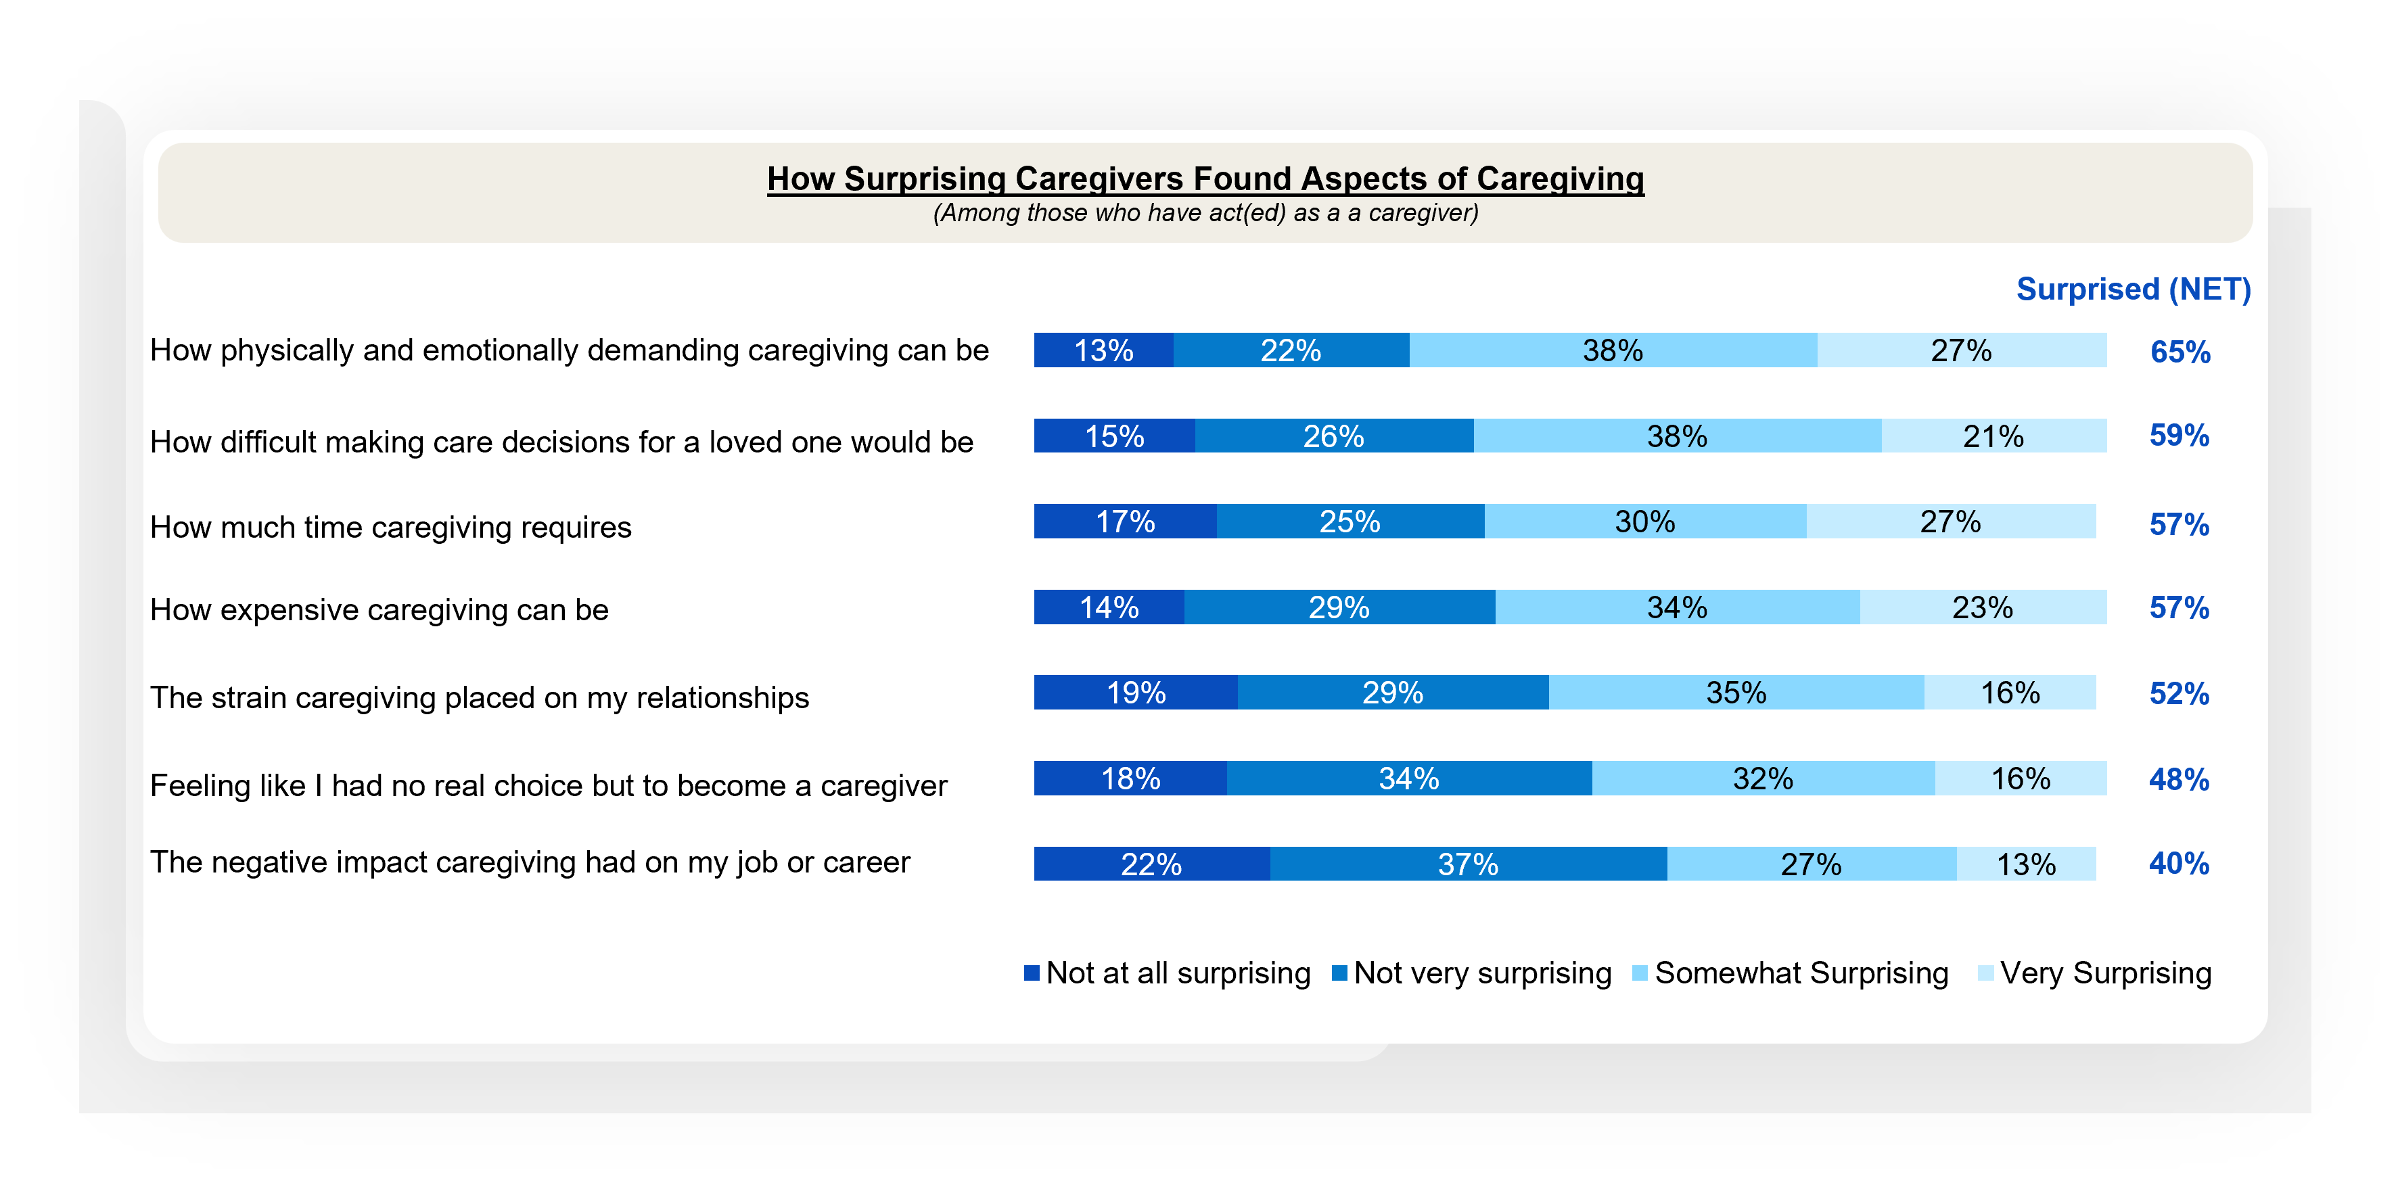
Two-thirds say they physical and emotional demands of caregiving surprised them
Personal Caregiving Experiences
Notes:
BASE: ACT(ED) AS CAREGIVER (n=660)
Q2026A8 How surprising did you find the following aspects of caregiving?

Slide 51
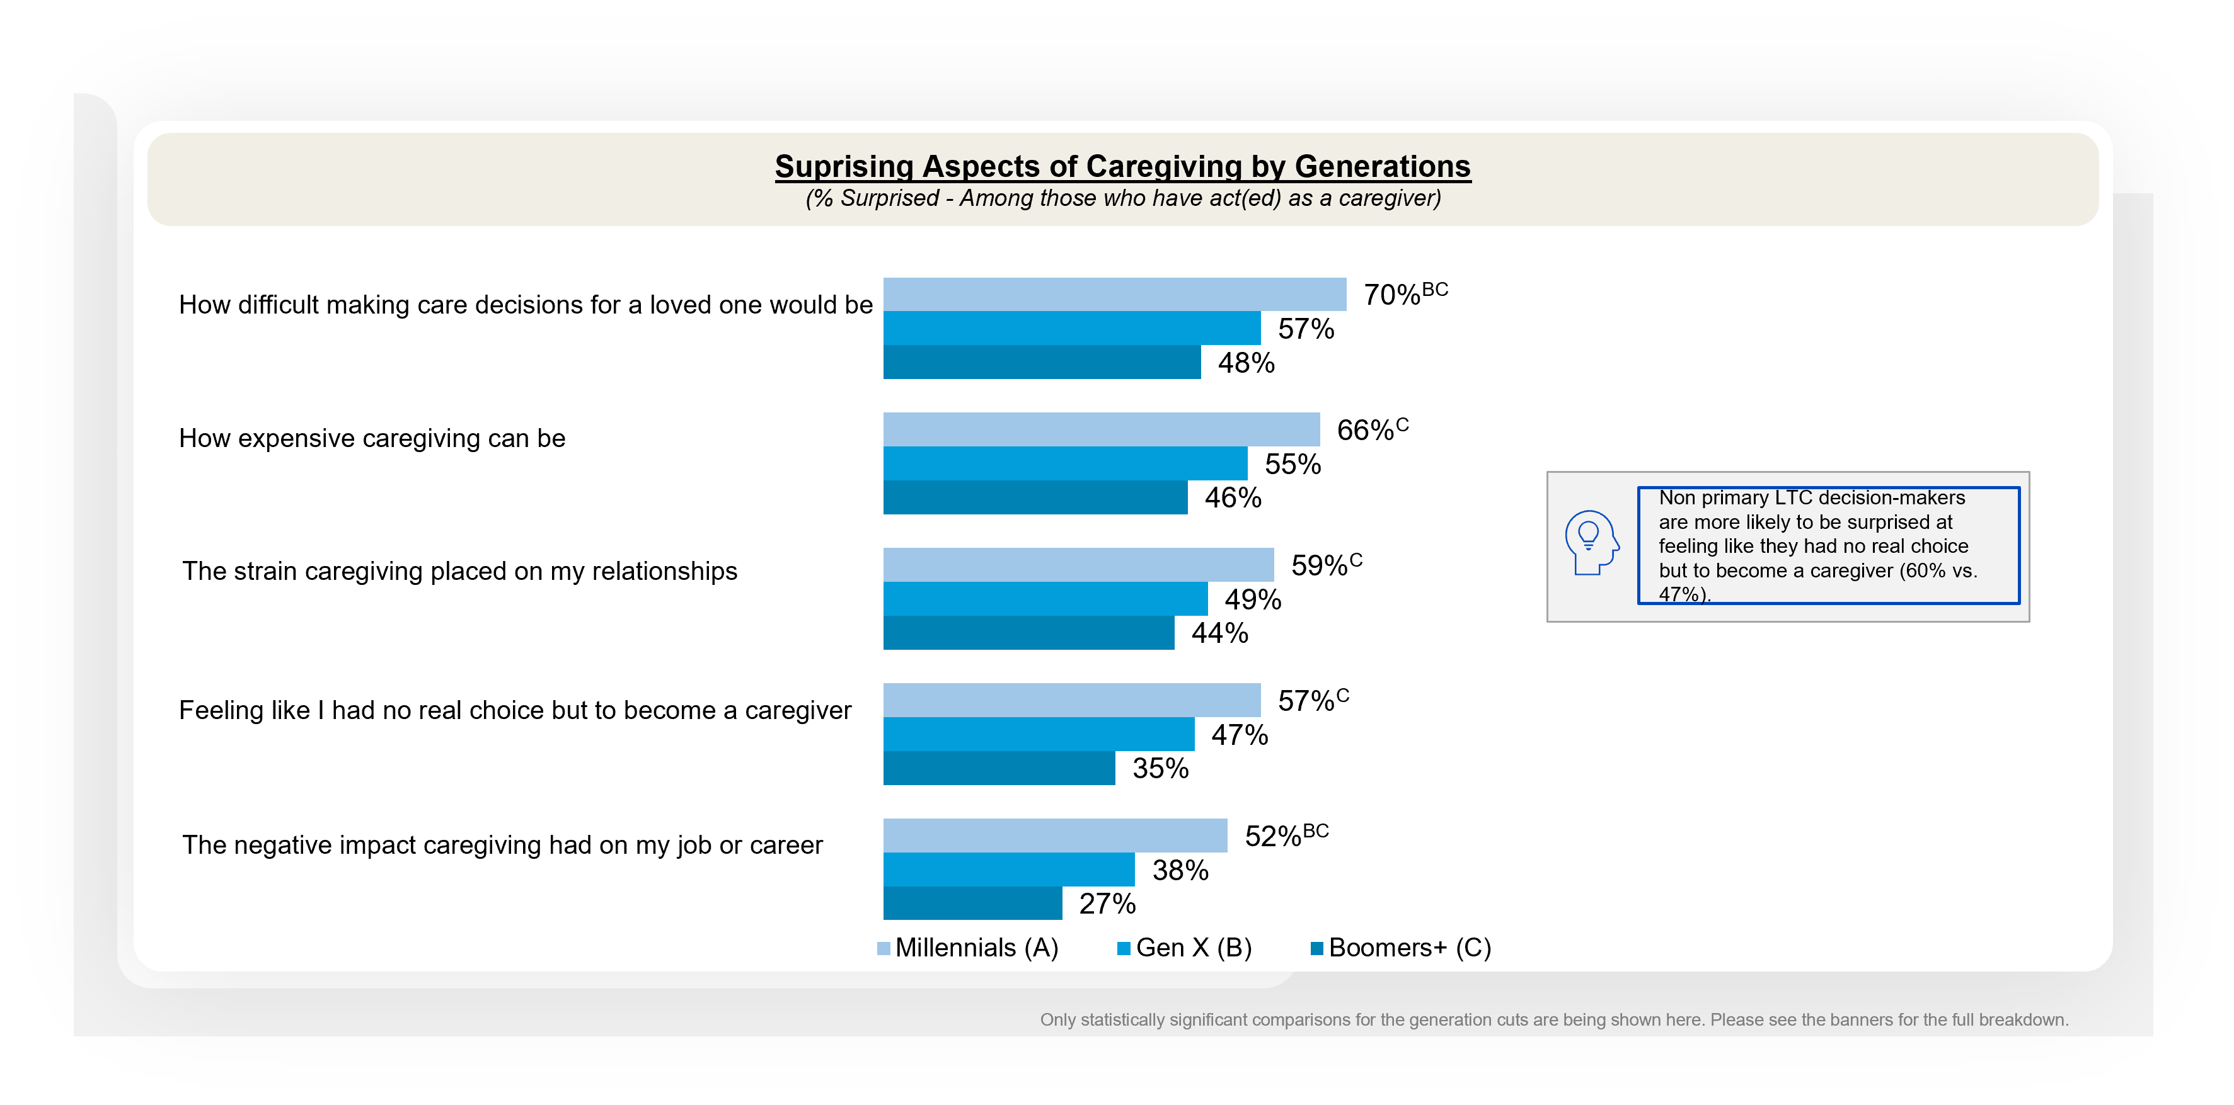
Millennials are more likely than Gen X and Boomers+ to be surprised at the difficulty of LTC decision-making and the negative impact on their job / career
Long-term Care for Loved Ones
Notes:
BASE: THOSE WHO HAVE ACT(ED) AS A CAREGIVER (MILLENNIALS (n=234); GEN X (n=218); BOOMERS+ (n=208)
Q2026A8 How surprising did you find the following aspects of caregiving?

Slide 52
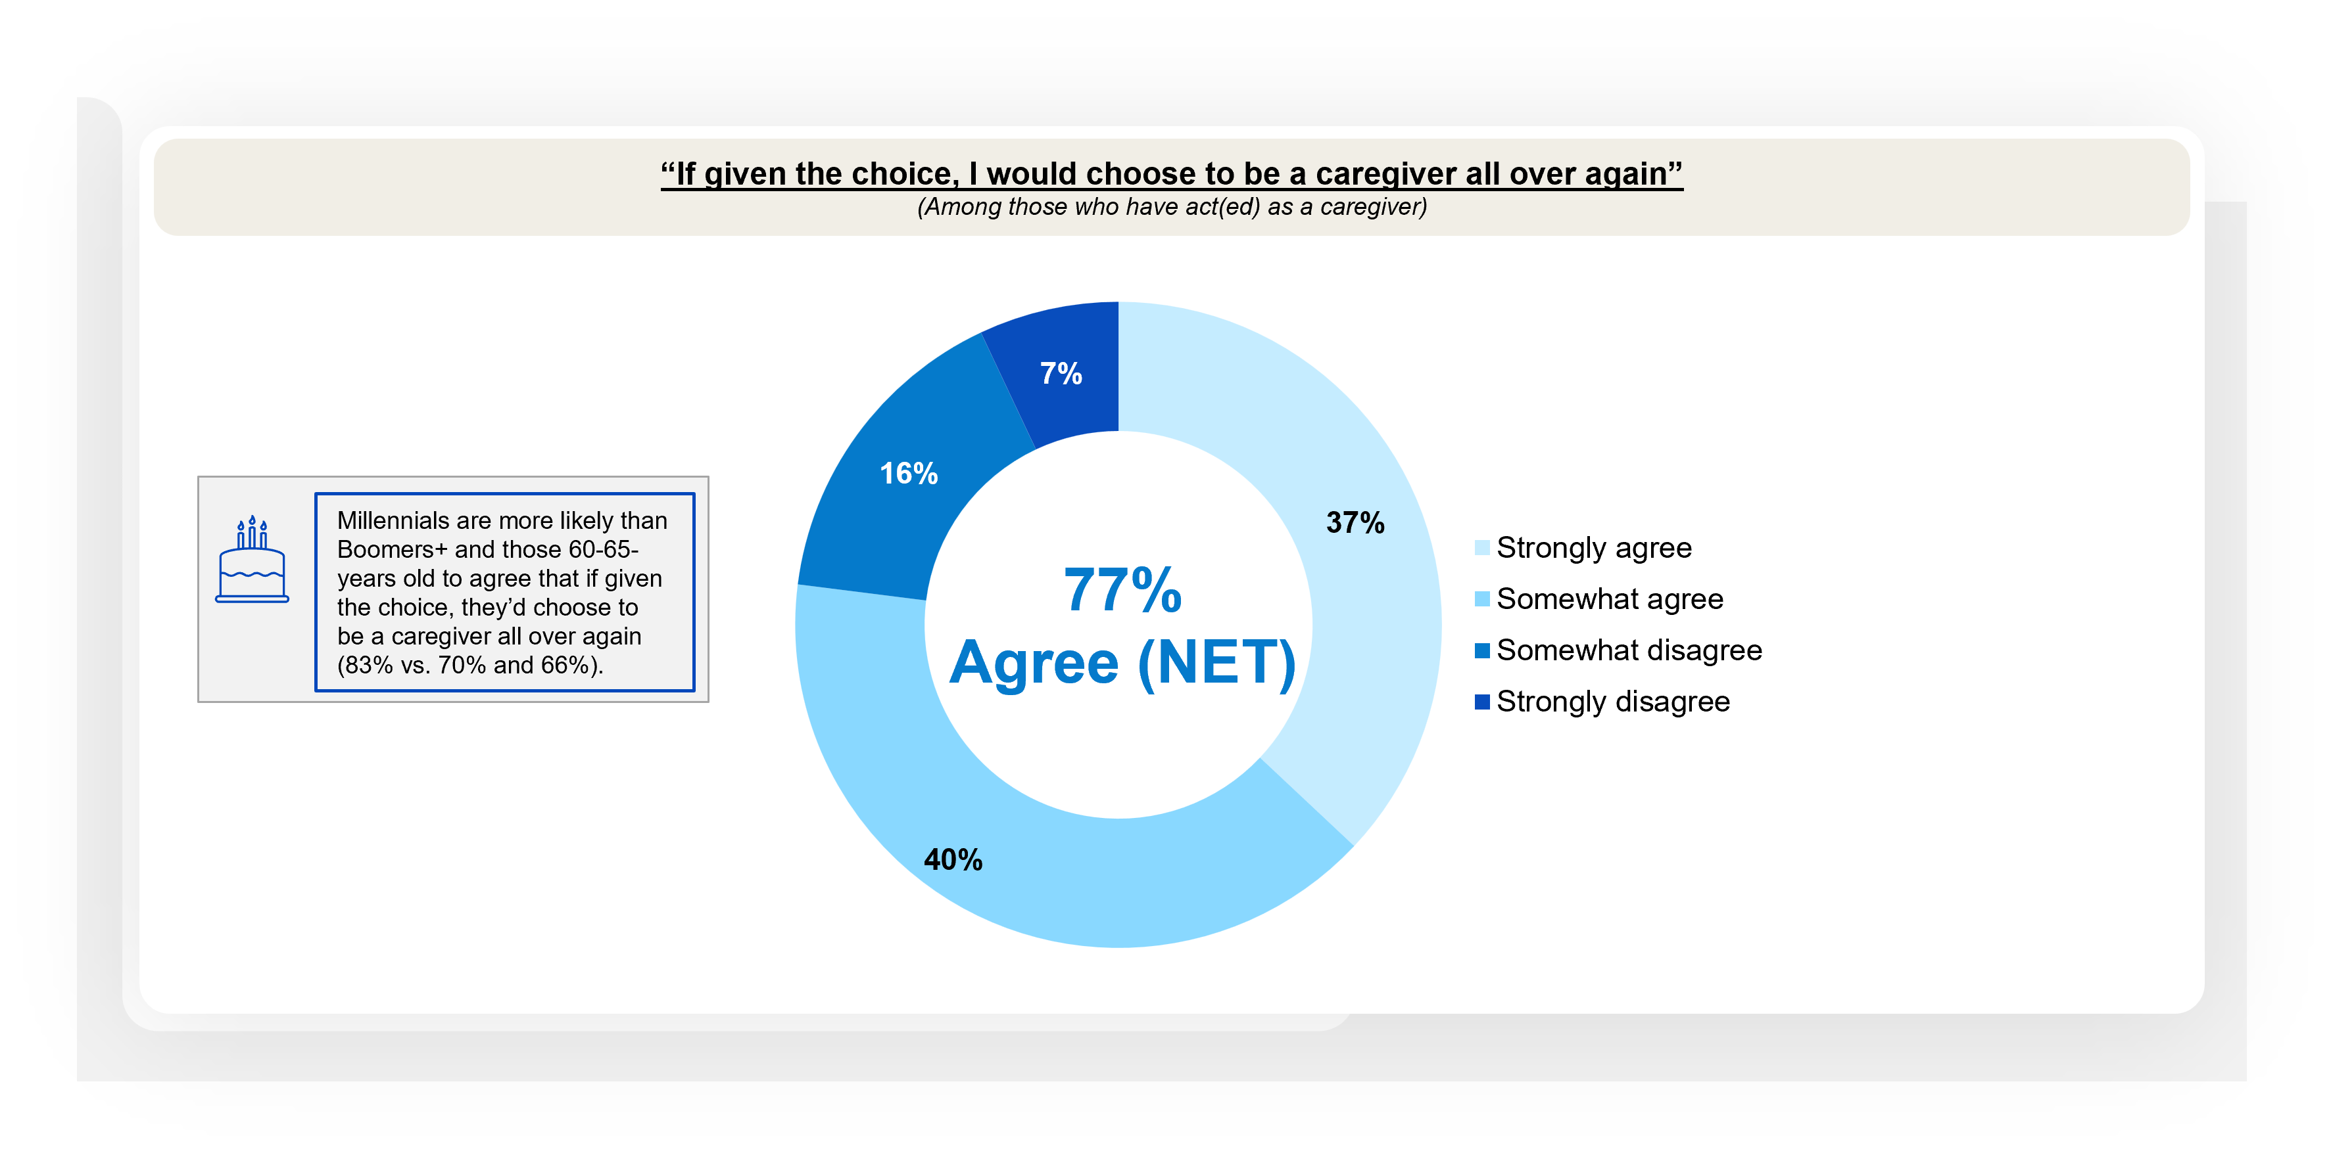
All in all, over three-quarters if caregivers would choose to be a caregiver all over again if given the choice
Personal Caregiving Experiences
Notes:
BASE: ACT(ED) AS CAREGIVER (n=660)
Q2026A6 Thinking about your experience as a caregiver, how much do you agree or disagree with each of the following statements?

Slide 53

When asked to look back, caregiver say advice from putting plan in place early to having clear conversations with family would have been valuable
Personal Caregiving Experiences
Notes:
BASE: ACT(ED) AS CAREGIVER (n=660)
Q2026A9 Looking back at your caregiving experience, how valuable do you feel the following pieces of advice would have been to your younger self about providing long-term care for a loved one?

Slide 54

“Start saving earlier” is the most common advice non-caregivers age 50+ would give their younger self about planning for LTC
Personal Caregiving Experiences
Notes:
BASE: THOSE AGED 50+ BUT NOT CAREGIVERS (n=341)
Q2026A10 Which of the following, if any, are the three most important pieces of advice you would want to give your younger self about planning for long-term care needs? Please select up to three.

Slide 55

Over 3 in 5 agree that current immigration policies will further reduce the number of available caregivers, including a quarter who strongly agree
Personal Caregiving Experiences
Notes:
BASE: ALL QUALIFIED RESPONDENTS (n=1208)
Q2026A27 How much do you agree or disagree with the following statement:
Current immigration policies will further reduce the number of available caregivers.

Slide 56

Nearly 3 in 4 say their biggest fear is not being able to provide care for their loved one
Attitudes Toward Caregiving
Notes:
BASE: ACT(ED) AS CAREGIVER (n=660)
Q2026A6 Thinking about your experience as a caregiver, how much do you agree or disagree with each of the following statements?

Slide 57

Choosing between today’s needs and tomorrow’s security: ~3 in 5 are willing to take a loan from their retirement to be a caregiver for a loved one
Attitudes Toward Caregiving
Notes:
BASE: ACT(ED) AS CAREGIVER (n=660)
Q2026A6 Thinking about your experience as a caregiver, how much do you agree or disagree with each of the following statements?

Slide 58

Many caregivers feel like they can’t take a day off from their caregiving responsibilities
Attitudes Toward Caregiving
Notes:
BASE: ACT(ED) AS CAREGIVER (n=660)
Q2026A6 Thinking about your experience as a caregiver, how much do you agree or disagree with each of the following statements?

Slide 59

Millennials are more likely than Gen X and Boomers+ to agree to a variety of different caregiving sentiments
Attitudes Toward Caregiving
Notes:
BASE: THOSE WHO HAVE ACT(ED) AS A CAREGIVER (MILLENNIALS (n=234); GEN X (n=218); BOOMERS+ (n=208))
Q2026A6 Thinking about your experience as a caregiver, how much do you agree or disagree with each of the following statements?

Slide 60
Disclosures
This material is not a recommendation to buy or sell a financial product or to adopt an investment strategy. Investors should discuss their specific situation with their financial professional.
This information is general in nature and is not intended to be tax, legal, accounting, or other professional advice. The information provided is based on current laws, which are subject to change at any time, and has not been endorsed by any government agency.
Nationwide and The Harris Poll are separate and non-affiliated companies.
Life and annuity products are issued by Nationwide Life Insurance Company or Nationwide Life and Annuity Insurance Company, Columbus, Ohio.
Nationwide Investment Services Corporation (NISC), member FINRA, Columbus, OH. Nationwide Retirement Institute is a division of NISC.
Nationwide, Nationwide is on your side, the Nationwide N and Eagle, and The Nationwide Retirement Institute are service marks of Nationwide Mutual Insurance Company. © 2026

Slide 61
LAM-5884AO.2 (6/26)

